Slide 1
Financial literacy 101
By Clint Young and Ghul Zadran
Office of Financial Aid
Monday, May 11, 2020 at 7:00 p.m. and
Wednesday, May 13, 2020 at 12:00 p.m.
Notes:
Hello, and thank you for joining us today for our workshop on Financial Literacy. The goal for this session is to provide you with some basic tips for managing your finances and to let you know about some resources that are available that may help improve your financial well-being.

Slide 2
Today’s topics
Budgeting
Saving
Debt Management & Responsible Borrowing
Credit Reports & Credit Scores
Financial Aid
Coronavirus Aid, Relief, and Economic Security (CARES) Act
NOVA’s Financial Stability Program
Single Stop Benefit Screener
Notes:
There are several topics that we plan to discuss today, including budgeting, saving, credit, borrowing, financial aid and other resources that are available. We have a lot to cover, so let’s get started!

Slide 3
Why do you need a budget?
Plan for short-term and long-term goals
Review bad spending habits
Gain control of your finances
Notes:
Our first topic is budgeting… And let’s face it, budgets are boring. Who wants to spend time counting their money and being reminded of what they cannot afford to buy. But once you get past the perspective of budgets constraining what you can buy, you will see how creating a budget can help you gain control of your finances, get out of debt, and help you achieve your financial goals.

Slide 4
Create a budget
Determine your net income
Track your spending
Set your goals
Make a plan (e.g. 50/30/20 budget)
Adjust your habits
Keep checking in
Notes:
So how do you create a budget? A brief web search will yield several approaches to budgeting, but it really boils down to a few simple steps.
The first thing you want to do is determine your monthly net income. This is the amount of take-home pay you receive each month after taxes and other deductions like contributions to retirement plans are withheld.
Then you will need to review what you are spending money on. It can be helpful to review your bills, credit card statements, and bank statements to examine your expenses for the past few months. Don’t forget about expenses that occur less frequently such as insurance payments or a quarterly water bill.
The next step is to determine short-term and long-term financial goals. For example, you might have a short-term goal of saving up to buy a used car later this year. Or perhaps you have a long-term goal of owning a home in 5 years and you want to save enough for a down payment. Whatever your goals may be, it is a good idea to write them down and determine when you want to achieve them, so you will have a better idea of how to adjust your budget to accomplish your goals.
Once you have identified and prioritized your goals you will need a plan to achieve them. One popular budget is the 50/30/20 approach where you spend roughly 50% of your net income on necessities, no more than 30% on wants and at least 20% on savings and debt repayment. If you stick to a budget like this over the long-term then you will likely have manageable debt, room to occasionally splurge on things you want, and enough savings to cover unexpected expenses, and eventually retire comfortably.
The next step, which is probably the toughest part of budgeting, is adjusting your habits. To achieve your financial goals you may need to find a way to make more money or reduce your expenses, or perhaps both. When determining how you will trim your expenses to free up money to save toward your financial goals, it’s helpful to categorize your expenses as needs versus wants. Examine what you are spending money on that you could do without and then cut back as necessary. An important point to remember is to always live within your means and don’t buy things that you cannot really afford, especially if it compromises your ability to achieve financial goals that you value more.
The last step of budgeting is checking in to review your budget on a regular basis to ensure that you are staying on track. When changes to your financial situation occur such as when you receive a raise or incur a new obligation such as a new loan payment, update your budget accordingly.
https://bettermoneyhabits.bankofamerica.com/en/saving-budgeting/creating-a-budget
https://www.nerdwallet.com/blog/finance/how-to-build-a-budget/ - 50/30/20 budget

Slide 5
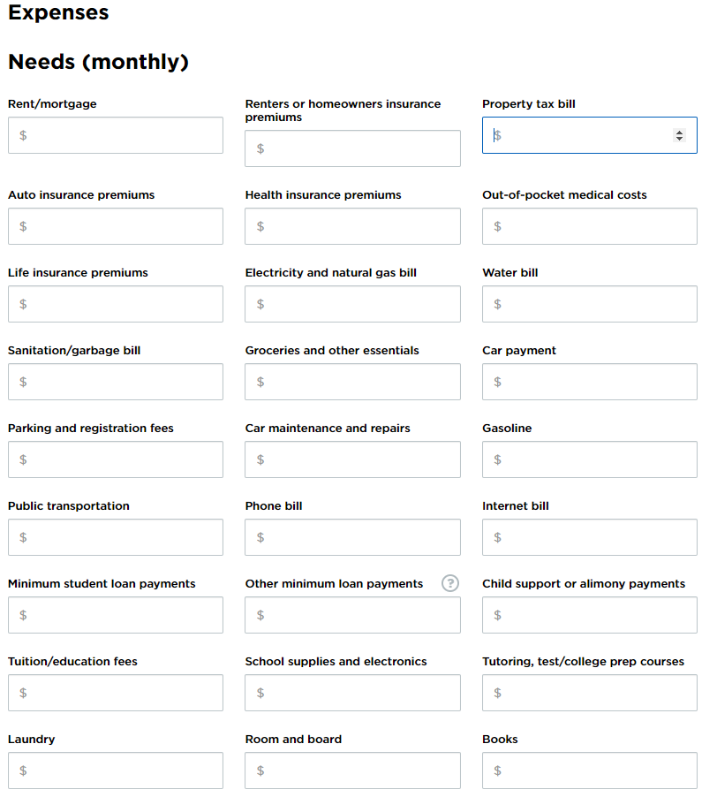
Review expenses
One example of a budget worksheet is available at:
https://www.nerdwallet.com/blog/finance/budget-worksheet/
Identify fixed, flexible, & discretionary expenses.
If you’re spending more than you’re making,
discretionary expenses should be cut first.
At the end of each month, compare budgeted
expenses with actual expenses.
Notes:
Once you have reviewed your expenses for the past few months and you’re ready to create a budget that you would like to stick to for the upcoming month, you could use the worksheet that is provided on our financial literacy blog shown here or one of the countless other templates that are available online for free. For my personal budget, I like to use a simple spreadsheet in Excel since it’s easy to customize and periodically update. You could also use a budgeting app on your phone which can be very convenient to keep track of your expenses throughout the month. At the end of the month you’ll want to compare what you actually spent to what you budgeted.
To determine where you might be able to cut back, it is helpful to identify expenses as either fixed, flexible, or discretionary.
Fixed expenses remain the same each month, such as a mortgage or rent payment, a loan payment, and insurance or medical premiums.
Flexible expenses include items that are necessary, such as groceries, clothing, and utilities, but enable you to control the amount of money spent on them. For example, while you need to buy groceries maybe you can get by with less expensive items or generic brands instead of name brands items.
Discretionary expenses are not necessary for survival. These could include expenses for entertainment, vacations, and impulse buys. If you need to reduce your spending, items from this category should be eliminated or cut back first.

Slide 6
Reduce expenses
Review your budget and determine ways you can reduce your expenses.
Eliminate small, but unnecessary costs…they add up.
Take-out
Unnecessary upgrades (movie channels, newest iPhone, etc.)
Reduce larger expenses.
Can you save by living in another place?
Can you reduce your transportation expenses?
Notes:
One of the goals of budgeting is to reduce your expenses to free up money for other things such as paying down debt and saving toward other goals. To do so, one of the most important things to remember is to live within your means which is simply spending less than you make. You also want to avoid the temptation of trying to keep up with your Facebook friends. They may be sporting designer clothes, driving luxury cars, or buying the latest gadgets, but they may also be drowning in debt; which is not something you want to do.
When trying to reduce your expenses, don’t forget about the small discretionary expenses such as spending $5 on a latte here or $30 on take-out there. This type of stuff can really add up. When I initially reviewed my budget, I found that I was spending way more on discretionary items like this than I thought. You may also want to consider examining your larger expenses such as housing and transportation. For example, you might find that you could save more by temporarily living with your parents, or having a roommate, or maybe driving a different car.

Slide 7
Create a savings plan
Try to balance your budget and save the surplus.
Aim to save at least 10% of your income.
How much do you need to save and by when to cover large expenses?
How much is that per month?
Set up an emergency fund to cover at least 3-6 months of expenses.
Notes:
Once you have created a budget, the next step is to create a savings plan. You’ll want to try to balance your budget and save the surplus. Ideally aim to save at least 10% of your income. To figure how much you need to save, it can be helpful to review what large expenses you expect in the future and then determine how much you need to save each month to cover it. For example, if you know that you need $1,500 to cover your tuition for the next semester that starts in 3 months, that means you need to save $500 per month if you are not receiving financial aid; which we’ll talk about in a few minutes.
It’s also a good idea to set up an emergency fund that can cover at least 3-6 months of expenses, so that you have a safety net in the event that you experience a loss of employment or incur a large unexpected expense such as a major car repair. If your income tends to fluctuate, for instance, if you are self-employed or are paid largely on a commission basis, then you may want to plan to build a larger emergency fund that can cover perhaps a year or more worth of living expenses.

Slide 8
Select a savings account
Get a decent interest rate (currently around 1.0 – 1.5%)
No fees
No minimum balance
FDIC Insured or NCUA Insured (for credit unions)
Compare banks on websites like www.bankrate.com
Then set up direct deposit to automatically save a portion of your paycheck.
Notes:
Your emergency fund should be very liquid, meaning you can quickly access the cash if you need to. It should also be secure, meaning that the funds should not be invested in something that can potentially lose value. That’s why most people keep their emergency fund in an insured savings account that pays interest. A decent interest rate on a savings account is currently around 1% to 1.5%. You certainly won’t become wealthy by earning 1% on your savings account, but at least you’ll have funds to fall back on in the event of an emergency.
You can compare savings accounts from different banks on websites like www.bankrate.com. You’ll likely find the best interest rate from online banks that do not operate with physical branches. You’ll need to decide if you value the higher rate over the convenience of being able to stop by a local bank. Be sure to carefully read the terms and conditions of the account and try to find a bank that charges minimal fees. If you are thinking about opening an account with a bank you have never dealt with before, you should take at least a few minutes to research the bank and see what other people are saying about it online.
Once you have identified the bank that you would like to start an emergency savings account with, consider setting up direct deposit so that a portion of your pay is automatically deposited into your savings account every month. This will essentially put your savings on auto-pilot and you can watch your account grow.

Slide 9
retirement savings – employer matches
Are you contributing enough to receive the maximum employer match?
Free money!
Tax-deferred, compound growth
A more comfortable retirement
Notes:
If you are currently employed and have already set up your emergency savings account, you may want to verify if you are receiving the maximum contribution from your employer to your retirement plan, if your employer provides such a benefit.
Many employers will match a portion of your contributions to your 401k or other retirement plan. If you’re not contributing enough to your retirement plan to receive the maximum employer match each pay period then you’re basically leaving free money on the table.
Contributions to employer retirement plans may be done on a pre-tax basis which means your paycheck shouldn’t be reduced by the same amount you contribute to your retirement plan and you shouldn’t be taxed on any earnings until you withdraw funds from the account. For example, if you contributed $100 to your tax-deferred retirement plan each pay period, your take-home pay should be reduced by less than $100 depending on your tax bracket and other factors. However, the full $100 you contributed plus any employer match will be invested in your retirement account immediately, so that it can potentially start appreciating in value. Of course contributions to retirement accounts will fluctuate with the market and may lose value, but over the long-term such contributions are likely to lead to a more comfortable retirement.
While retirement may seem like a long way off for many of us, it’s never too early to start saving for it. In fact, the longer you wait, the harder it will be to save enough to catch up.

Slide 10
Pay down debts
After establishing an emergency fund and setting aside enough funds for short-term expenses, considering paying down your debts.
Usually you want to start paying off the debt with the highest interest rate first.
Financial calculators can show how much interest you’re saving or paying.
Notes:
Once you have created a budget and have funded your emergency savings account, you may want to consider paying down your debt. Instead of just paying the required monthly payment you could start sending in extra payments to be applied toward the principal amount you borrowed. This will pay off your loan faster and you’ll spend less on interest over the life of the loan. Generally, you may want to pay off debt that has the highest interest rate first. However, you may also want to take into consideration the affect other debt has on your monthly cash flow and the amount of time remaining on the term of each loan. Keep in mind that more of your payment is applied toward interest during the early part of the loan period and more of your payment is applied toward principal the closer you get to the end of the loan period.
There are several websites that provide online financial calculators that you may find helpful when evaluating how much you can save by paying off your debt early. One such website is fncalculator.com. For instance, the Credit Card Payoff Calculator at www.fncalculator.com shows how if you had a $5,000 credit card balance, with a 19% annual interest rate and you only paid $100 toward it each month, it would take nearly 100 months to repay the debt and you would end up paying back about $10,000 which is twice the amount originally borrowed. However, it also shows how if you paid $500 per month, this same $5,000 debt would be repaid in 11 months instead of 100 months and you would only pay $500 in total interest instead of $5,000 in interest.

Slide 11
Managing credit cards
Live within your means!
Pay off your balance in full each month.
Avoid fees and finance charges including:
Compound interest (interest charged on interest)
Late and returned payment fees
Over-limit fee
Cash advance and balance transfer fees
Notes:
With painfully high interest rates that can approach 20% or more, credit card debt is one of the worst kinds of debt to carry. Probably the biggest pitfall with using credit cards is buying stuff that you really can’t afford. For some reason, simply swiping a credit card often doesn’t feel as bad as pulling out your wallet and handing over your hard-earned cash. That’s why it’s so important to live within your means.
Ideally, you’ll want to manage your finances so that you can pay off all your credit card balances in full every month by the due date in order to avoid being charged interest or other fees.

Slide 12
Credit scores
Having good credit can make it cheaper and easier to borrow when you need a loan.
Notes:
So what does your credit score mean? A credit score is a number that reflects the likelihood that someone will be able to repay their debts. The most common type of credit score is a FICO score, and it takes into account a person’s payment history and credit utilization to calculate a number between 300 and 850. Any FICO score above 750 is considered excellent and a number below 550 reflects problems and a higher risk.
Credit scores often impact whether you can obtain a loan and the interest rate you are charged. Having a good credit score can make it easier and less expensive to borrow when you need a loan. Credit scores can also impact other areas of your life. Before you rent an apartment, are offered car insurance or property insurance, or set up utility service in your name, your credit score may be checked and it might affect the rate you are charged or if you approved. The Fair Credit Reporting Act also permits employers to check the credit reports of candidates with their permission, and reasonably use that information in the hiring decision. Therefore, it’s definitely in your best interest to have a high credit score.
So what are the factors that affect your credit score?
Well, 35% of your credit score is influenced by your payment history. Paying bills late negatively impacts your credit score and the later you are, the more it affects your score. Accounts sent to collections, charge-offs, debt settlements, bankruptcies, and liens will also really hurt your credit score. Consistently paying all of your bills on time is one of the best things you can do to improve your credit score.
30% of your credit score is based on the amount that you owe. It takes into account the amount that you owe in relation to the amount of credit that is available to you, which is also known as your credit utilization rate. For example, if you have a $5,000 limit on your credit card and you have a $4,900 balance on that card it could potentially lower your credit score because you have used nearly all of the credit that is available to you on that card. It is important to point out that your credit card utilization rate is calculated at the time your credit report is pulled, not just by looking at the amount of any balance that is carried over from month to month. How much you owe in relation to the original amount borrowed also affects your score. The less you still owe, the better.
15% of your credit score is impacted by the length of your credit history. The number of years you’ve been using credit, the age of your oldest account, and the average age of all your accounts can affect your score. If you have a relatively short credit history, focus on making all your payments on time and not borrowing too much. It may also be a good idea to keep your oldest account open even if it has a $0 balance to increase the length of your credit history.
10% of your credit score considers how many new accounts your have, how many accounts you applied for recently, and the length of time it’s been since you opened a new account. Several new accounts can lower your credit score because it could be an indication that you are struggling to pay your bills or you are planning to take on a lot of new debt.
The final 10% of your credit score is affected by your credit mix. For example it might be better to have different types of credit such as a mortgage, car loan, store accounts, and a few credit cards instead of a couple of maxed out credit cards. However, since this is a small component of your credit score it is not generally advisable to open new accounts just to increase your mix of credit.

Slide 13
Check your credit report
Get your Free Annual Credit Report at:
www.annualcreditreport.com
3 Credit Reporting Agencies:
Equifax
Experian
TransUnion
You can request a free credit report every 4 months if you alternate between the credit reporting agencies.
What to look for on your credit report:
https://www.consumerfinance.gov/askcfpb/313/what-errors-should-i-look-for-in-my-credit-report.html
How to resolve identity theft:
https://www.identitytheft.gov/Steps
Notes:
Your credit report may include a list of all businesses that have given you credit or a loan, the total amount of each loan, or the credit limit on each card. It will also show how often you paid your debts on time, the amount you paid, any missed or late payments, bad debts, bankruptcies, and other public record information.
There are three credit reporting agencies, Equifax, Experian, and TransUnion. The federal government requires each of them to give you a free copy of your credit report once per year if you request it.
To receive a free copy of your credit report go to www.annualcreditreport.com, which is the only source for free credit reports authorized by federal law.
When you review your credit report you’ll want to ensure that all of the personally identifiable information, accounts, loans, and payment history is correct. If something doesn’t look right you should contact the business that issued the account or the credit reporting agency that issued the report. If there is an account on your report that you did not open or if one of your accounts shows a balance that is higher than it should be, it may be a case of identity theft and you’ll want to follow up on that right away. Tips for what to look for on your credit report and steps for resolving identity theft are provided on the two government websites listed at the bottom of this slide.

Slide 14
Responsible borrowing
Only borrow what you truly need and can afford to repay!
Try to keep total student loan debt below the salary you expect to make your first year after graduation.
Contact your loan servicer if you have trouble making loan payments to discuss your options to avoid default.
“Buy what you don’t need and before long you
will sell your necessities.” - Benjamin Franklin
Notes:
Whether you’re borrowing a student loan or any other type of loan, you should only borrow what you absolutely need and what you can afford to repay. If you are borrowing to finance your education, you should try to keep your total student loan debt as low as you can, and ideally below the salary you realistically expect to make during the first year after you graduate.
Loan repayment for Federal Direct student loans ordinarily begins six months after students are no longer enrolled in at least six credits. However, to provide relief during the COVID-19 national emergency, no payments are currently being required on federal student loans owned by the Department of Education until September 30, 2020.
If you decide to borrow a student loan, you may want to consider signing up for electronic debit so that your monthly loan payment can be electronically debited from your checking or savings account. Once you enter repayment, you should contact your loan servicer if you have trouble affording your loan payments or if you have questions about your loans. You may qualify for deferment, forbearance, or a different repayment plan that can temporarily reduce or postpone the amount you must pay.
If you do not repay your student loans in accordance with the Master Promissory Note, it can have serious consequences. If you miss two monthly payments it may be reported to the credit reporting agencies and after 270 days of delinquency the loan may be considered to be in default. A defaulted student loan typically cannot be discharged, even in bankruptcy, and it can lead to wage garnishment, withholding of tax refunds, collection fees, denial of financial aid, and a damaged credit history.

Slide 15
Consider federal student loans before credit cards and private loans
4.53% is the current fixed rate on undergraduate Federal Direct Subsidized and Unsubsidized Loans disbursed between 7/1/2019 – 6/30/2020.
Direct Loans typically offer better repayment plans with deferment and forbearance options.
Private alternative loans often have variable rates or higher fixed rates.
In April 2020, credit card interest rates averaged around 16.5% according to www.bankrate.com
Notes:
If you’re thinking about borrowing a student loan you may wish to consider federal student loans before turning to credit cards and private alternative student loans. Federal student loans such as Direct Subsidized, Unsubsidized, and parent PLUS loans generally offer lower interest rates, better borrower protections, and more repayment plans than private student loans or credit cards. For example, Federal Direct Unsubsidized Loans disbursed this spring have a relatively low fixed interest rate of 4.53%, which has temporarily been reduced to 0% until September 30, 2020 due to the COVID-19 national emergency.
If you apply for financial aid and demonstrate financial need, you may even qualify for a Federal Direct Subsidized Loan that may not accrue interest while you are enrolled at least half-time in college as long as certain requirements are met.

Slide 16
Planning for loan repayment
Before you borrow, start planning how to repay student loans.
Use NOVA’s Loan Planning Form available at:
www.nvcc.edu/forms/pdf/125-346.pdf
Review your loan history (if any).
Determine the impact of additional borrowing.
Review career and income projections at:
www.bls.gov/ooh
Notes:
If you decide to borrow a student loan while attending NOVA, I highly encourage you to use NOVA’s Loan Planning Form which is form number 125-346 in the NOVA Forms Library. The Loan Planning Form can help you review your loan history, determine how your monthly payment might change if you borrow additional loans, and show you how to look up your loan servicer’s contact information so that you can get in touch with your loan servicer if you have any questions regarding loan repayment.
You can also check out the Department of Labor’s Occupational Outlook Handbook at www.bls.gov/ooh. It is an exceptional career planning resource that shows important data on thousands of different occupations in the US including projected growth rates, salaries, educational requirements, and typical working conditions.

Slide 17
Apply for financial aid
You may qualify for aid for your college & living expenses!
Types of Financial Aid
Grants
Scholarships
Work-Study
Student Loans
Notes:
If you haven’t already done so, you should apply for financial aid. All students are encouraged to apply for aid, since you really don’t know what you qualify for until you apply. You might qualify for aid that covers your tuition, books, living expenses, and transportation expenses. If your aid is more than what you owe the school, you can get a refund for any excess aid.
There are four main types of financial aid.
Grants are basically free money based on financial need.
Scholarships are another form of gift aid, but they can be need-based or merit based, and the eligibility requirements can vary significantly. Scholarships are usually competitive, so the more scholarships you apply for, the better your chances of receiving one.
Work-Study is a type of need-based, self-help aid that can be earned by working part-time while attending school. Jobs are often on campus and may offer flexible hours. At NOVA, first year work-study students are paid $11 per hour and can work up to 20 hours per week on campus. It is important to note that on-campus work-study employment is currently suspended at least until the Fall 2020 semester.
Federal Student Loans allow students to borrow funds to cover educational expenses and provide the option of deferred repayment. Student loans can help bridge the gap between what college costs and what the student can afford to pay out-of-pocket by the tuition deadline. Most colleges, including NOVA, offer a monthly payment plan which can be beneficial in such situations.

Slide 18
How to apply for aid
1) Students create an FSA ID.
Parents of dependent students create an FSA ID.
2) Complete the FAFSA at https://studentaid.gov.
Reapply each year by NOVA’s priority application date.
3) Check your MyNOVA “To Do List”.
www.nvcc.edu > MyNOVA > VCCS SIS: Student Information System > Student Center
NOVA’s Guide to Applying for Financial Aid:
www.nvcc.edu/financialaid/apply
Notes:
So how do you apply for financial aid? It really only takes three simple steps to be considered for grants, loans, and work-study at NOVA.
The first thing you should do is create an FSA ID which will allow you to electronically sign your financial aid application. If you are a dependent student for financial aid purposes, then one of your parents should create an FSA ID as well. Dependency status is determined when you complete the FAFSA. Typically, students who are under 24 years old, unmarried, and have no military service, or children that they financially support are considered dependent students and must report parental information on the financial aid application.
You may create an FSA ID on the same website that you will submit your Free Application for Federal Student Aid also known as the FAFSA. That website is StudentAid.gov. Remember to submit your FAFSA each year to reapply for aid. Even though NOVA’s March 1st priority application date has already passed for the upcoming fall semester, you should still submit your FAFSA as soon as possible so that you can be considered for financial aid before NOVA’s August 3rd payment deadline for the fall term.
Once you submit the FAFSA you should start checking your To Do List on your MyNOVA Student Center to see if any additional documentation is required. If anything is requested then a message will be posted on your To Do List and an email will be sent to your email address provided on the FAFSA and to your myNOVA Message Center. When you are awarded financial aid, you will receive another email with instructions on how to view your award on your MyNOVA Student Center.
Please keep in mind that when aid is offered prior to the term census date (or in other words the last day to drop a course with a tuition refund for the longest session of the term), it is based on anticipated full-time enrollment in at least 12 eligible credits that are required for your degree. If you take fewer than 12 eligible credits, then your aid may be reduced. You will want to ensure that you have enough anticipated aid to cover your tuition balance or make other payment arrangements such as enrolling in NOVA’s monthly payment plan before the payment deadline each semester.

Slide 19
Financial aid appeals
The different types of appeals include:
Income Appeals
Satisfactory Academic Progress (SAP) Appeals
Dependency Appeals to Exclude Parental Information on the FAFSA
Selective Service Appeals
Cost of Attendance Appeals, and
Requests for Emergency Aid
For more information visit:
https://blogs.nvcc.edu/financialaid/financial-aid-appeals/
Notes:
If your Free Application for Federal Student Aid (FAFSA) is not really reflective of your current situation, you may wish to consider submitting an appeal to the Financial Aid Office in order to provide additional information and supporting documentation. Generally speaking, you, your spouse if applicable, or your parents if parental information is provided on the FAFSA, must have experienced extenuating circumstances in order to have grounds for an appeal.
If you submit an appeal, the Financial Aid Office will determine:
If you have provided enough supporting documentation to make a decision on your appeal,
If your appeal can be approved based on federal, state, and institutional policies, and
If your financial aid eligibility will change if your appeal is approved.
The different types of appeals include:
Income Appeals
Satisfactory Academic Progress Appeals
Dependency Appeals to Exclude Parental Information on the FAFSA
Selective Service Appeals
Cost of Attendance Appeals, and
Requests for Emergency Aid
If your income has been negatively impacted by the COVID-19 pandemic, in addition to applying for unemployment benefits with your state, you may also wish to consider submitting an income appeal and an emergency grant application to NOVA. Within the next few weeks, NOVA will email potentially eligible students to provide instructions for them to apply for emergency grant funding that was recently allocated through the Coronavirus Aid, Relief, and Economic Security Act, also known as the CARES Act. There will be a new emergency grant application on our website for this purpose very soon.
Before you submit an appeal, we encourage you to discuss your situation with a financial aid team member to learn more about the options that may be available for you. Guidance can also be provided on the appropriate form to use, what information should be included in your written statement, and the type of documentation that should be included with your appeal.
For additional information, please visit our blog page on financial aid appeals which can be accessed from NOVA’s financial aid homepage, www.nvcc.edu/FinancialAid.

Slide 20
Economic impact payments
Visit https://www.irs.gov/coronavirus/economic-impact-payments to determine:
Eligibility for the payment
Check your status
Provide direct deposit information
Answers to FAQ’s
The IRS may not have your direct deposit information if you owed taxes for both 2018 and 2019 and may be planning to mail you a check which can take much longer to receive.
Notes:
Most of you have probably heard about how the CARES Act is providing economic impact payments to American households of up to $1,200 for adults with annual incomes less than $99,000 and $500 per child under 17. If you have not received your payment yet and believe you may qualify, it may be because the IRS does not have your direct deposit information.
Instead of waiting several more weeks to see if you will get a check in the mail, you may confirm if you are eligible for this payment and provide direct deposit information at www.irs.gov/coronavirus/economic-impact-payments. If you owed federal taxes for both 2018 and 2019, the IRS may not have your direct deposit information and may be planning to mail you a check later this year. However, if you provide your bank information on the aforementioned website and if you qualify for this payment, you may receive it within 2-3 weeks after providing your account and routing number.
(Answers to FAQ’s are available at https://www.irs.gov/coronavirus/get-my-payment-frequently-asked-questions#bank).

Slide 21
COVID-19 Financial Hardship relief
If you cannot afford to make a payment, check with your creditor.
You may be able to temporarily reduce or postpone payments you owe.
It is important to communicate your situation to your lender/creditor.
If you can pay, then you should.
Some tips are available at: www.bankrate.com/coronavirus-and-your-money
Notes:
During the coronavirus national pandemic, many creditors are providing payment relief. If you are able to pay your creditors then you should. However, if you have experienced a financial hardship and you absolutely cannot afford a payment, check with your lender or the company that you owe to discuss available options. You may be able to temporarily reduce or postpone payments on loans or other bills that you owe.
It is important to communicate your situation with your creditor. You may or may not qualify for payment relief. Everyone’s situation is different as are the options offered by creditors. Again this is just general advice, but if you can afford to make a payment you should and if you truly cannot afford a payment, contact your creditor to discuss options and consequences.

Slide 22
Financial stability program
Provides personalized support, including free financial coaching
Benefit eligibility screening
Assistance with accessing community resources such as:
Government Benefits
Housing Options
Food
Child Care
Energy Assistance
Health Insurance
Legal Services
www.nvcc.edu/financial-stability/index.html
Email: singlestop@nvcc.edu
Notes:
NOVA’s Financial Stability Program provides students with access to community resources and the knowledge they need to successfully manage their finances. If you ever experience financial, housing, or food insecurity, please visit the Financial Stability Program website, www.nvcc.edu/financial-stability, and reach out to their team. I’m sure you will be impressed with the support that you receive. They can assist you with determining your eligibility for government benefits such as SNAP, TANF, WIC, and other resources, and also with applying for those benefits. You can even receive a personalized financial coaching session for free with an accredited financial counselor. For more information please visit the Financial Stability Program website or email singlestop@nvcc.edu.

Slide 23
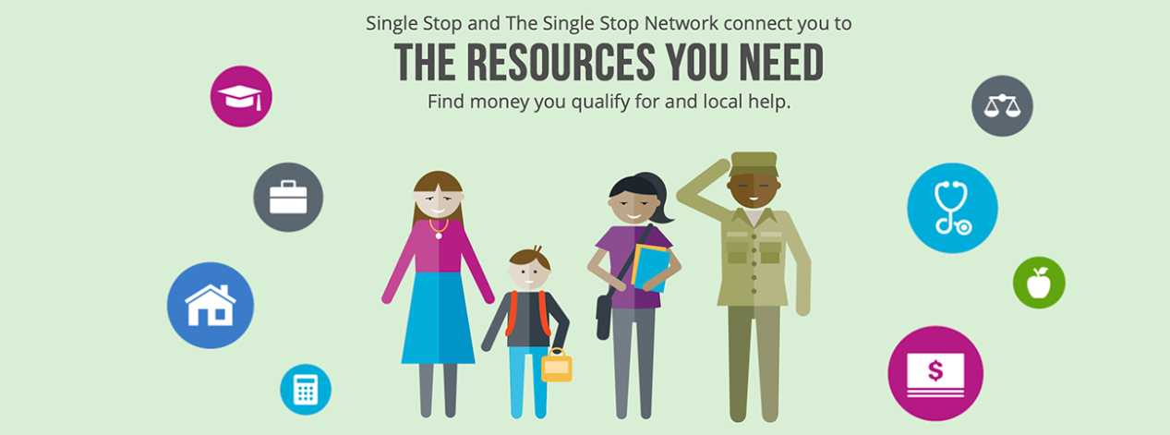
Use the Single Stop screener
https://nvcc.singlestoptechnologies.com/
Notes:
To quickly determine if you may qualify for a variety of benefits and community resources you may complete the Single Stop screener online at nvcc.SingleStopTechnologies.com. It only takes about 5-10 minutes to calculate your eligibility for resources such as:
Child Care Services
Energy Assistance
Food Assistance such as SNAP and W.I.C.
Health Care Coverage
Immigration Assistance and
Legal Assistance
Once you go to the Single Stop website, click, “Sign Up” and enter your email as the username and create a password for your account. Be sure to include a phone number.
Then take 5-10 minutes to fill in your information and it will automatically calculate your eligibility.
Make sure you hit the "send" button. Then a NOVA Single Stop Center staff member will contact you to discuss the next steps and to answer any questions you may have.

Slide 24
disclaimer
The information contained in this presentation is very general and should not be considered professional advice. Everyone’s situation is different and you should consider seeking independent legal, financial, tax-related or other advice based on your own unique circumstances.
While we are selective about the external websites and resources that are mentioned, we do not endorse any external websites, products, or content.
Northern Virginia Community College (NOVA) and its agents are not liable for any loss caused, whether due to negligence or otherwise arising from the use of, or the reliance on, the information provided directly or indirectly in this presentation.
Notes:
Well, that wraps up the slides for today’s webinar. As we transition to taking your questions, we are just displaying this disclaimer to make it clear that the information contained in this presentation is very general and should not be considered professional advice or an endorsement for anything mentioned today. Everyone’s situation is different, and while you are welcome to utilize the free resources discussed today, you may wish to seek advice from licensed financial and legal professionals regarding your own unique circumstances.

Slide 25
General Questions?
For student-specific questions, please contact a financial aid team member at:
www.nvcc.edu/financialaid/support/staff.html or
Call the 24-Hour Student Support Center at 1-855-323-3199.
Notes:
And with that, we will start taking your general questions. If you have specific questions related to your student account or items of a more confidential nature such as submitting a financial aid appeal, please contact the Financial Aid Office using the contact information provided on our financial aid website or call the 24-Hour Student Support Center at 1-855-323-3199.

