Slide 1
Anatomical Terminology Lab

Slide 2
Anatomical Terminology Lab Outline
Case Study: “Assisting the Surgeon” (in pairs)
Activity 1: Organ Systems and Function (in pairs)
Activity 2: Anatomical Terminology (in pairs)
Activity 3: Directional Terms (individually)
Activity 4: Body Planes and Sections (in pairs)
Activity 5: Body Cavities and Membrane Linings (in pairs)
Activity 6: Abdominal Regions and Quadrants (in pairs)
Anatomical Terminology

Slide 3
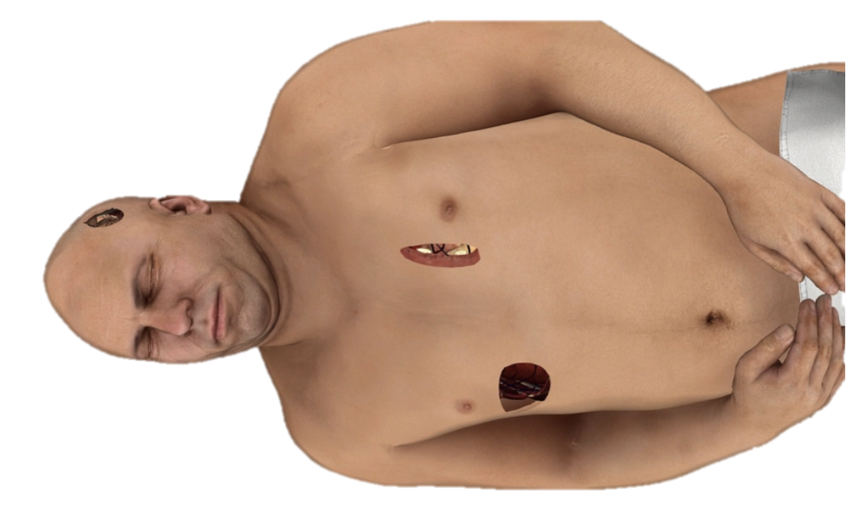
Case Study: “Assisting the Surgeon”
Activity Case Study
Read through the case study in the lab manual
You have a patient with three stab wounds come into the ER
You will be answering question about your patient as you go through lab today as you learn anatomical terminology.
Anatomical Terminology

Slide 4
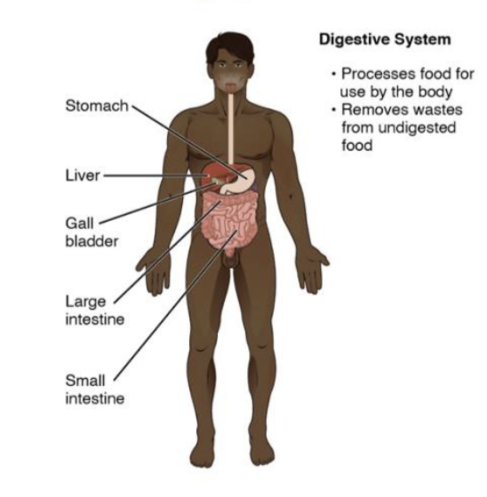
Organ Systems and Functions
Activity 1
There are 11 different organs systems. You will the organs in each system and their functions. Remember, some organs belong to more than one organ system.
Anatomical Terminology
Label the organs on the torso model. Keep the labels on for the duration of the lab! Fill in the chart in the manual.
OPENSTAX

Slide 5
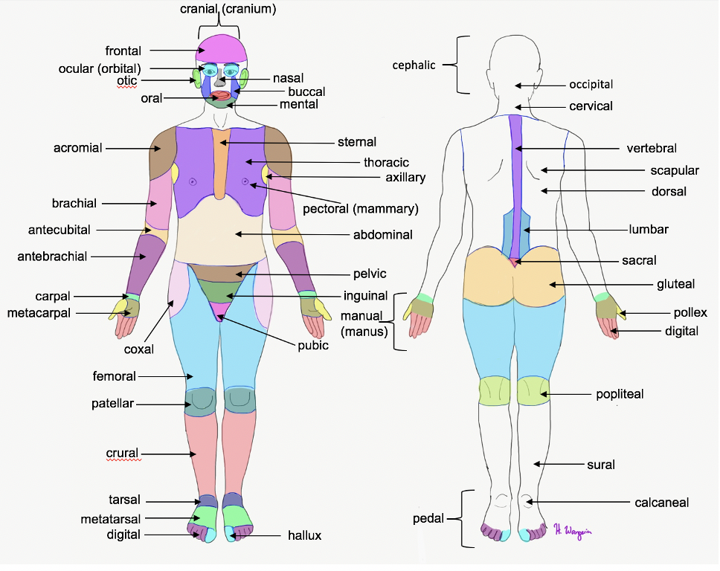
Anatomical Terminology – Surface Terms
Activity 2
You will learn these surface terms for each region – practice at home using the Canvas quiz and extra study material
Anatomical Terminology
Use the sticky labels to label these terms on the muscle model in lab. You will need your instructor’s signature before moving on. Then put all the terms back in the correct spot!

Slide 6
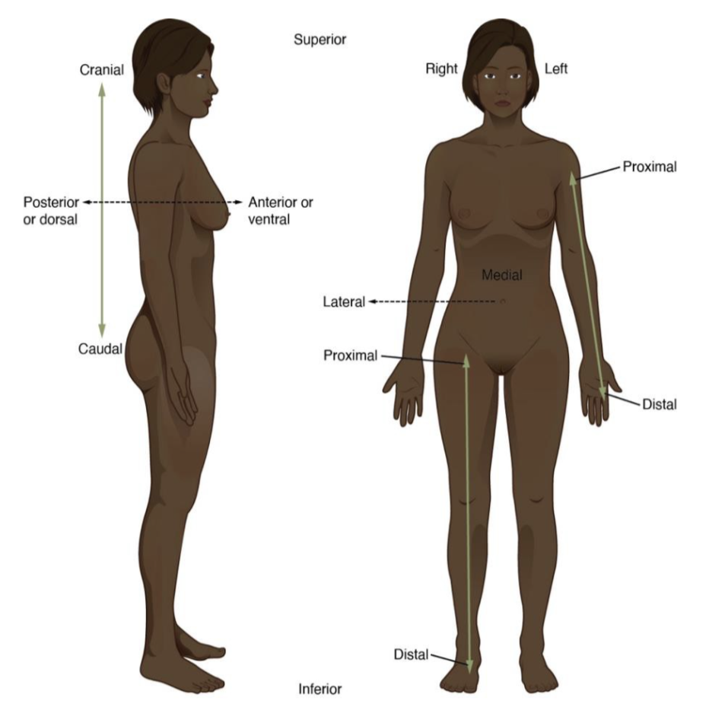
Directional Terms
Activity 3
A few tips:
These terms are all relative to one another (you must be describing the relationship of two body parts to one another)
Proximal and distal are only used in the appendages (in place of superior/inferior)
Anatomical Terminology
Use the images in the lab manual and your labelled models to help you answer the questions in the lab.
OPENSTAX

Slide 7
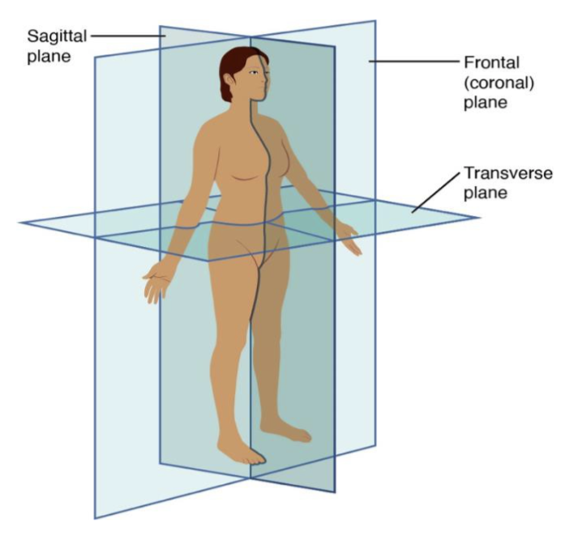
Body Planes and Sections
Activity 4
Planes of section divide the body into different regions
Frontal – anterior/posterior
Transverse – superior/inferior
Sagittal – left/right
Anatomical Terminology
You will make a model of a head out of clay and use the plastic knife to cut it into the different planes of section. You will then analyze the images in the tray and finally your patient’s stab wounds (in the lab manual).
OPENSTAX

Slide 8
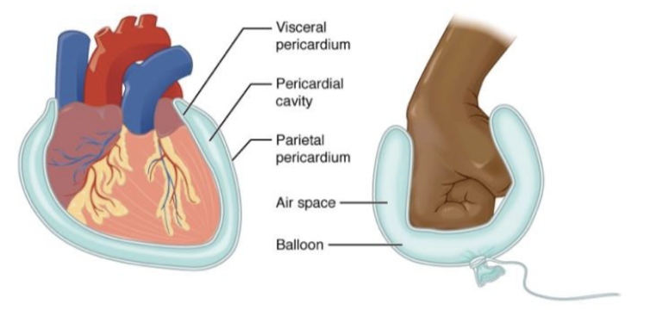
Body Cavities and Membrane Linings
Activity 4
Serous Membranes – line body cavities , made of two layers
Visceral – inner layer that touches the organ
Parietal – outer layer farthest from organ
With serous fluid in between
Anatomical Terminology
We will use a Ziplock bag filled with fluid to represent a serous membrane. You will learn the names of the serous membranes of the body.
OPENSTAX

Slide 9
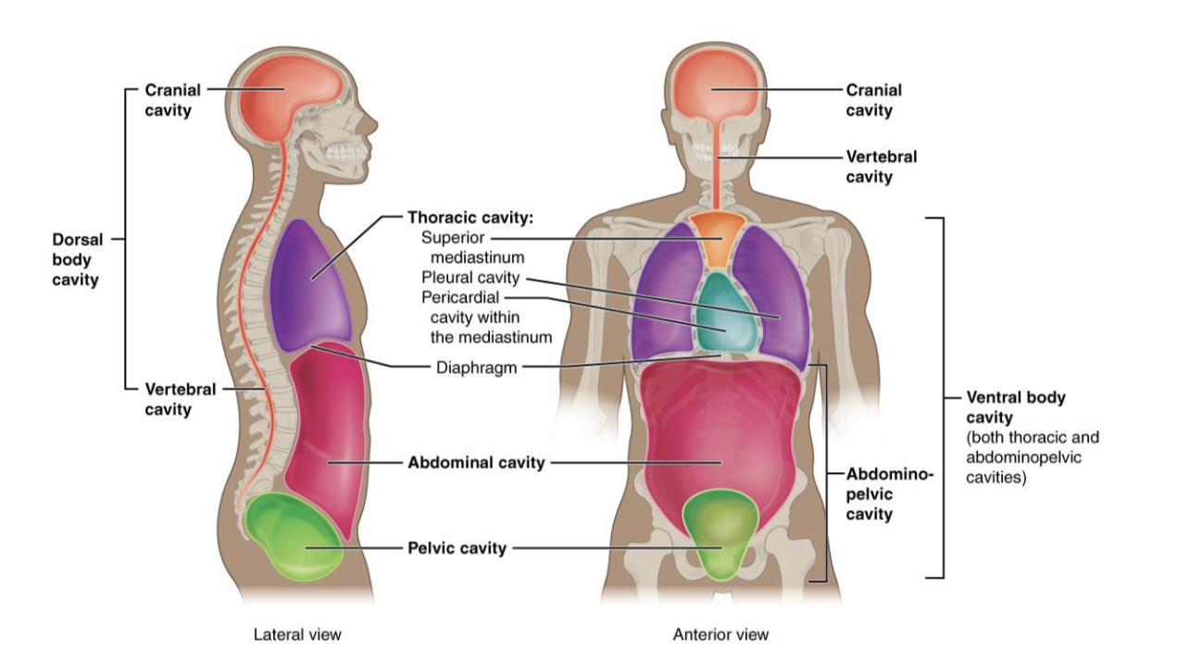
Body Cavities and Membrane Linings
Activity 5
Body Cavities - the body is divided into different cavities (spaces) lines with serous membrane.
Dorsal
Cranial
Vertebral
Ventral
Thoracic
Abdominopelvic
Anatomical Terminology
Label the body cavities on the models and identify the organs in the charts.
OPENSTAX

Slide 10
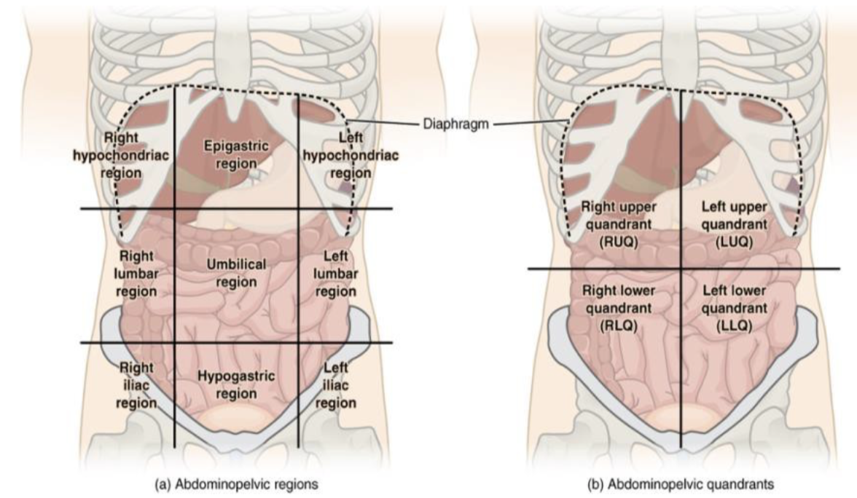
Abdominal Regions and Quadrants
Activity 6
The abdomen can be divided into either 4 quadrants or 9 regions
Label the regions on the model by making tape dividers and identify the organs in each region.
Anatomical Terminology
OPENSTAX

Slide 11
Clean up!
Be sure you answered all question in the lab
Clean your lab station, put the material away neatly
Wipe down your table with disinfectant
Make sure all labels are in the correct spots on the terminology sheets
Don’t forget to submit the post-lab.
Anatomical Terminology

