Slide 1
Appendicular Skeleton
Bio141 OER Lab Manual © 2022 by H. Wangerin, P. Rodgers, G. Backus is licensed under CC BY-NC-SA 4.0

Slide 2
Appendicular Skeleton
Case Study “Hips of Steel” (in pairs)
Activity 1: Bones of the Appendicular Skeleton (as a group)
Activity 2: Bone Markings of the Upper Limb (as a group)
Activity 3: Bones Markings of the Lower Limb (as a group)
Putting it all Together (in pairs)
Appendicular Skeleton

Slide 3
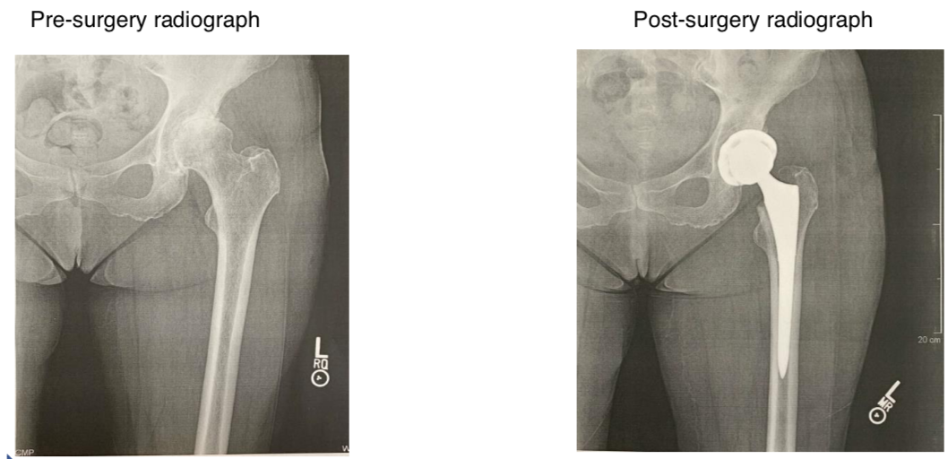
Case Study: “Hips of Steel”
Appendicular Skeleton
Bio141 OER Lab Manual © 2022 by H. Wangerin, P. Rodgers, G. Backus is licensed under CC BY-NC-SA 4.0

Slide 4
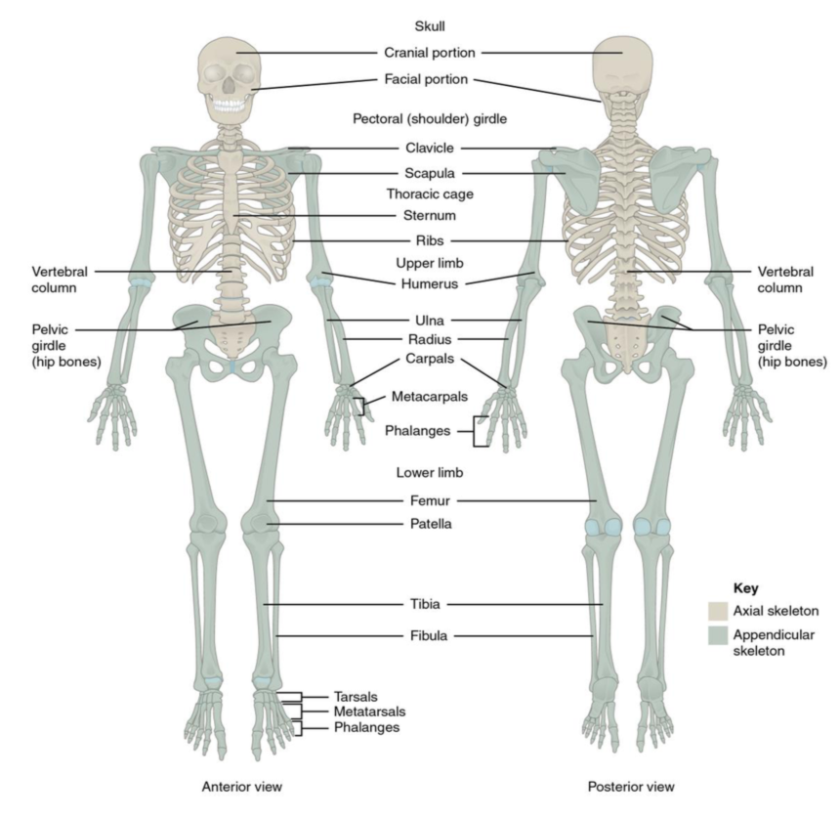
What are the Bones of the Appendicular Skeleton
Activity 1
In this activity you will be using the sticky tack to label the bones of the appendicular skeleton.
You will then quiz one another on the bones – today is all about getting practice!!
Appendicular Skeleton

Slide 5
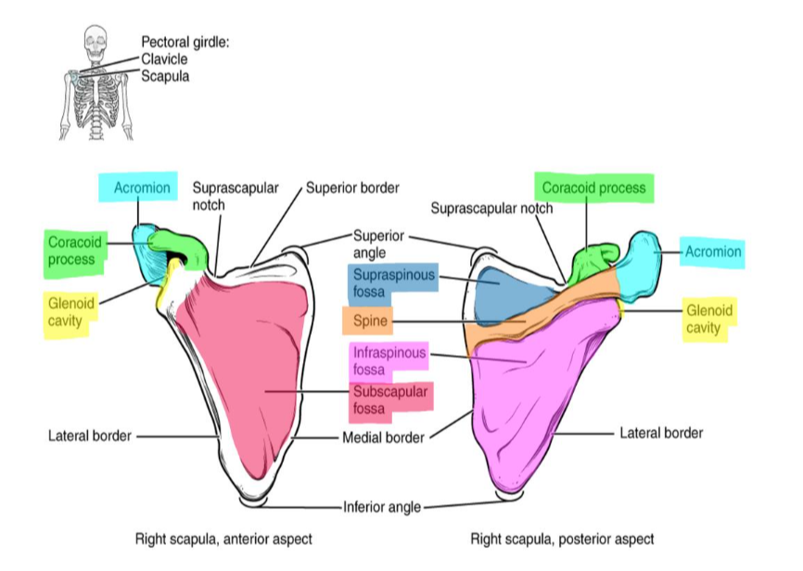
Bone Markings of the Upper Limb
Activity 2
In this activity you will be using the sticky tack to label the bone markings of the upper limb.
You will then quiz one another on the markings – today is all about getting practice!!
Appendicular Skeleton
Bio141 OER Lab Manual © 2022 by H. Wangerin, P. Rodgers, G. Backus is licensed under CC BY-NC-SA 4.0

Slide 6
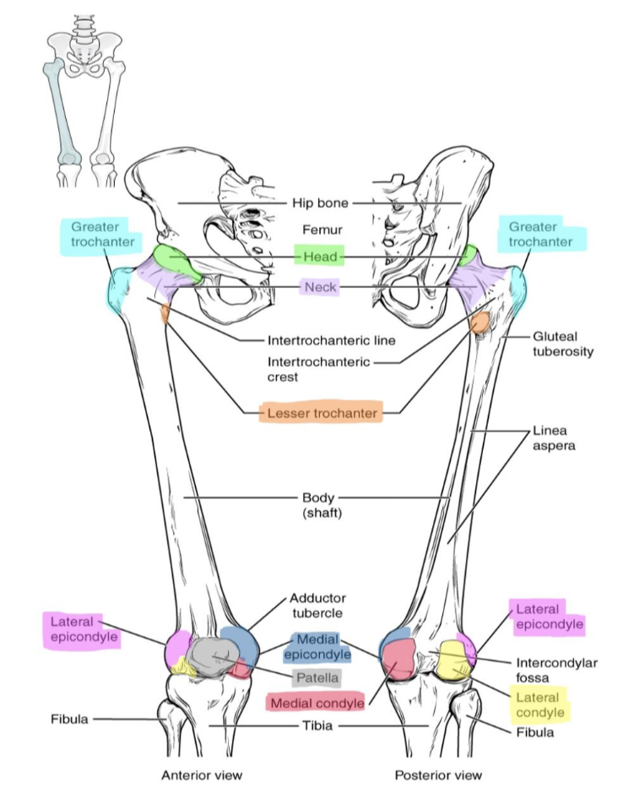
Bone Markings of the Lower Limb
Activity 3
In this activity you will be using the sticky tack to label the bone markings of the lower limb.
You will then quiz one another on the markings – today is all about getting practice!!
Appendicular Skeleton
Bio141 OER Lab Manual © 2022 by H. Wangerin, P. Rodgers, G. Backus is licensed under CC BY-NC-SA 4.0

Slide 7
Lab Clean-Up: Before you leave be sure to…
Remove and replace all of the terminology labels on the terminology sheets and return them to the binder
Place the slides back in the slide boxes
Place all the material back in the lab tray neatly
Check the tray supply list with the supplies in the tray
Return the trays to the side table
Appendicular Skeleton
Bio141 OER Lab Manual © 2022 by H. Wangerin, P. Rodgers, G. Backus is licensed under CC BY-NC-SA 4.0

