Slide 1
Histology Part 2

Slide 2
Histology Part II
Histology - Part II
Activity 3: Supportive Connective Tissue (individually and as a group)
Activity 4: Muscle Tissue (individually and as a group)
Activity 5: Nervous Tissue (individually and as a group)
Histology Part II

Slide 3
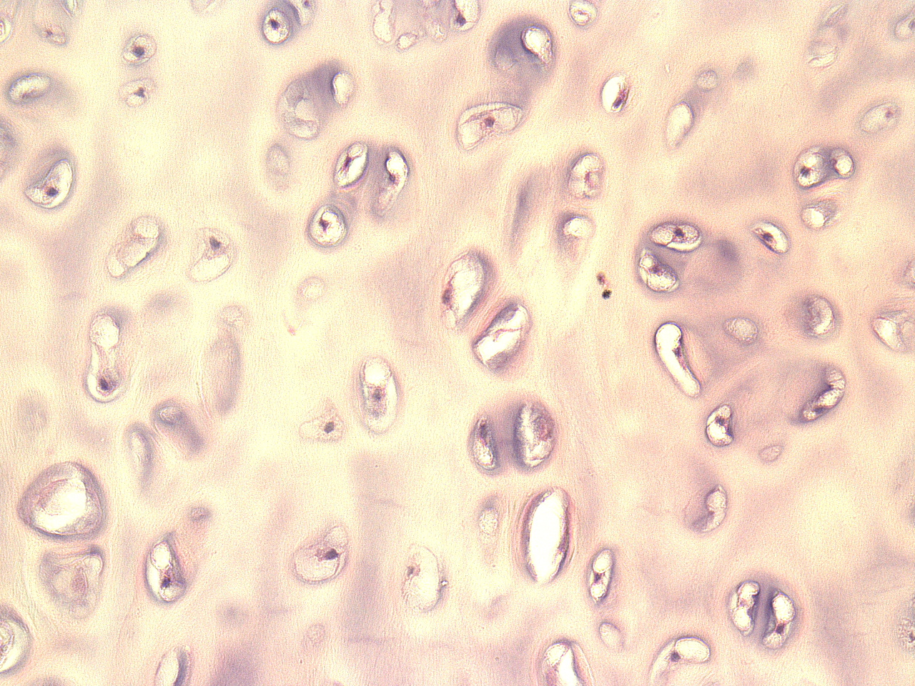
Connective Tissue – Hyaline Cartilage
Cells: mostly chondrocytes that sit in a lacuna (space)
Fibers: collagen (short, fine and dispersed)
Matrix: firm, made of chondroitin sulfates (polysaccharides) that bind to ground substance proteins and make proteoglycans
Location: end of long bones, trachea, tip of nose, connects ribs to sternum
Histology Part II
© Wangerin

Slide 4
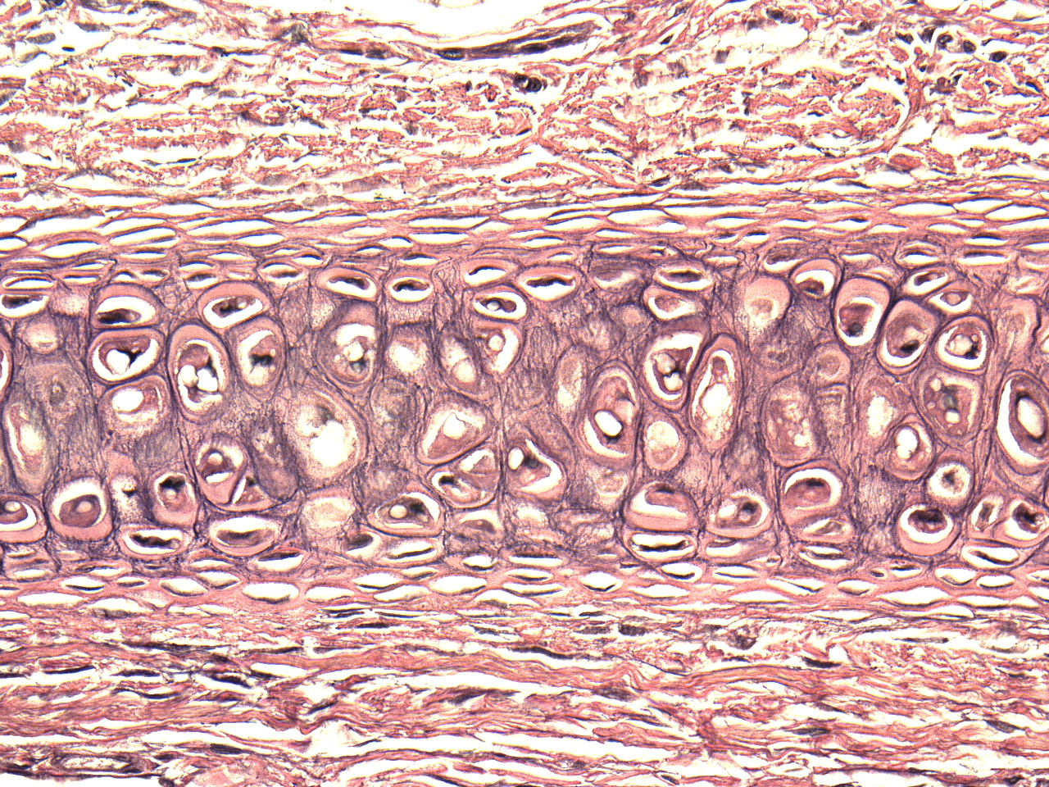
Connective Tissue – Elastic Cartilage
Cells: mostly chondrocytes that sit in a lacuna (space)
Fibers: mostly elastic
Matrix: firm, made of chondroitin sulfates (polysaccharides) that bind to ground substance proteins and make proteoglycans
Location: external ear, epiglottis
Histology Part II
© Wangerin

Slide 5
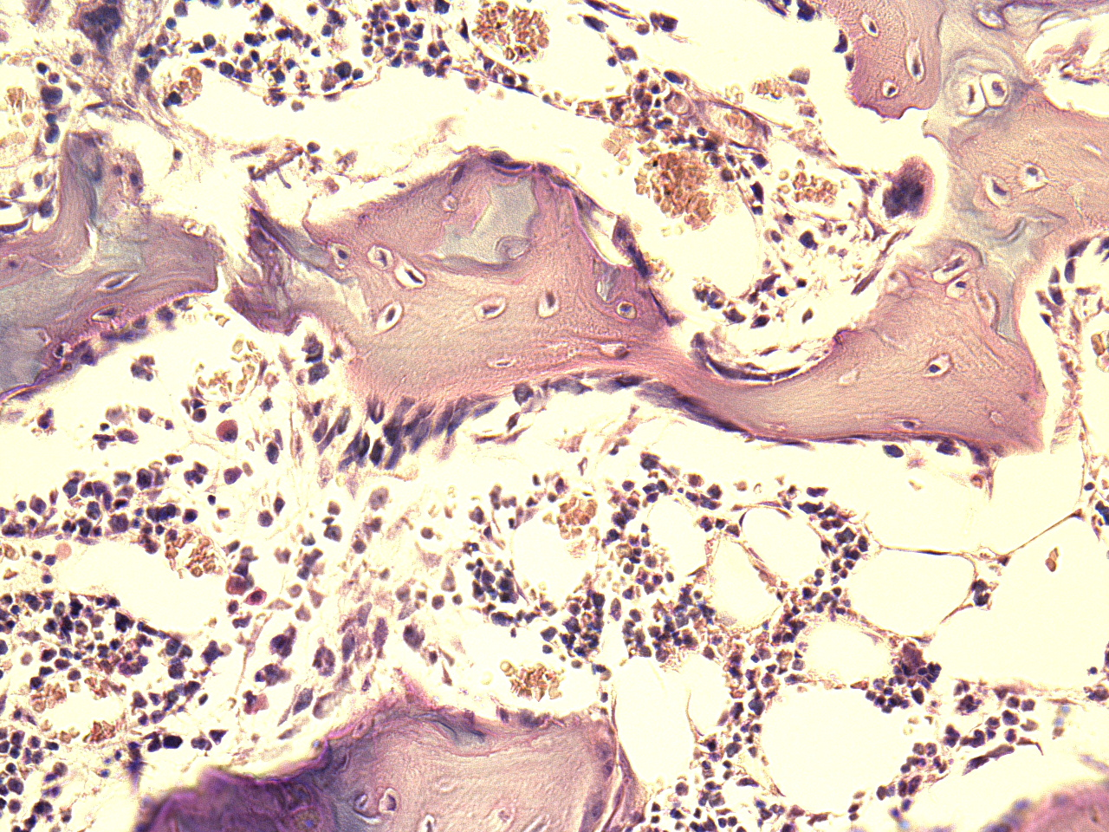
Connective Tissue – Fibrocartilage
Cells: mostly chondrocytes that sit in a lacuna (space)
Fibers: bundles of thick collagen
Matrix: firm, made of chondroitin sulfates (polysaccharides) that bind to ground substance proteins and make proteoglycans
Location: meniscus of knee, intervertebral discs
Histology Part II
© Wangerin

Slide 6
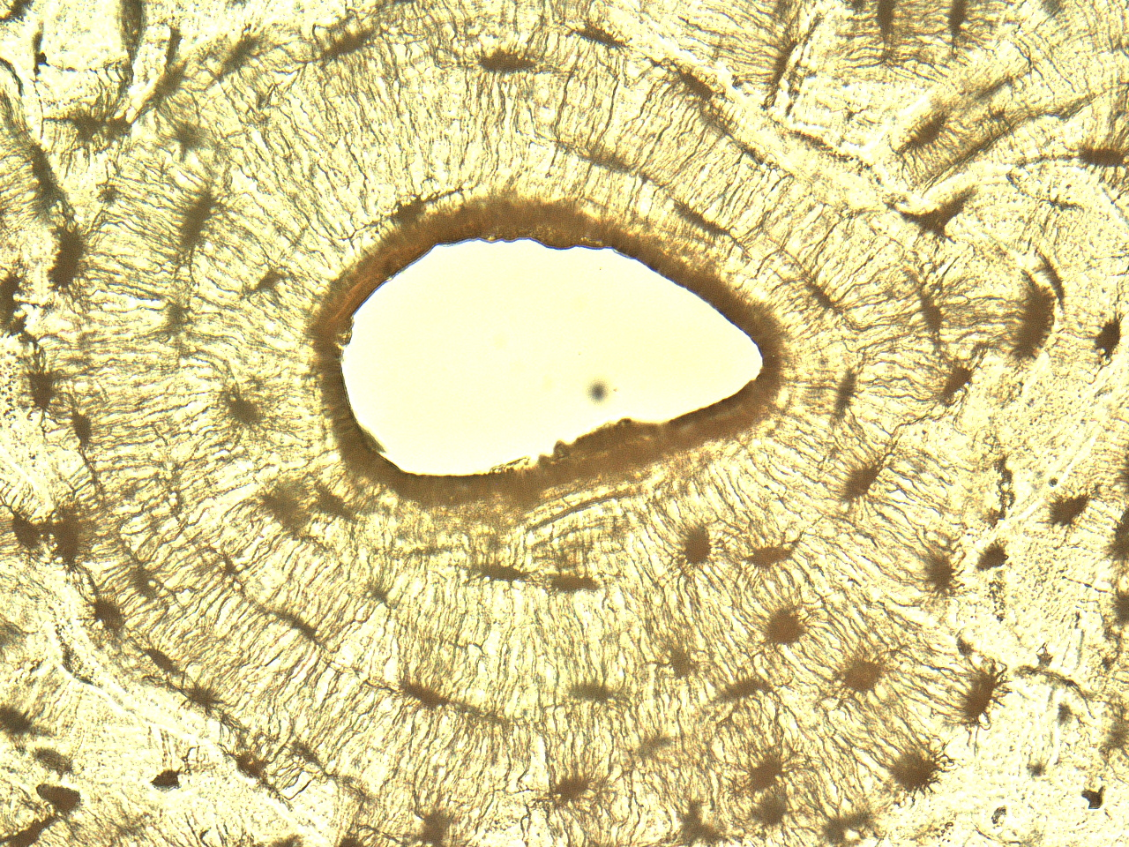
Connective Tissue – Compact Bone
Cells: mostly osteocytes that sit in a lacuna (space)
Fibers: collagen
Matrix: hard and calcified
Location: bones
Histology Part II
© Wangerin

Slide 7
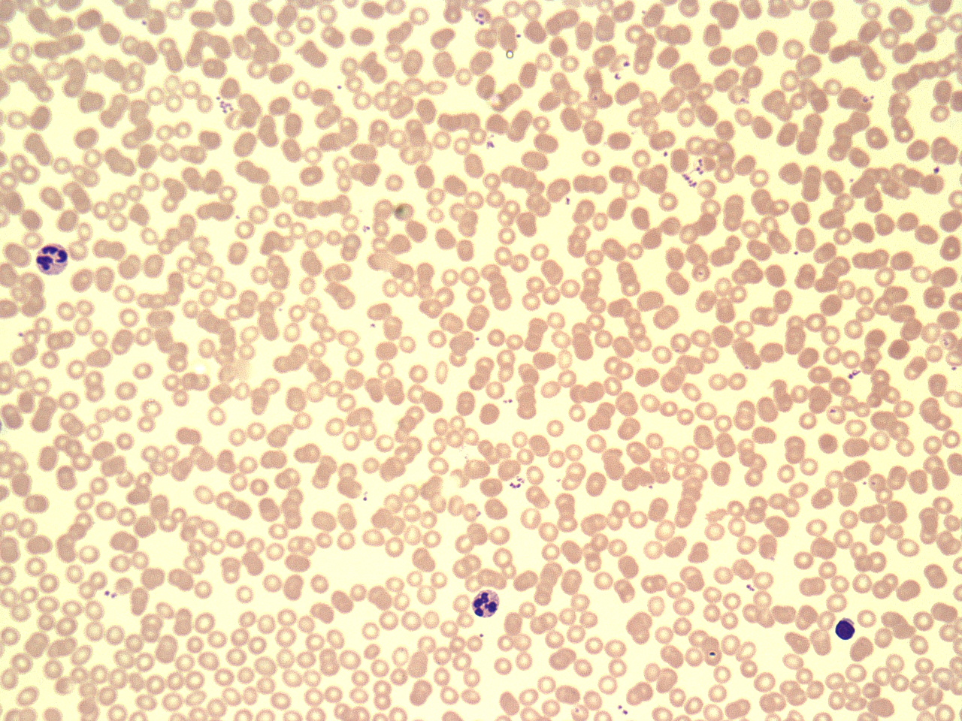
Connective Tissue – Blood
Cells: red and white blood cells
Fibers:
Matrix: fluid
Location: within blood vessels
Histology Part II
© Wangerin

Slide 8
Activity 2: Supportive Connective Tissue
Hyaline cartilage
Fibrocartilage
Elastic cartilage
Blood
Bone
Tips and Tricks for Finding Supportive Connective Tissue
Look for the cell types
Identify the types of fibers
Histology Part II

Slide 9
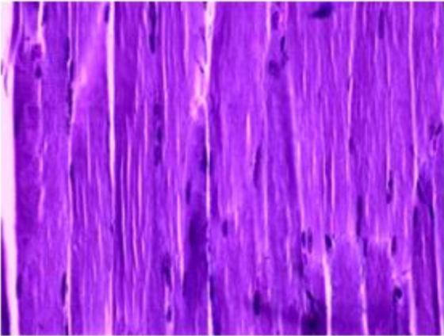
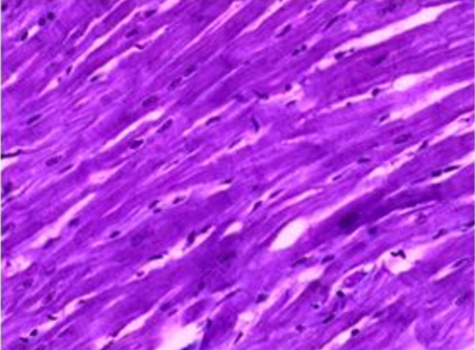
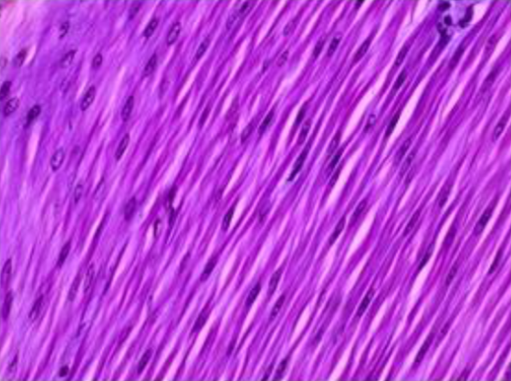
Muscle Tissue
Skeletal Muscle
Cardiac Muscle
Smooth Muscle
Histology Part II
© Wangerin

Slide 10
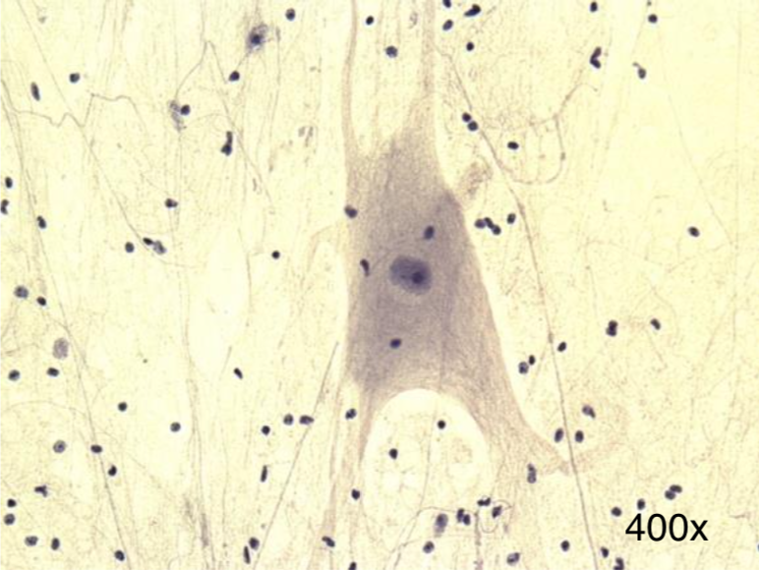
Nervous Tissue
Notice the large cell (neuron) with many extensions and the small darkly staining nuclei of the supporting cells (neuroglial cells)
Histology Part II
© Wangerin

Slide 11
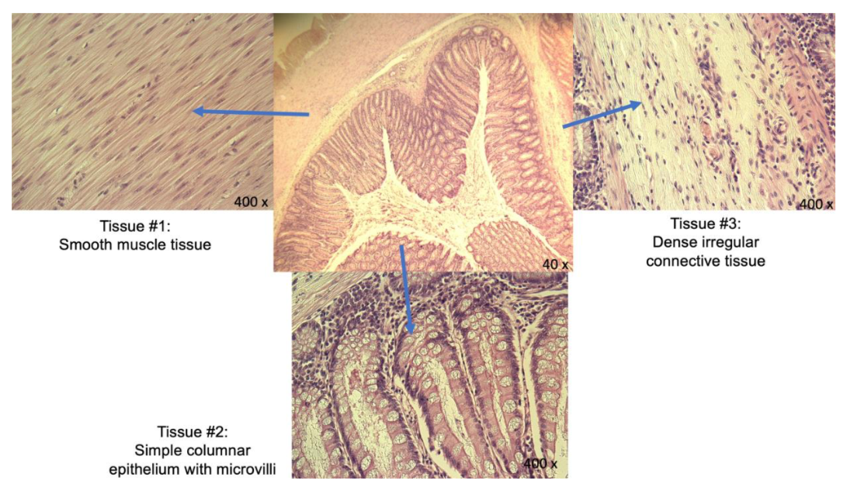
Activity 5: Exploring an Organ
Now you will apply what you have learned and analyze a cross section of the intestine.
Histology Part II
© Wangerin

Slide 12
Lab Clean-Up: Before you leave be sure to…
Have your in-lab work checked
Place the slides back in the slide boxes
Place all the material back in the lab tray neatly
Check the tray supply list with the supplies in the tray
Histology Part II

