Slide 1
Integument Lab
Case Study: “Cancer is Only Skin Deep” (in pairs)
Activity 1: Layers and Cells of the Skin (as a lab group)
Activity 2: Layers and Structures of the Dermis and Hypodermis (individually and in pairs)
Putting it all Together (in pairs)
Integument

Slide 2
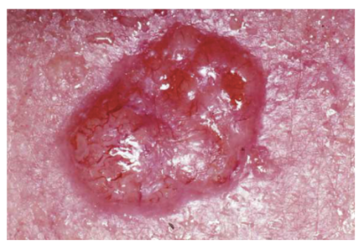
Case Study: Cancer is Only Skin Deep
Read through the case study and answer the questions
Integument

Slide 3
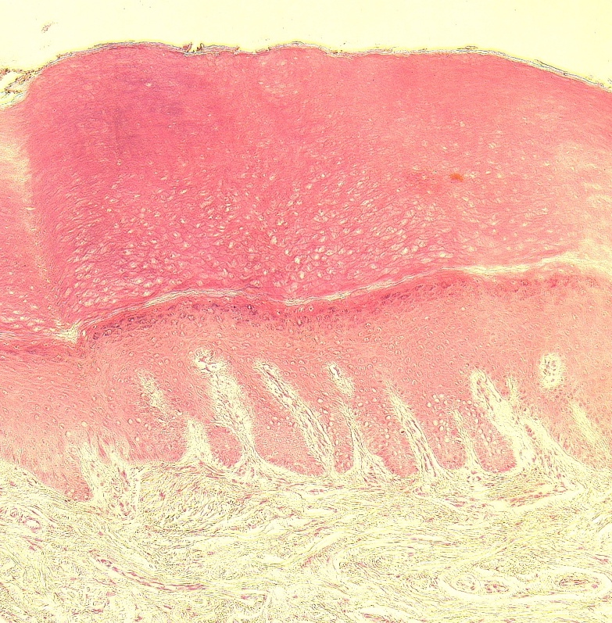
Layers and Cells of the Epidermis
Activity 1
The epidermis is made of 4-5 different layers.
stratum corneum
epidermis
stratum lucidum
Integument
stratum granulosum
stratum spinosum
stratum basale
dermis
dermal papillae
400x
Figure 3: Slide of thick skin

Slide 4
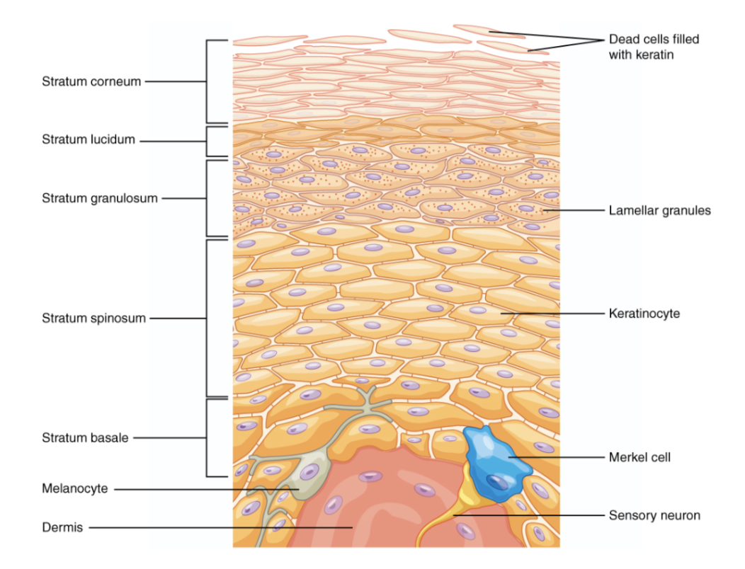
Layers and Cells of the Epidermis
Activity 1
There are three different types of cells in the epidermis:
Keratinocytes
Melanocytes
Markel cells
Integument

Slide 5
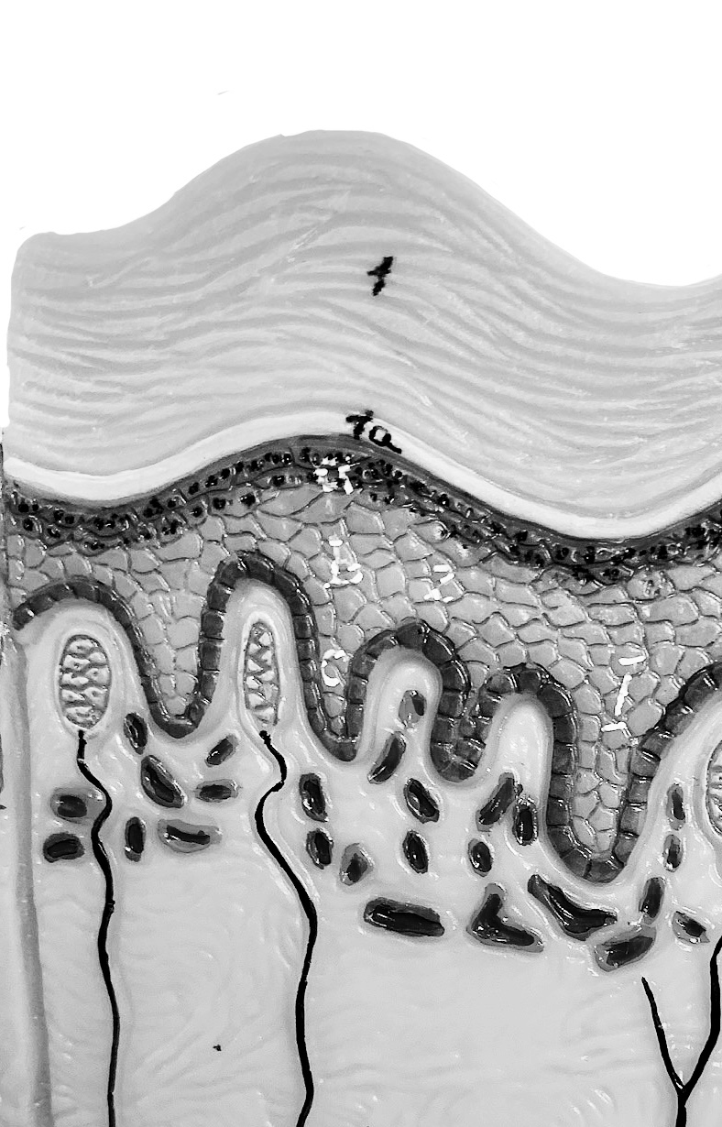
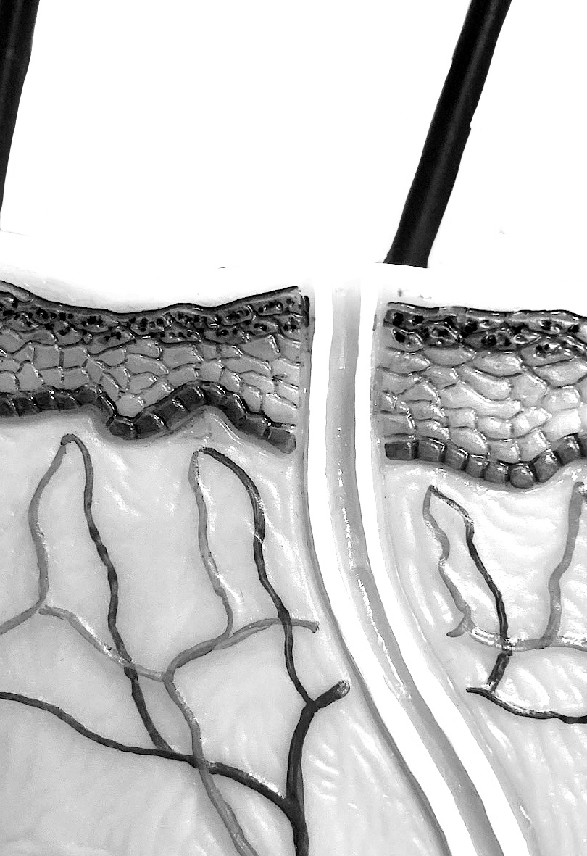
Layers and Cells of the Epidermis
Activity 1
Identify the layers of the epidermis in the image of the skin model.
Integument
Skin model to label

Slide 6
Layers and Cells of the Epidermis
Activity 1
There are two types of skin with some unique features, thin and thick skin. Draw an image of thin and thick skin under the microscope.
Thick skin slide Thin skin slide
Integument

Slide 7
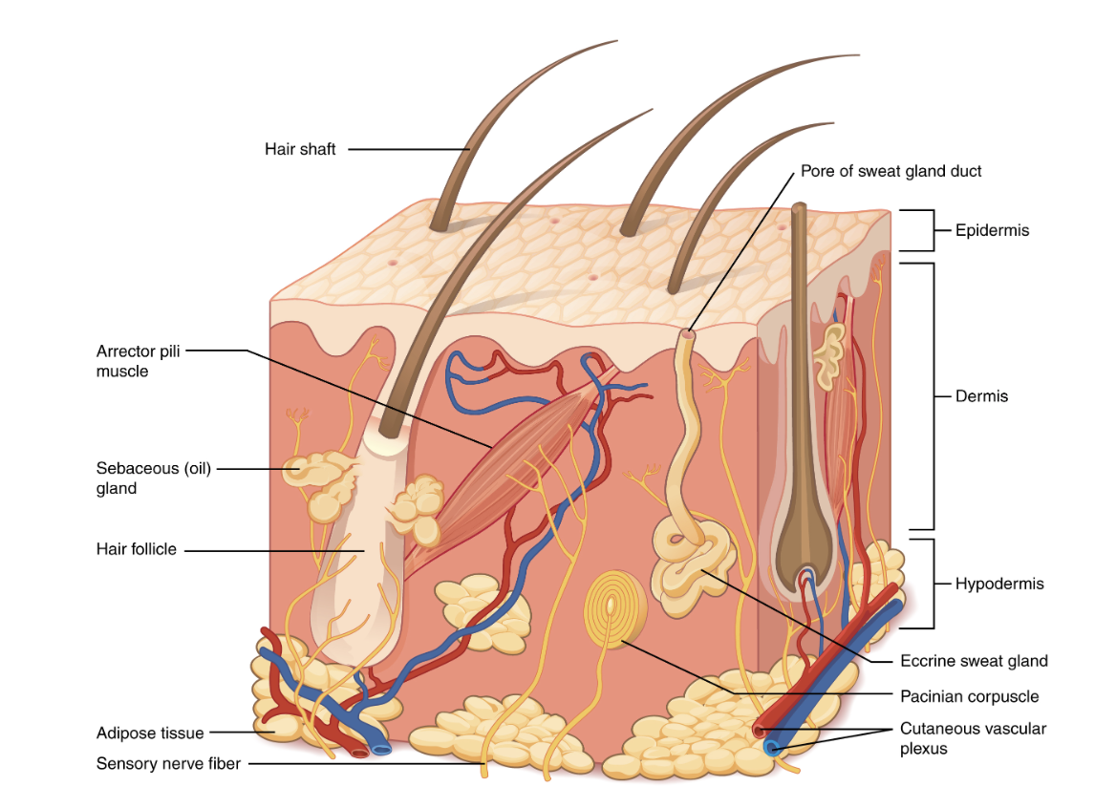
Layers and Structures of the Dermis and Hypodermis
Activity 2
You will learn several different structures in the skin.
Integument

Slide 8
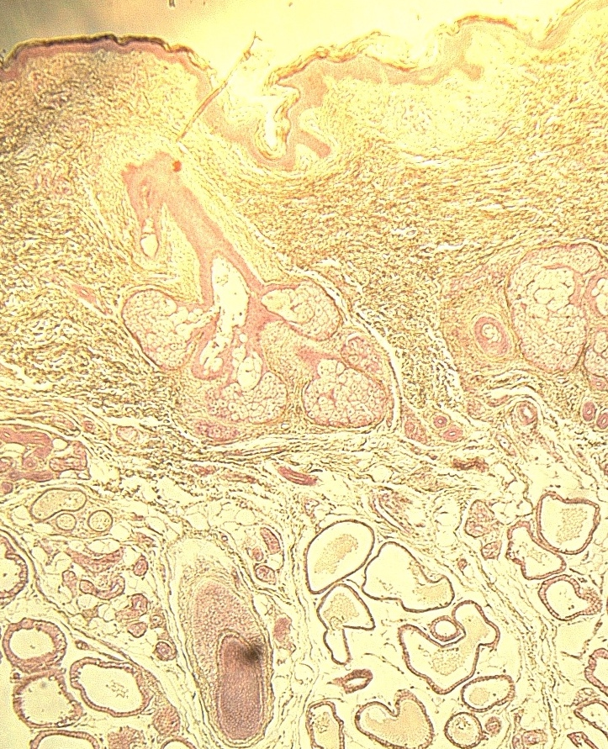
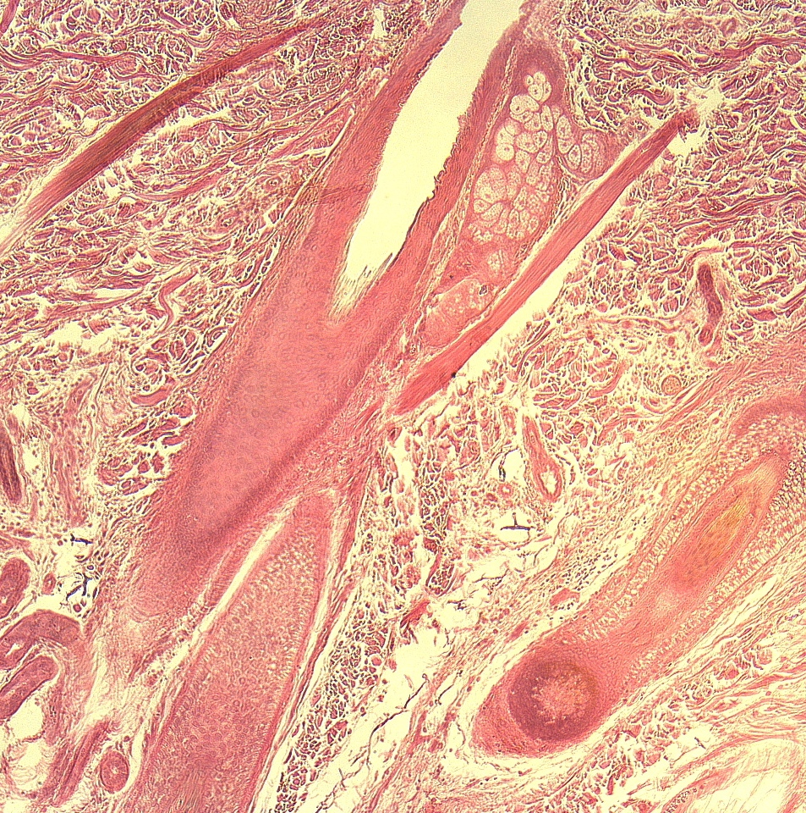
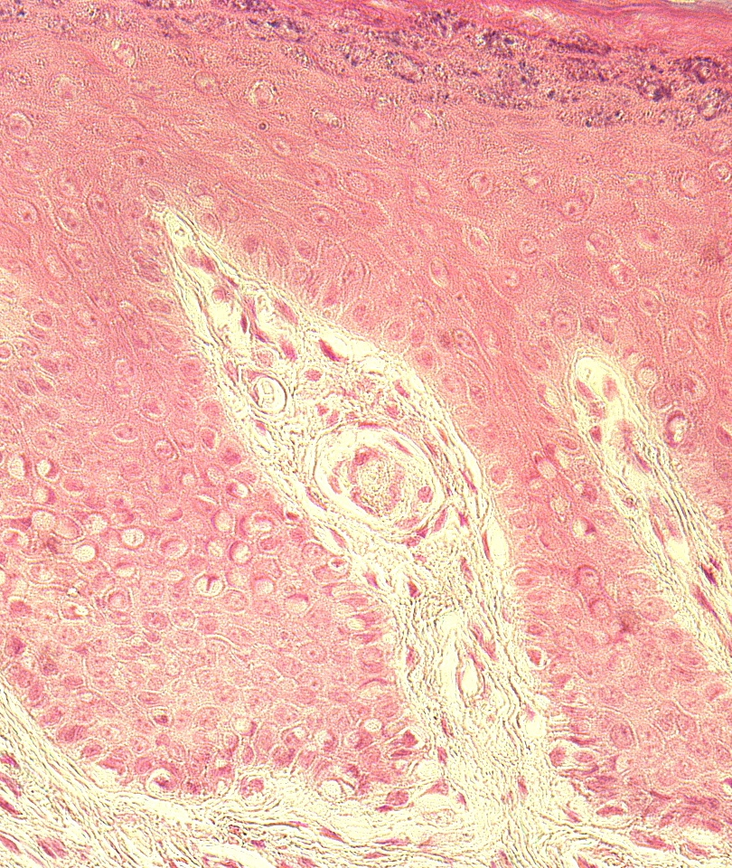
Layers and Structures of the Dermis and Hypodermis
Activity 2
sebaceous gland
arrector pili muscle
sebaceous gland
Can you identify these structures at high power on your microscope?
hair follicle
apocrine sweat gland
Integument
400x
Figure 5: Hair follicle
400x
Figure 6: Glands of the skin
tactile (Meissner) corpuscle
400x
Figure 7: Tactile (Meissner) corpuscle

Slide 9
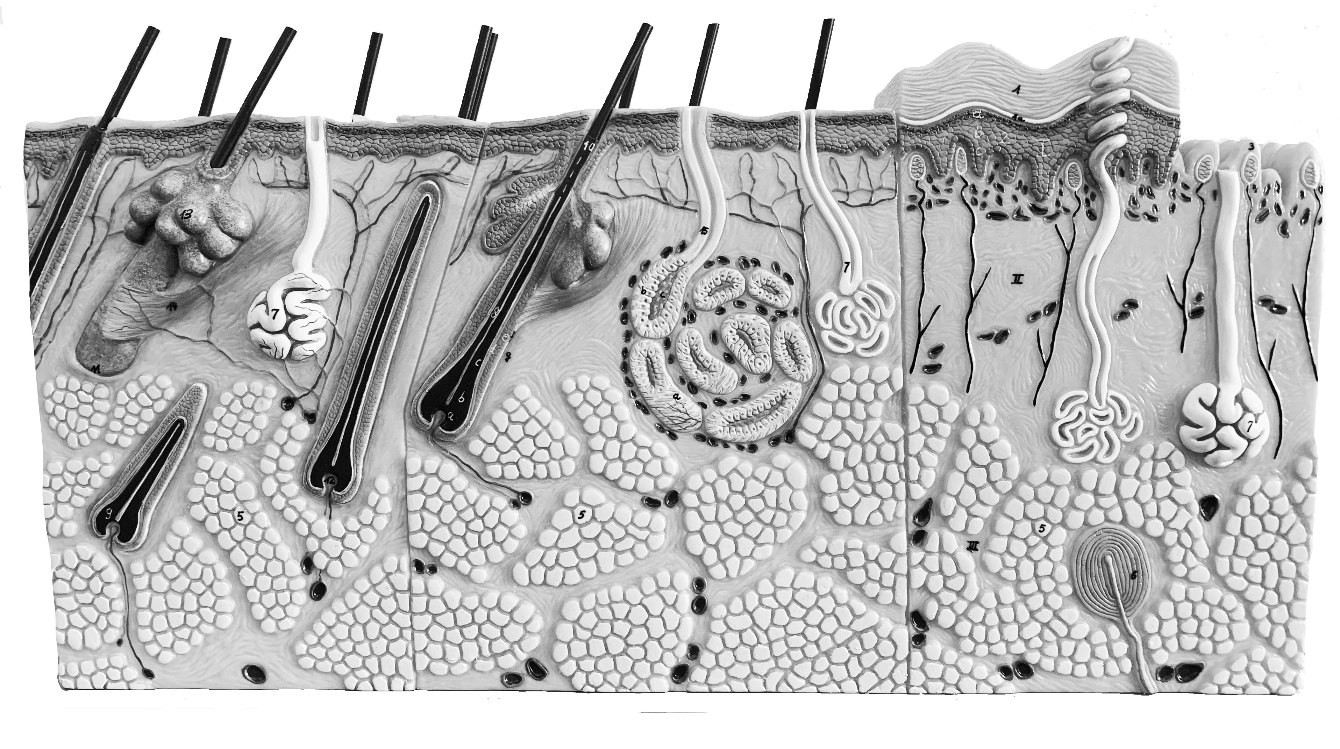
Layers and Structures of the Dermis and Hypodermis
Activity 2
Label the structures on the skin model.
Integument
Skin model to label 2

Slide 10
Layers and Structures of the Dermis and Hypodermis
Activity 2
Layer | Tissue Type | Description
Epidermis
Dermis
Hypodermis
View the slide of thick and thin skin and fill in the table.
Integument

Slide 11
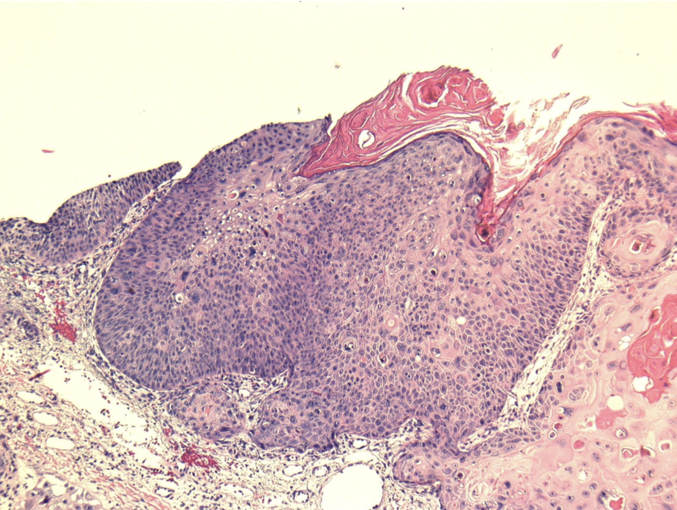
Putting it all Together (work in pairs)
View the slide that came back from the pathologist and answer the questions
Integument

Slide 12
Lab Clean-Up: Before you leave be sure to…
Have your work checked by your instructor
Remove and replace all the terminology labels on the terminology sheets and return them to the binder
Place the slides back in the slide boxes
Return the microscopes (remember to put the stage all the way down and leave the scanning objective in place)
Place all the material back in the lab tray neatly
Check the tray supply list with the supplies in the tray
Return the trays to the side table
Don't forget about Lab Exam 1 next week! It is all short answer and fill-in-the blank.
Integument

