Slide 1
Introduction to Bones

Slide 2
Introduction to Bone Tissue
Bone Tissue
Case Study “Case of the Mysterious Femur Fracture” (in pairs)
Activity 1: Examining the Anatomy of a Long Bone (in pairs)
Activity 2: Examining the Cartilage Associated with Bones (in pairs)
Activity 3: Examining the Microscopic Histology of Bone (in pairs & individually)
Activity 4: Examining the Components of Bones (in pairs)
Introduction to Bone Tissue

Slide 3
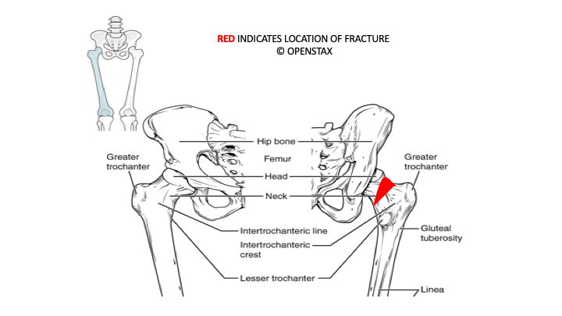
Case Study “The Mysterious Femur Fracture”
Introduction to Bone Tissue

Slide 4
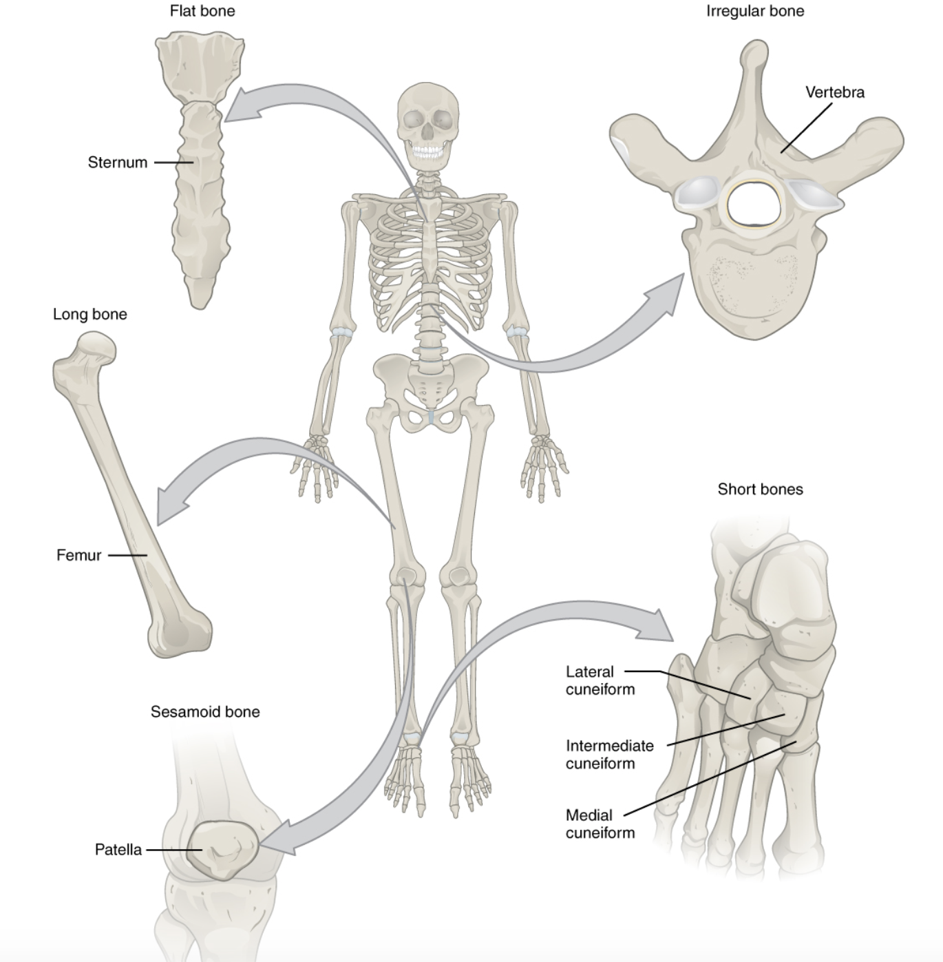
Examining the Gross Anatomy of Bones
Activity 1
Bones come in different shapes.
You are encouraged to view the bone shapes on the articulated skeleton.
Introduction to Bone Tissue

Slide 5
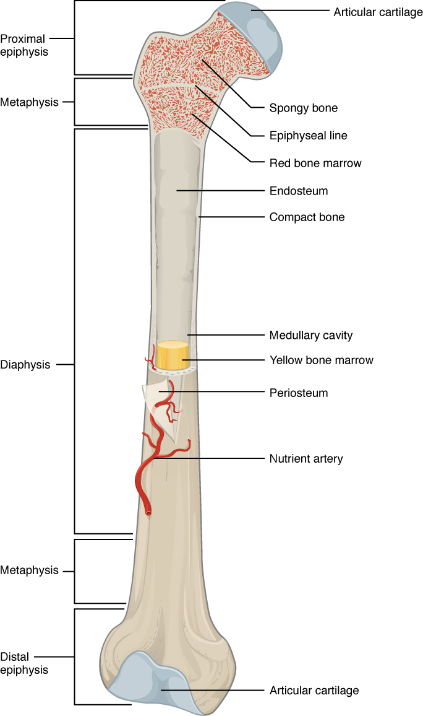
Examining the Gross Anatomy of Bones
Activity 1
Long bones have three regions:
distal epiphysis
proximal epiphysis
diaphysis
(we are not learning the metaphysis in lab)
Now draw your own labelled image of a long bone in the workbook
Introduction to Bone Tissue

Slide 6
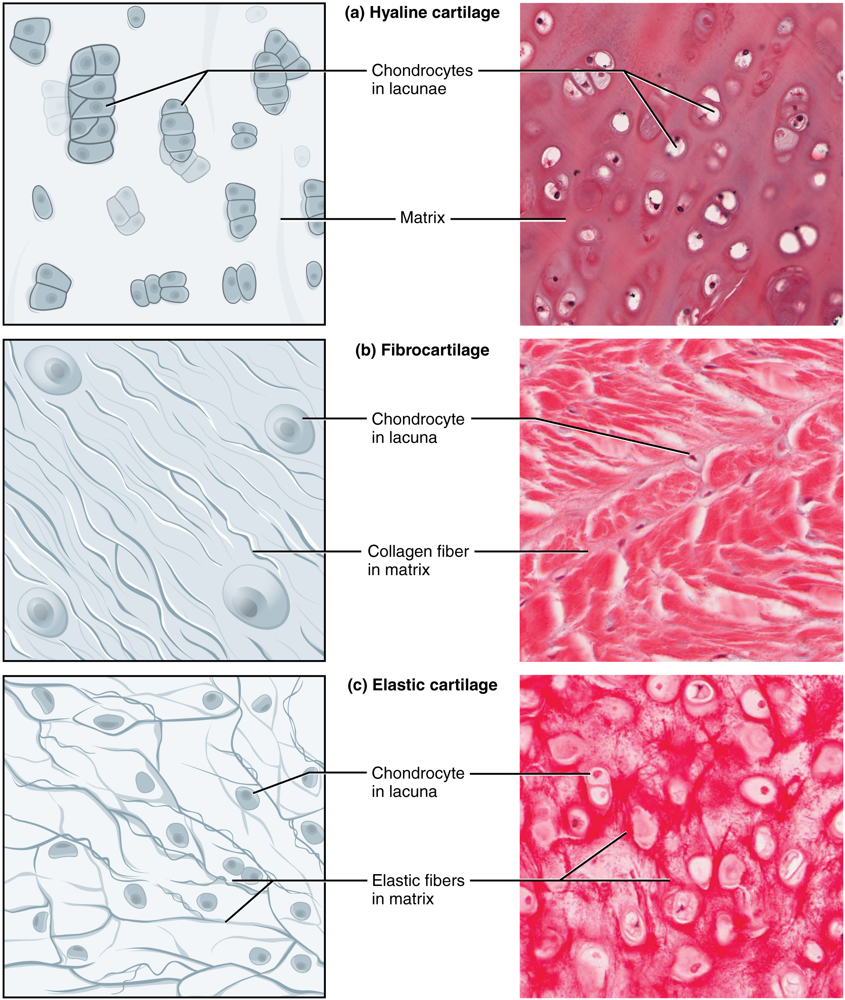
Examining the Cartilage Associated with Bone
Activity 1
You learned the features of cartilage in the histology lab. Here we are reviewing and learning the locations of the types of cartilage on the skeleton.
Introduction to Bone Tissue

Slide 7
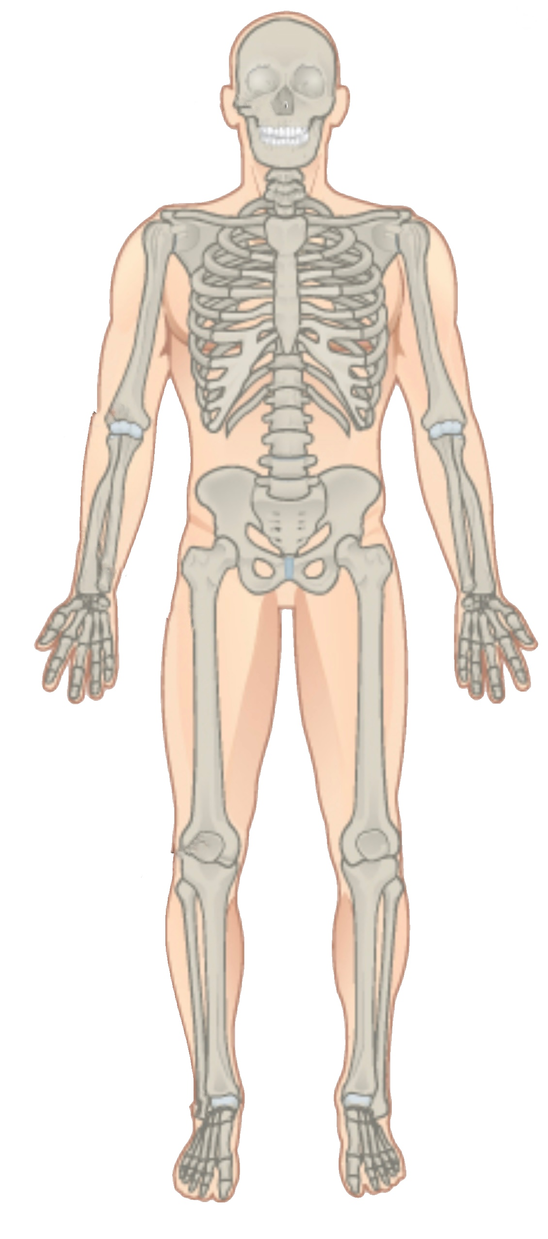
Examining the Cartilage Associated with Bone
Activity 1
Identify the type of cartilage in each area of the skeleton. You will need to know the specific names of these areas as well.
Introduction to Bone Tissue
Cartilage on skeleton

Slide 8
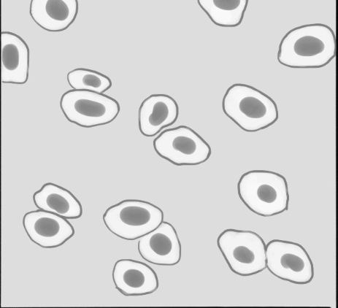
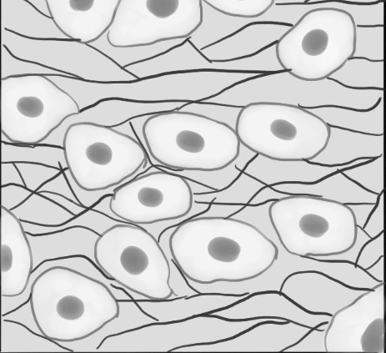
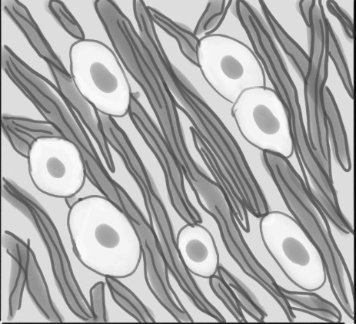
Examining the Cartilage Associated with Bone
Activity 1
Now you will review the three different types of cartilage and identify the structures indicated in the drawings below.
Introduction to Bone Tissue
Type of cell: Name of cavity for cell: Type of fiber:
Type of cartilage:
Cartilage types

Slide 9
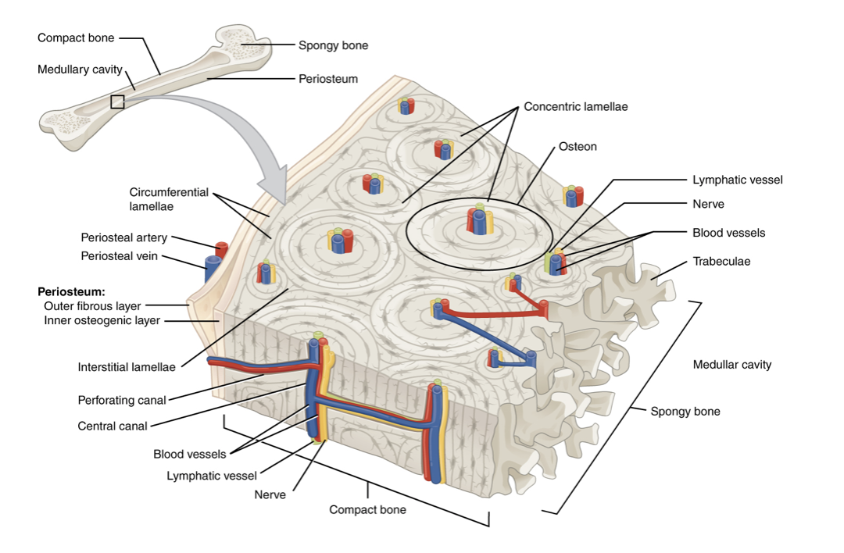
Examining the Microscopic Histology of Bone
Activity 3
Bone can be compact (made of osteons) or spongy (made of trabeculae)
Introduction to Bone Tissue

Slide 10
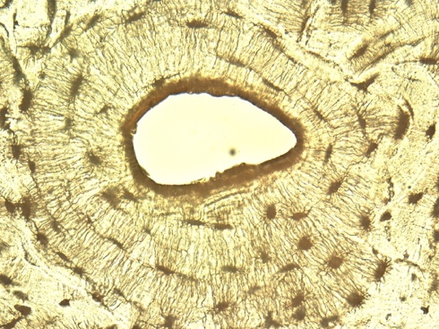
Examining the Microscopic Histology of Bone
Activity 3
Osteons are an organized arrangement of osteocytes and lamellae.
Introduction to Bone Tissue

Slide 11
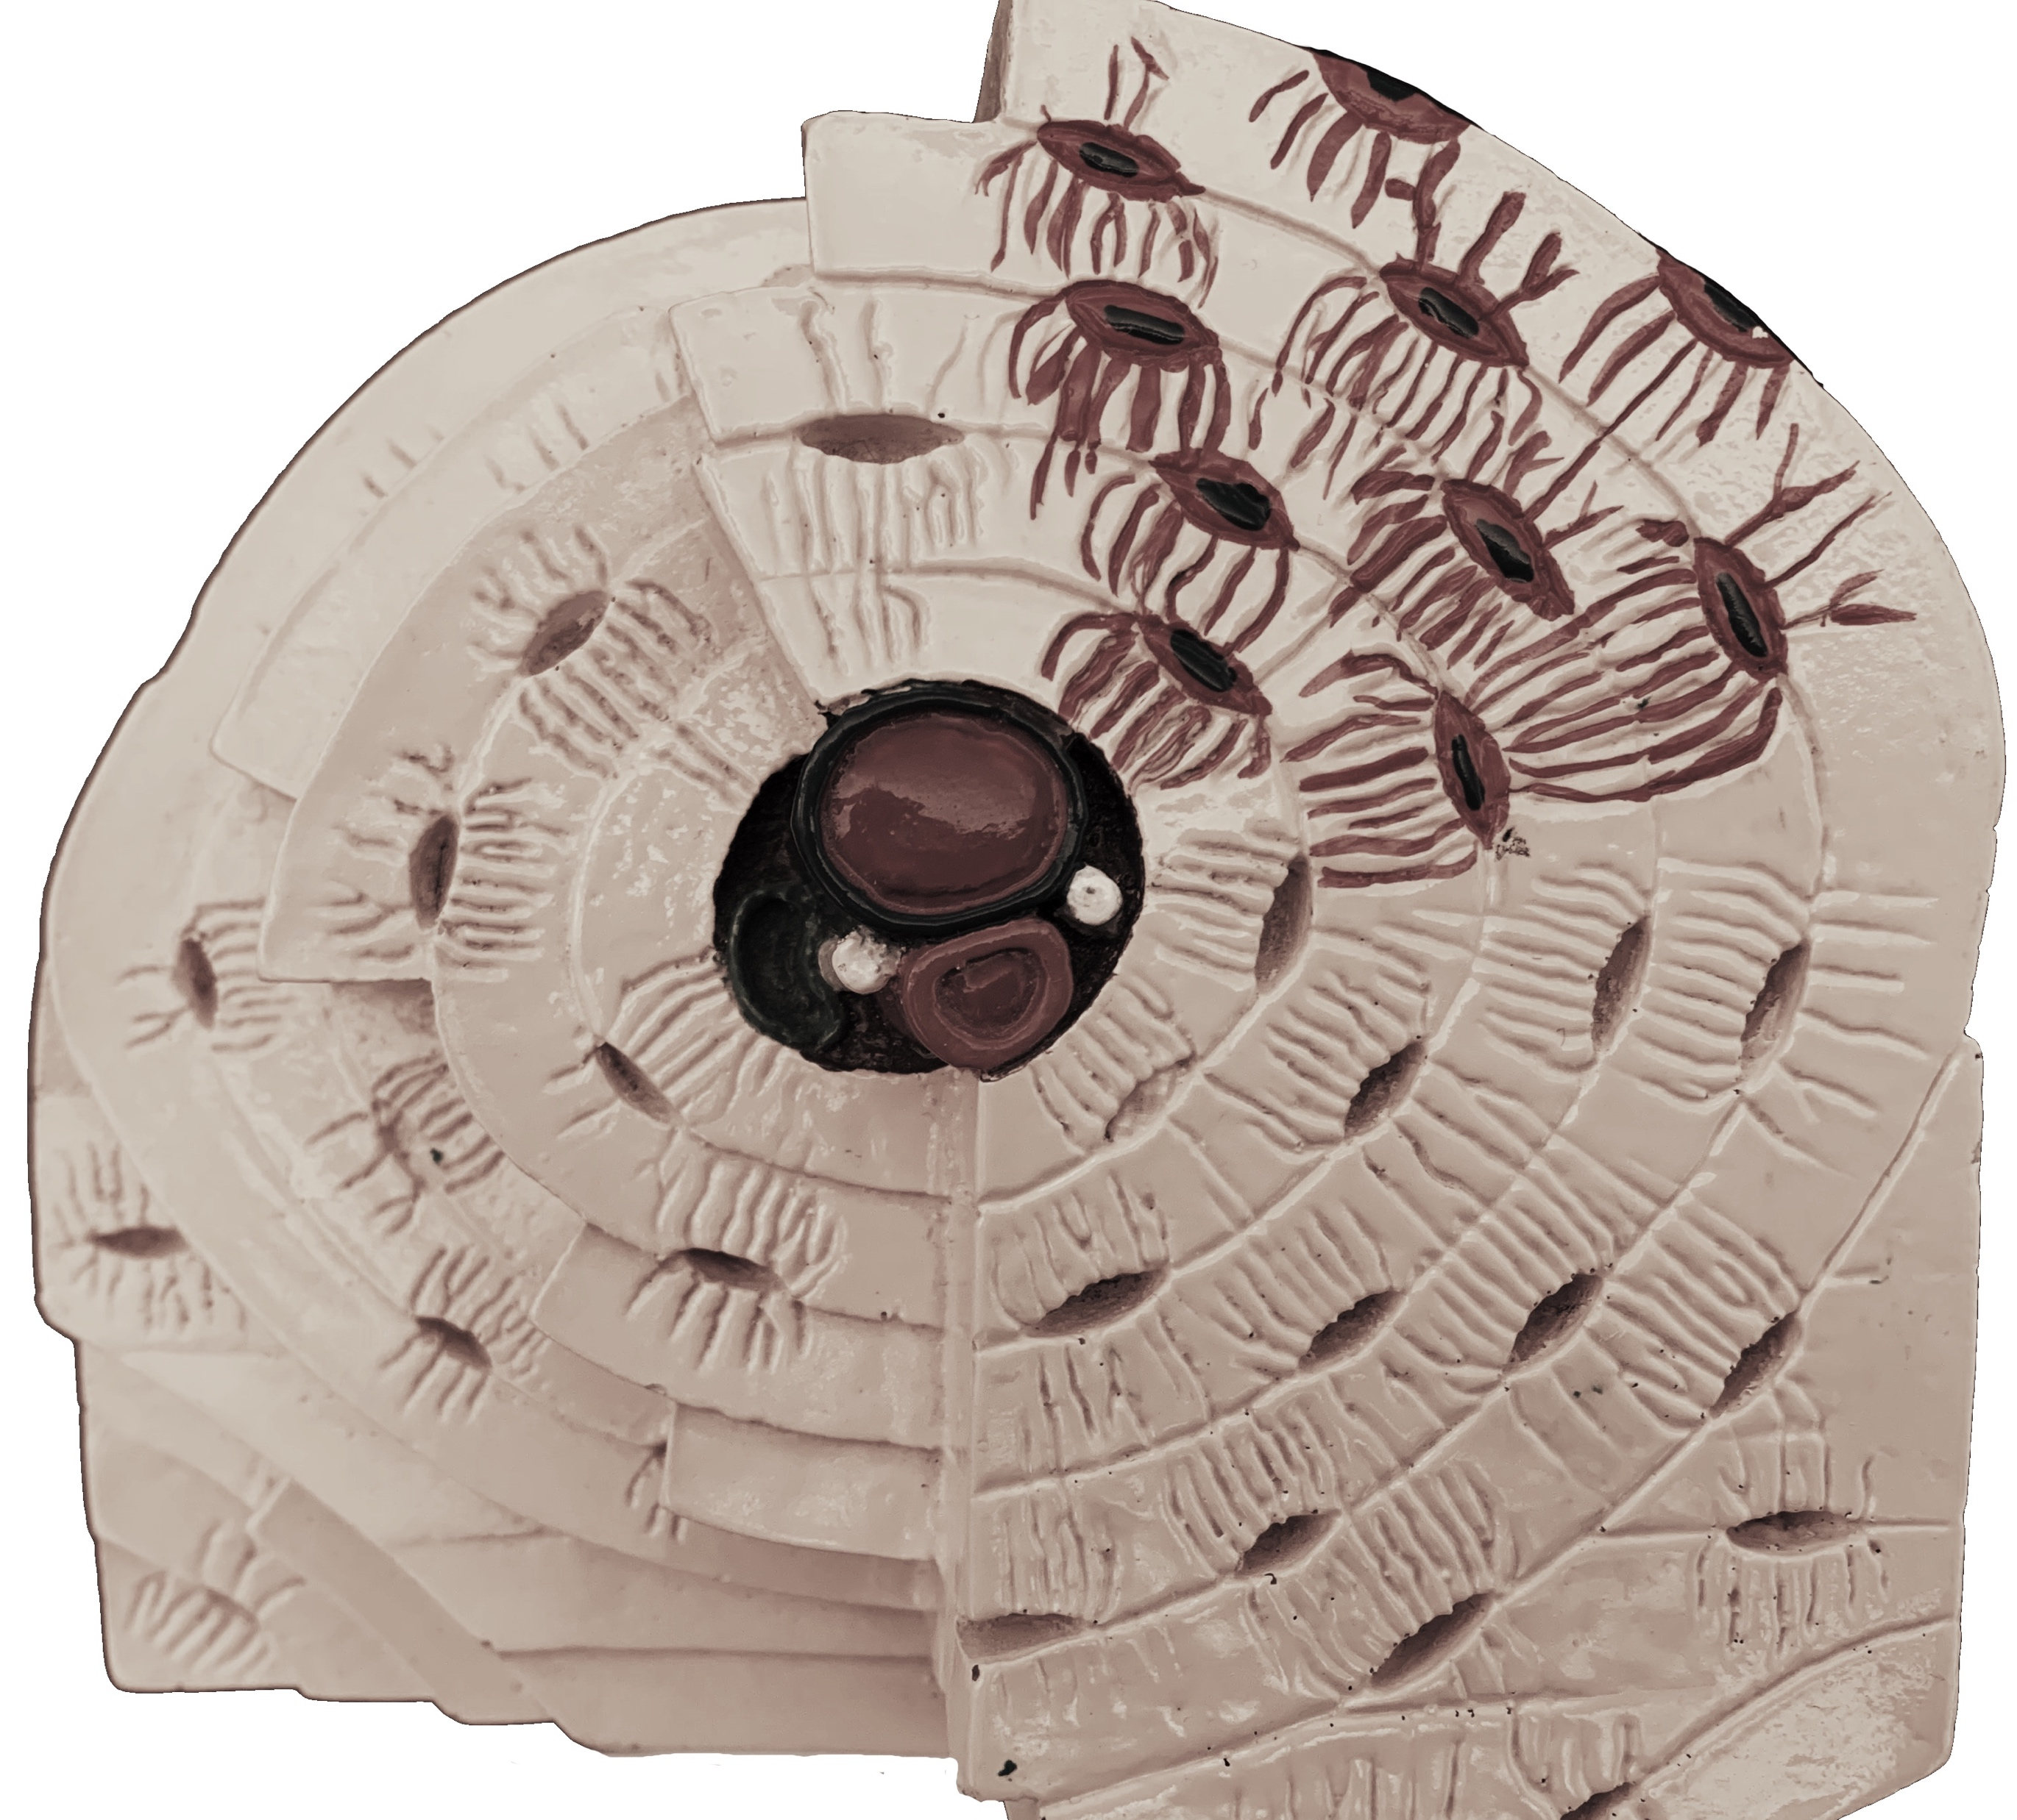
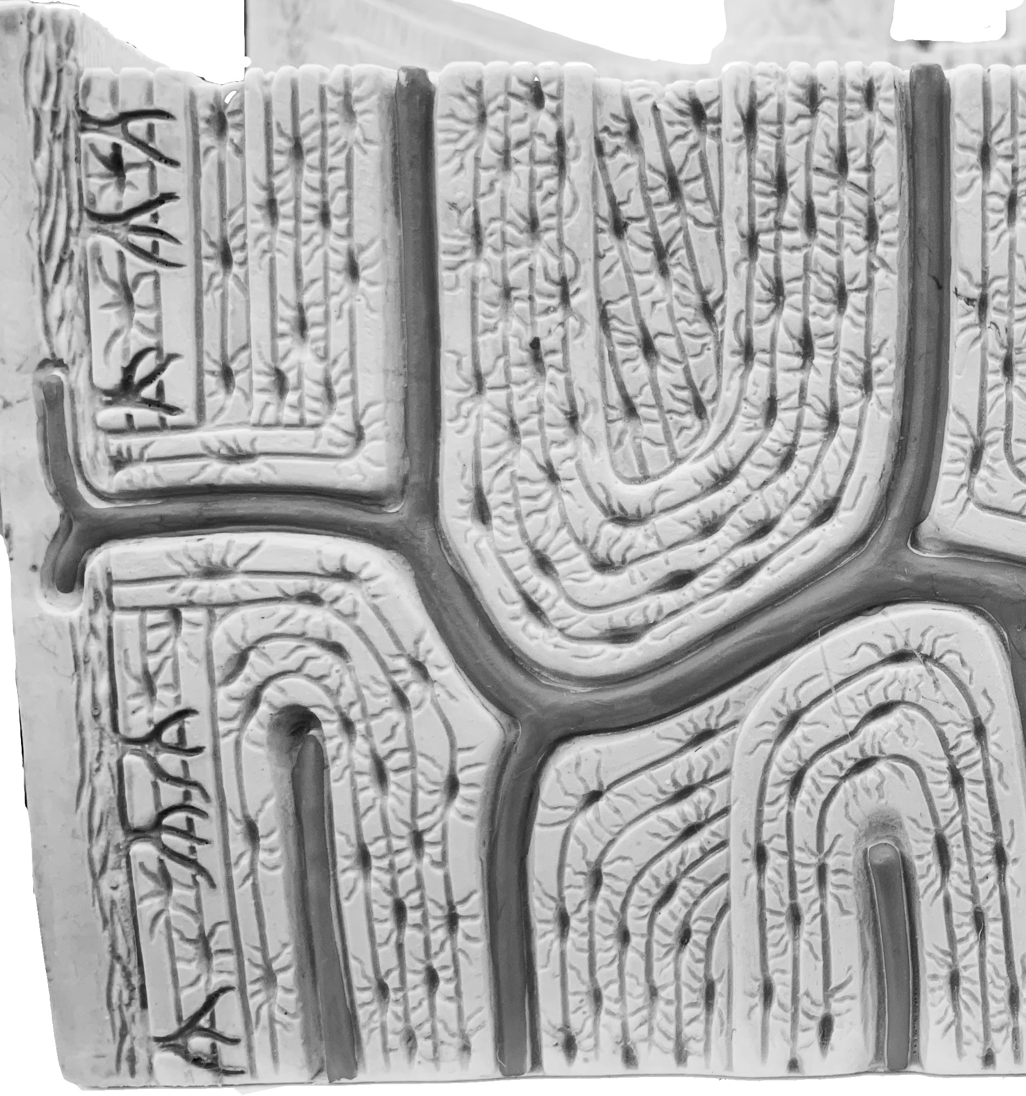
Examining the Microscopic Histology of Bone
Activity 3
You will label the images of the model in your lab manual. These models are also available for you to view in lab as well.
Introduction to Bone Tissue
Osteon models to label

Slide 12
Examining the Microscopic Histology of Bone
Activity 3
Next draw an image of an osteon under a microscope. See if you can identify the different parts. Don’t forget that this tissue is dead so you will not see osteocytes but instead the spaces for the osteocytes in the bone matrix
Introduction to Bone Tissue

Slide 13
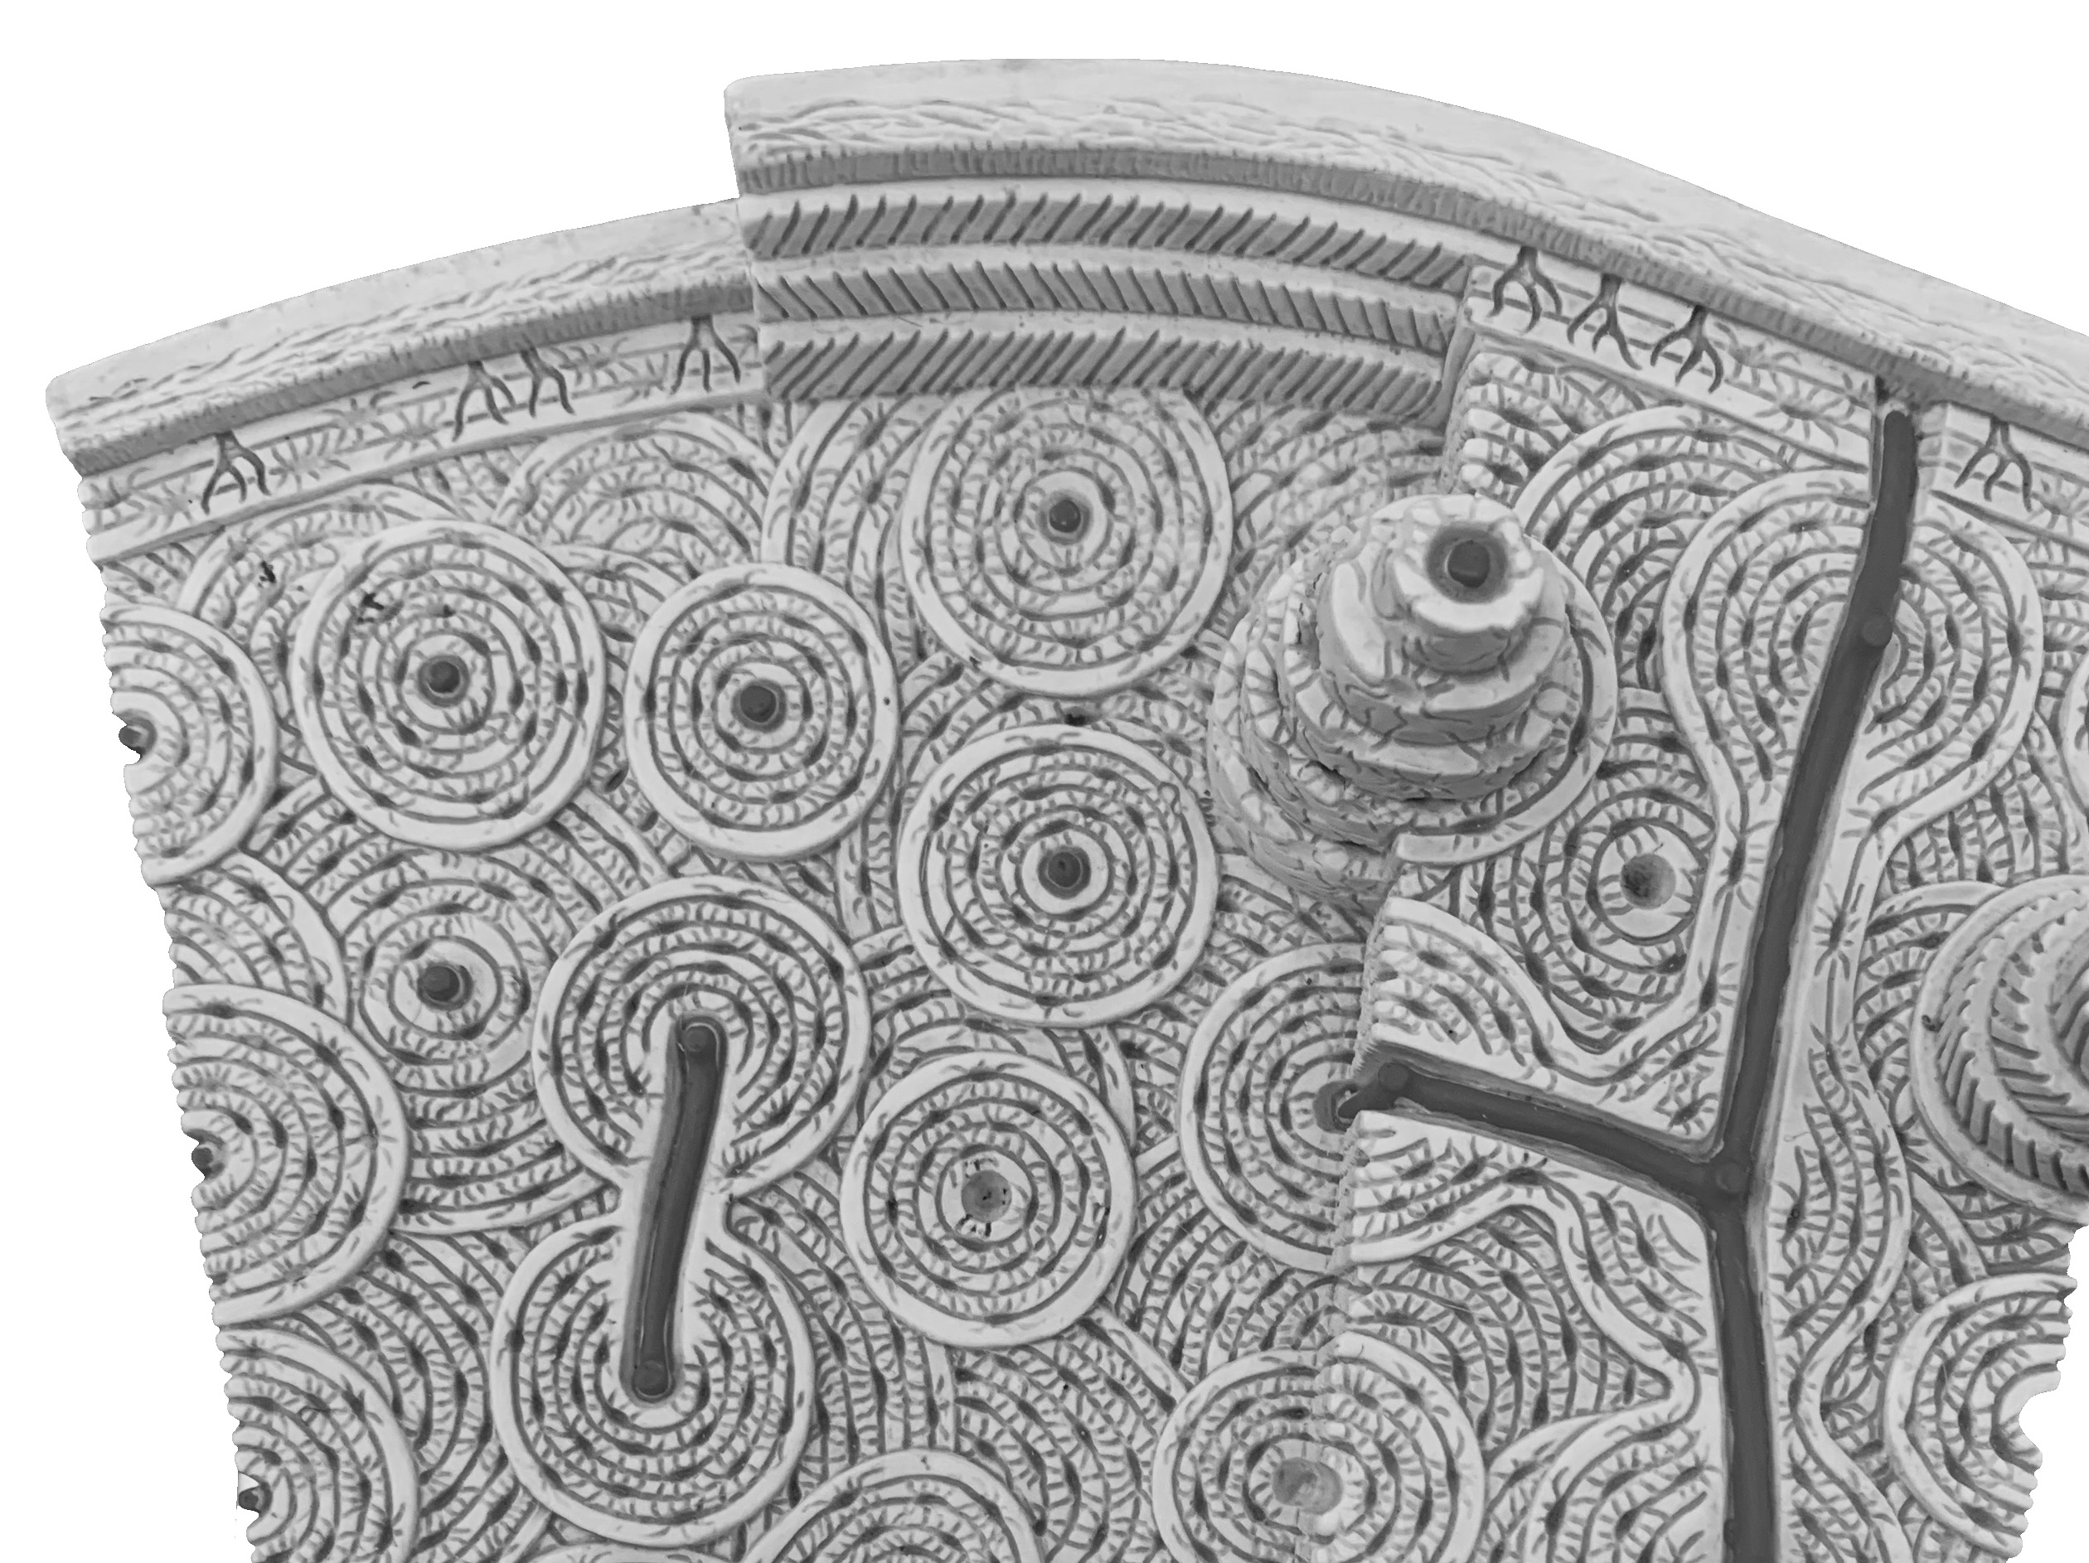
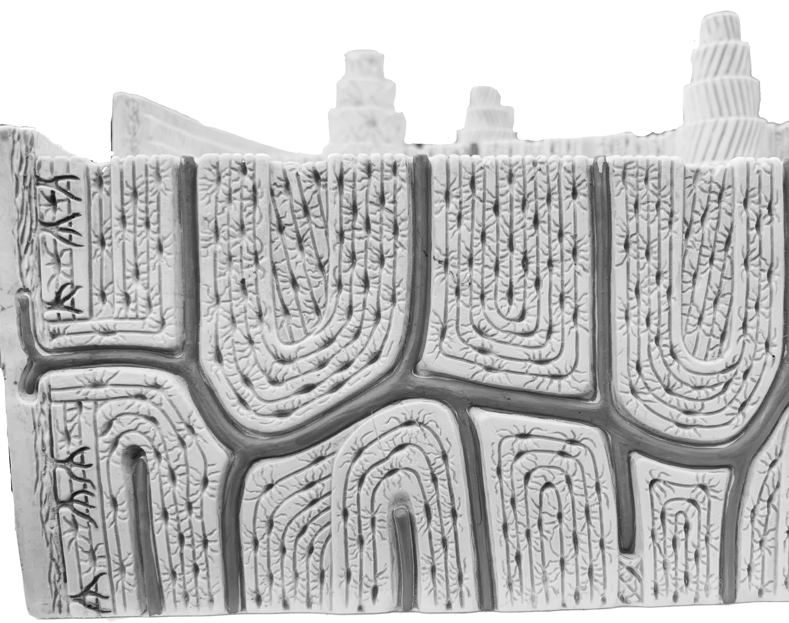
Examining the Microscopic Histology of Bone
Activity 3
Now trace the flow of blood and nutrients though compact bone.
B
N
W
Introduction to Bone Tissue
T
W
B
T
O
N
O
Osteon models nutrient flow

Slide 14
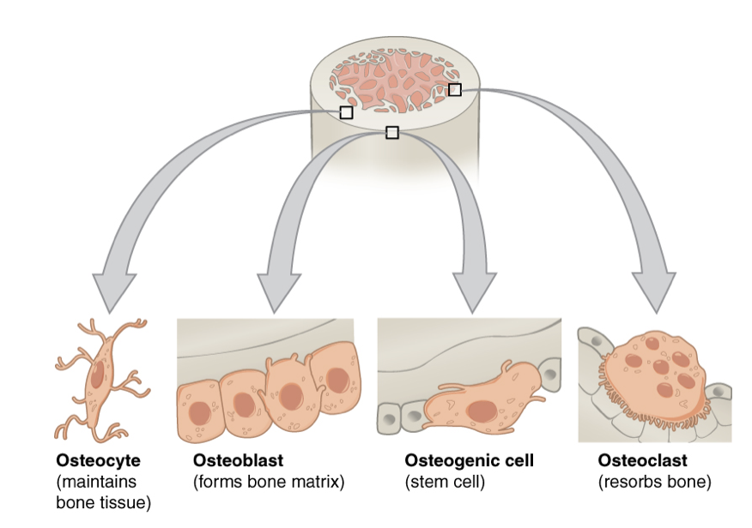
Examining the Components of Bone
Activity 4
The bone matrix is composed of collagenous proteins and hard minerals.
Osteoclast cells reabsorb bone matrix by dissolving the minerals in acid and digesting the proteins with enzymes.
We will mimic the two processes of bone reabsorption using a chicken bone
Introduction to Bone Tissue

Slide 15
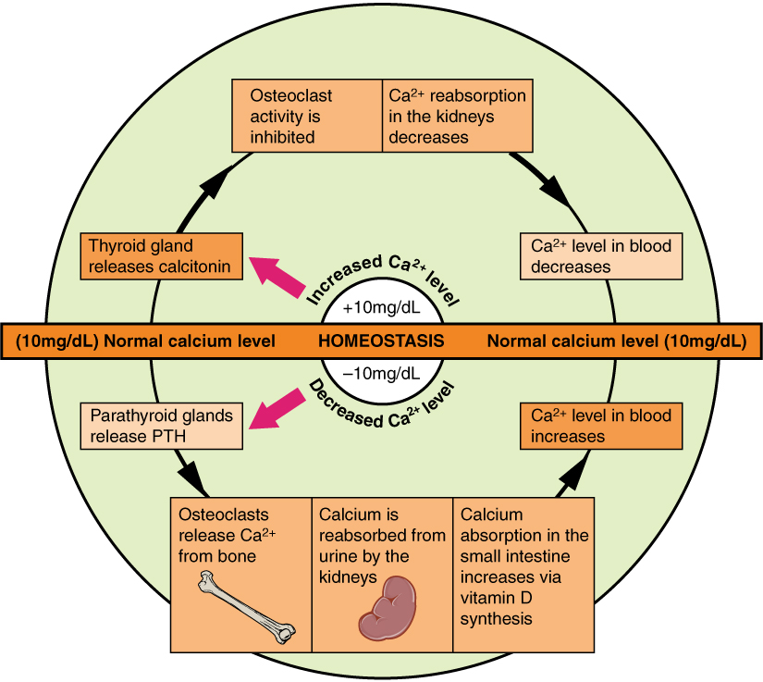
Examining the Components of Bone
Activity 4
Hormones help to regulate the activity of osteoclasts and osteoblasts.
Introduction to Bone Tissue

Slide 16
Examining the Components of Bone
Activity 4
Now observe the raw, acid-soaked and baked bone and make observations about their different bone textures.
 | Raw Bone | Acid-Soaked Bone | Baked Bone
Observations on texture
Component missing in bone matrix | X
Introduction to Bone Tissue

Slide 17
Examining the Components of Bone
Putting it all Together
Read through this section and look at your patient data. In lab today you will determine which values are abnormal. In the post-lab you will reflect on what these values mean for potential bone surgery on this patient.
Introduction to Bone Tissue
 | Vitamin D | Calcium level | Phosphate level | Estrogen level
Patient | 35 ng/mL | 4.6 mg/dL | 2.1 mg/dL | 5 pg/mL
Normal | 20-40 ng/mL | 8.6-10.3 mg/dL blood (UCLA) | 2.8-4.5 mg/dL | <10 pg/mL

Slide 18
Lab Clean-Up: Before you leave be sure to…
Have your instructor check your work.
Place the slides back in the slide boxes
Return the microscopes (remember to put the stage all the way down and leave the scanning objective in place)
Place all the material back in the lab tray neatly
Check the tray supply list with the supplies in the tray
Return the trays to the side table
Introduction to Bone Tissue

