Slide 1
Microscope Lab

Slide 2
Microscope Lab Outline
Activity 1: Parts of a Microscope (in pairs)
Activity 2: Depth of Field (individually)
Activity 3: Field Diameter and Review of Cells (individually)
Microscope Lab

Slide 3
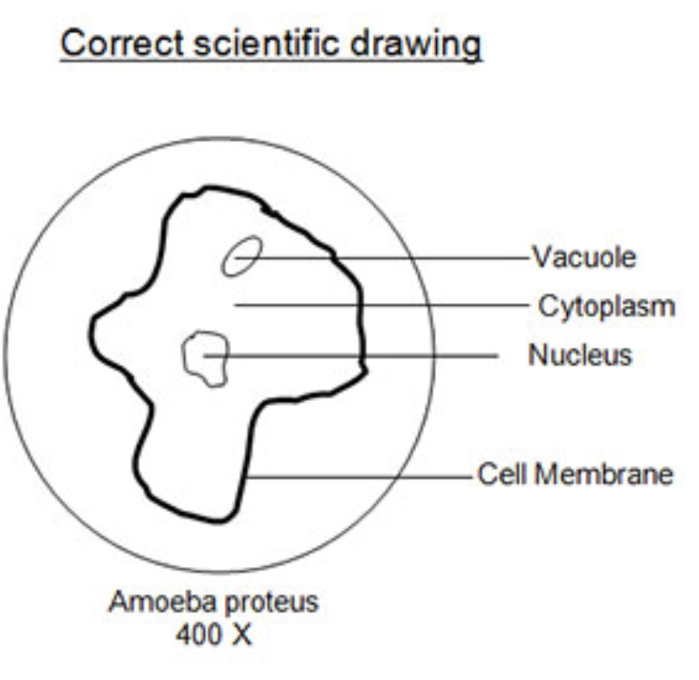
Scientific Drawing
You will draw all images in your lab. Please keep these drawing neat.
Here is a link which shows how to correctly draw a scientific image (no, you don’t need to be an artist)
https://www.thinglink.com/scene/1051158097717886979
Microscope Lab

Slide 4
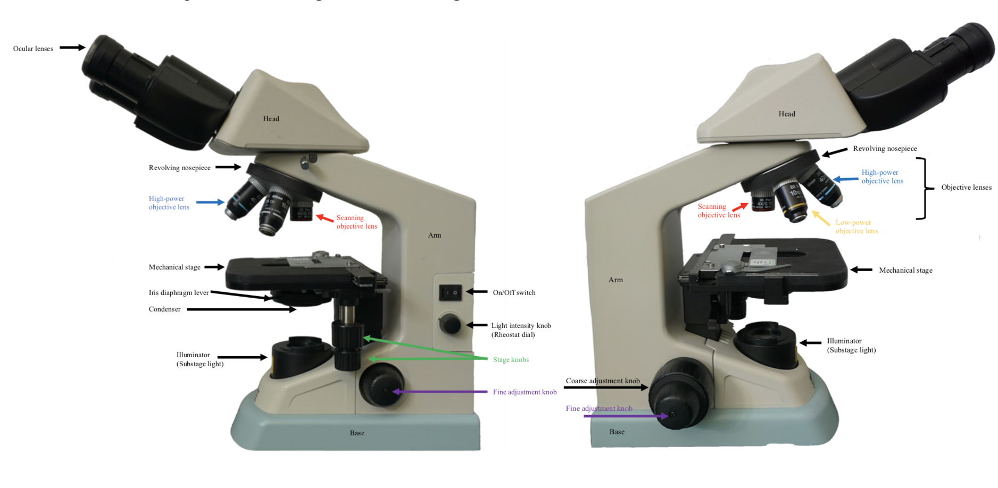
Parts of a Microscope
Activity 1
Microscope Lab
Use the terminology labels to identify the parts of a microscope

Slide 5
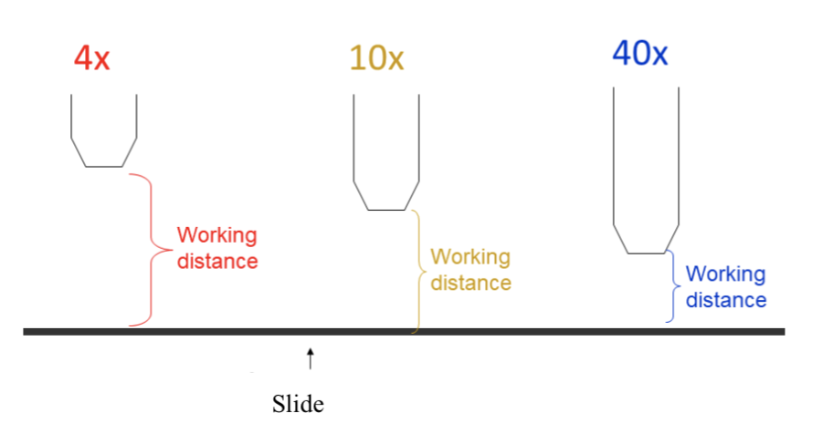
Total Magnification and Working Distance
Activity 1
Total Magnification = Magnification of ocular lens x magnification of objective lens
Working distance = distance between objective lens and the slide
Microscope Lab

Slide 6
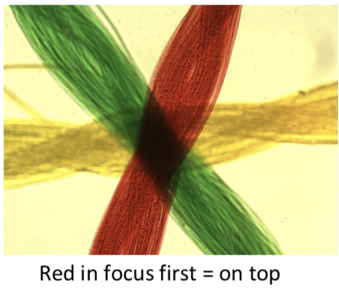
Depth of Field
Activity 2
Depth of field measures the thickens of a specimen seen in view at one time.
Microscope Lab

Slide 7
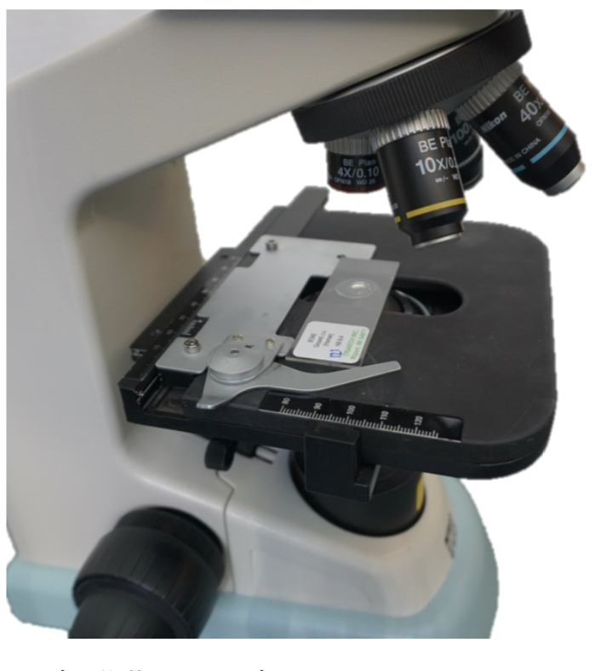
Depth of Field
Activity 2
Work individually to to place the string slide correctly on the microscope and then identify the order of the strings on the slide. Every slide is different!
Microscope Lab

Slide 8
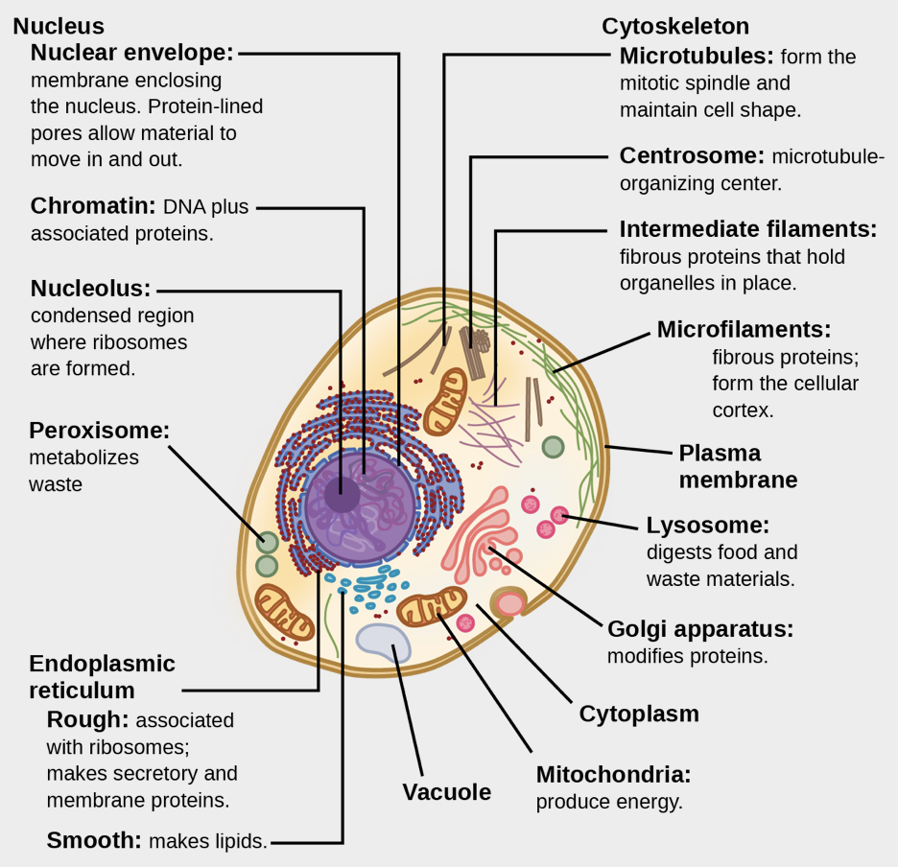
Field Diameter and Review of Cells
Activity 3
We will now review the parts of a cell. This is not in your lab book.
Microscope Lab
Cell Tour Video posted on canvas as extra study material:
https://www.wisc-online.com/learn/natural-science/life-science/ap11403/a-typical-animal-cell
© Openstax

Slide 9
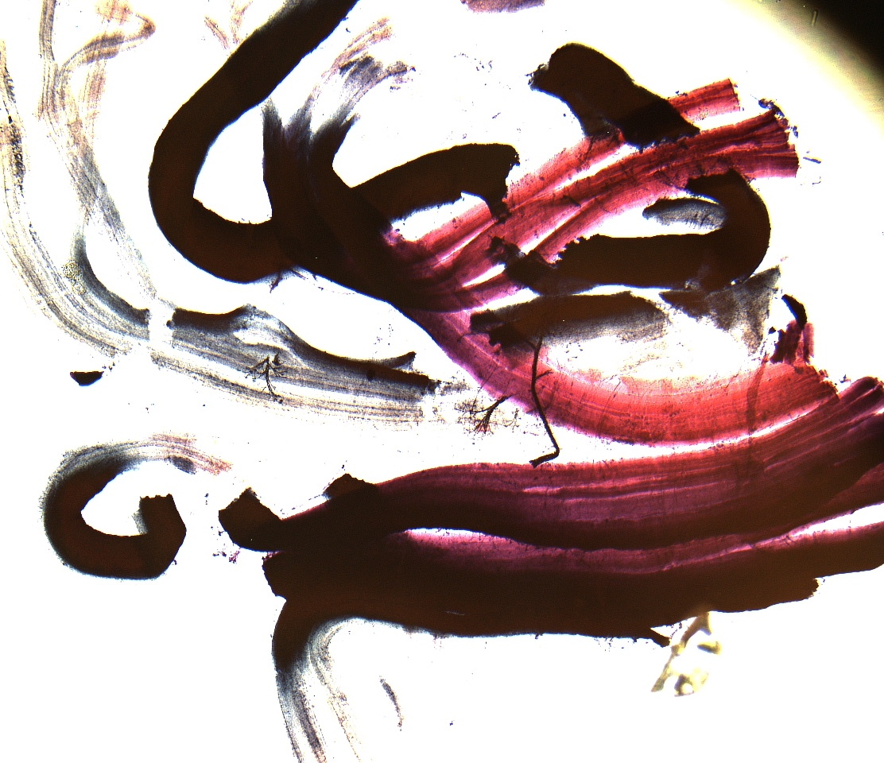
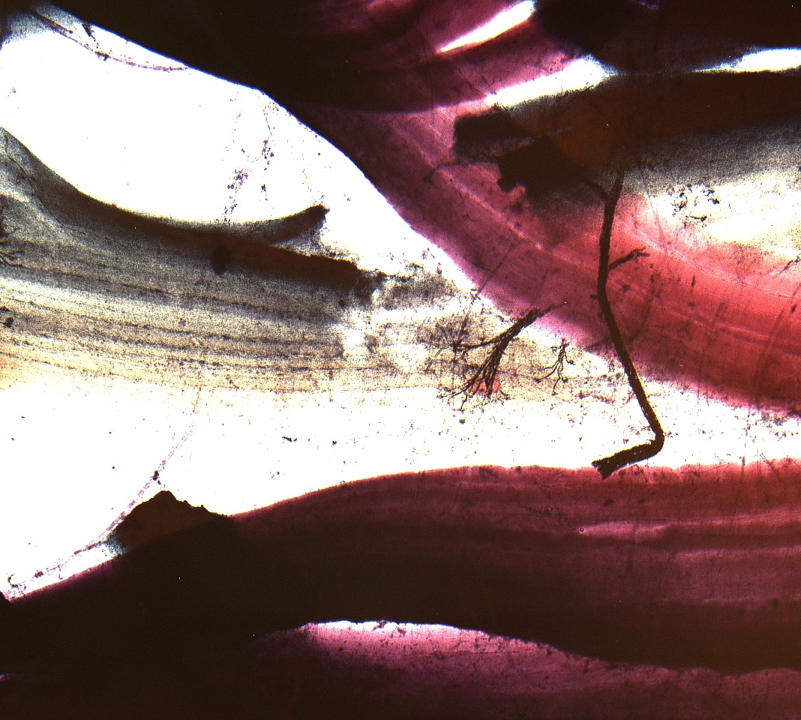
Field Diameter and Review of Cells
Activity 3
Microscope Lab
Motor end plate
View the image of the peripheral nerve. Label the two different cells, skeletal cell and nerve cell.

Slide 10
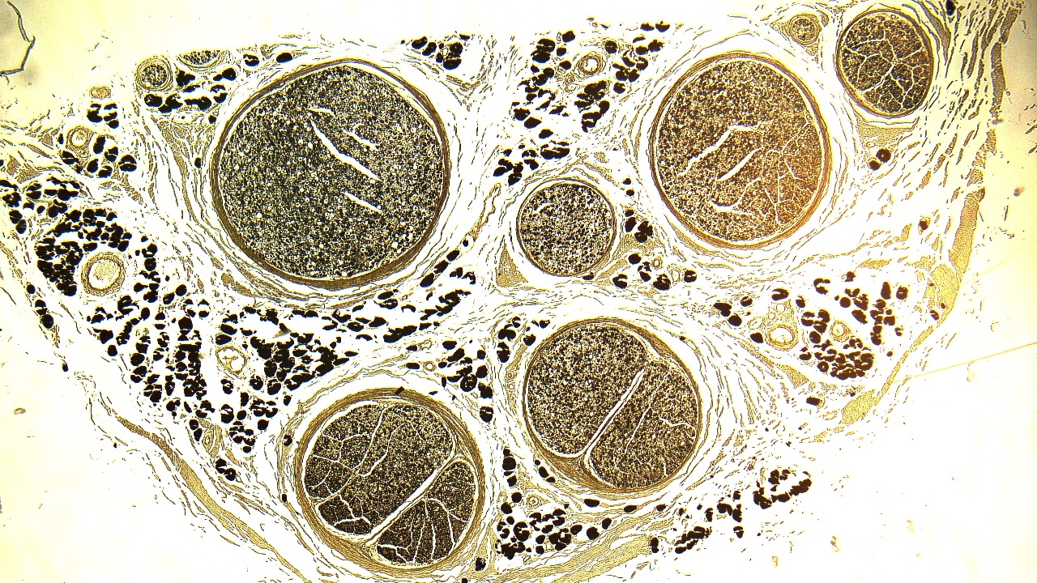
Field Diameter and Review of Cells
Activity 3
Fascicle
Nerve
Microscope Lab
Peripheral nerve
Use this image and the slide of the peripheral nerve in cross section to view a single neuron and draw it using the high-power lens. How did the field of diameter change as you went up in magnification?

Slide 11
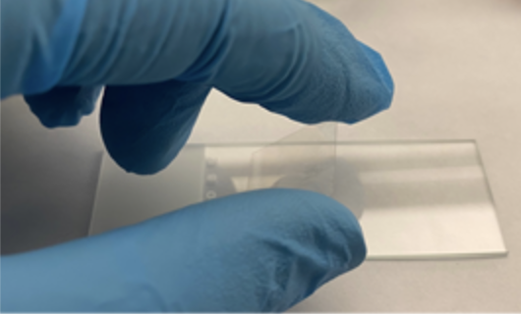
Field Diameter and Review of Cells
Activity 3
You are now going to create a wet mount and view your cheek cells under the microscope.
Follow the instructions in the lab manual for creating the slide. Please wear gloves!
Microscope Lab

Slide 12
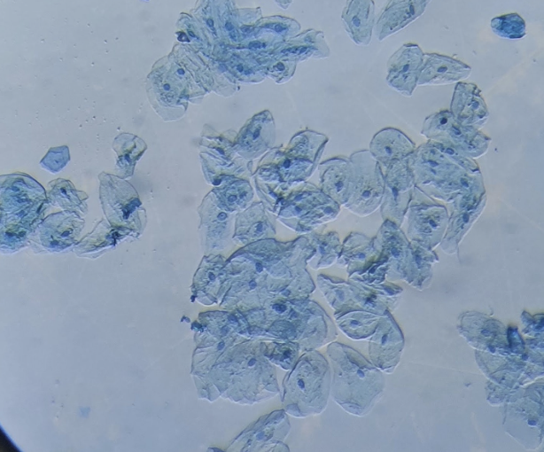
Field Diameter and Review of Cells
Activity 3
To view the cells under the microscope, you will need to move the iris diaphragm lever down (to the right).
Draw a picture of the cells and label the parts.
Microscope Lab
© AwesomeBioChem

Slide 13
Clean-up
Before putting the microscope away…
lower the stage
click the scanning lens in view
unplug and coil the cord
place the microscope with the handle facing out in the cupboard
Microscope Lab

Slide 14
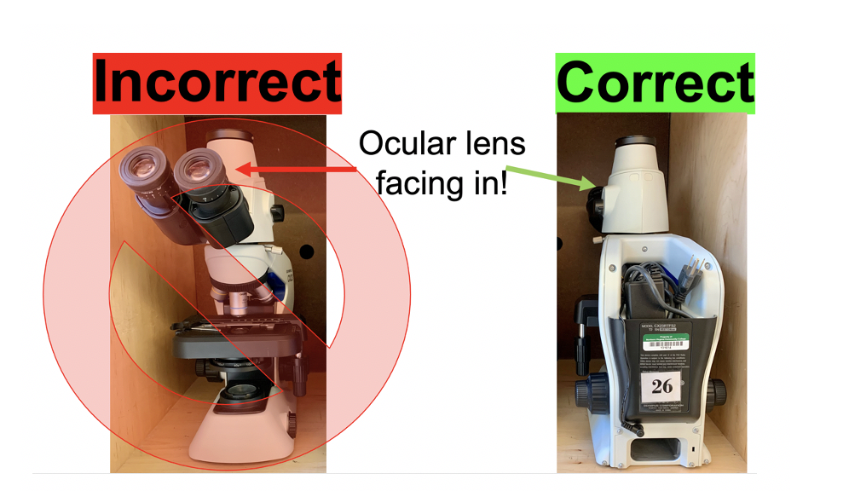
Clean up!
Be sure you answered all questions in the lab
Clean your lab station, put the material away neatly
Put the microscope away correctly
Wipe down your table with disinfectant
Make sure all labels are placed back in the correct spots on the terminology sheets
Don’t forget to submit the post-lab
Microscope Lab

