Slide 1
Muscles
Bio141 OER Lab Manual © 2022 by H. Wangerin, P. Rodgers, G. Backus is licensed under CC BY-NC-SA 4.0

Slide 2
Muscles
Case Study “Too Tired to Stand”
Activity 1: Muscle Actions (in pairs)
Activity 2: Muscles and the Axial Skeleton (in pairs)
Activity 3: Muscles of the Appendicular Skeleton (in pairs)
Muscles

Slide 3
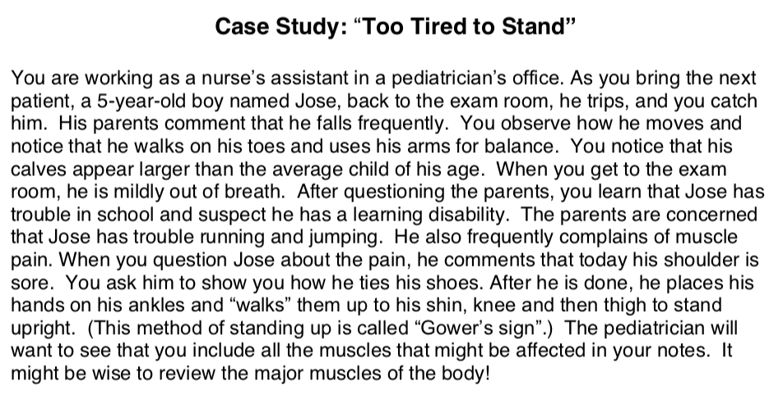
Case Study: “Too Tired to Stand”
Have you read the instruction book? You need to read the Case Study and answers the questions.
Muscles
Bio141 OER Lab Manual © 2022 by H. Wangerin, P. Rodgers, G. Backus is licensed under CC BY-NC-SA 4.0

Slide 4
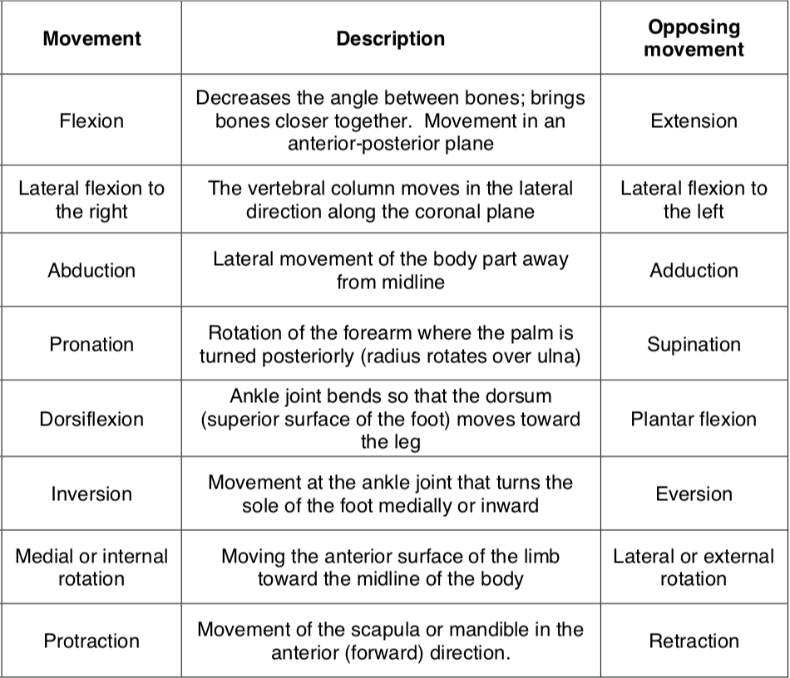
Muscle Actions
Activity 1
Muscles

Slide 5
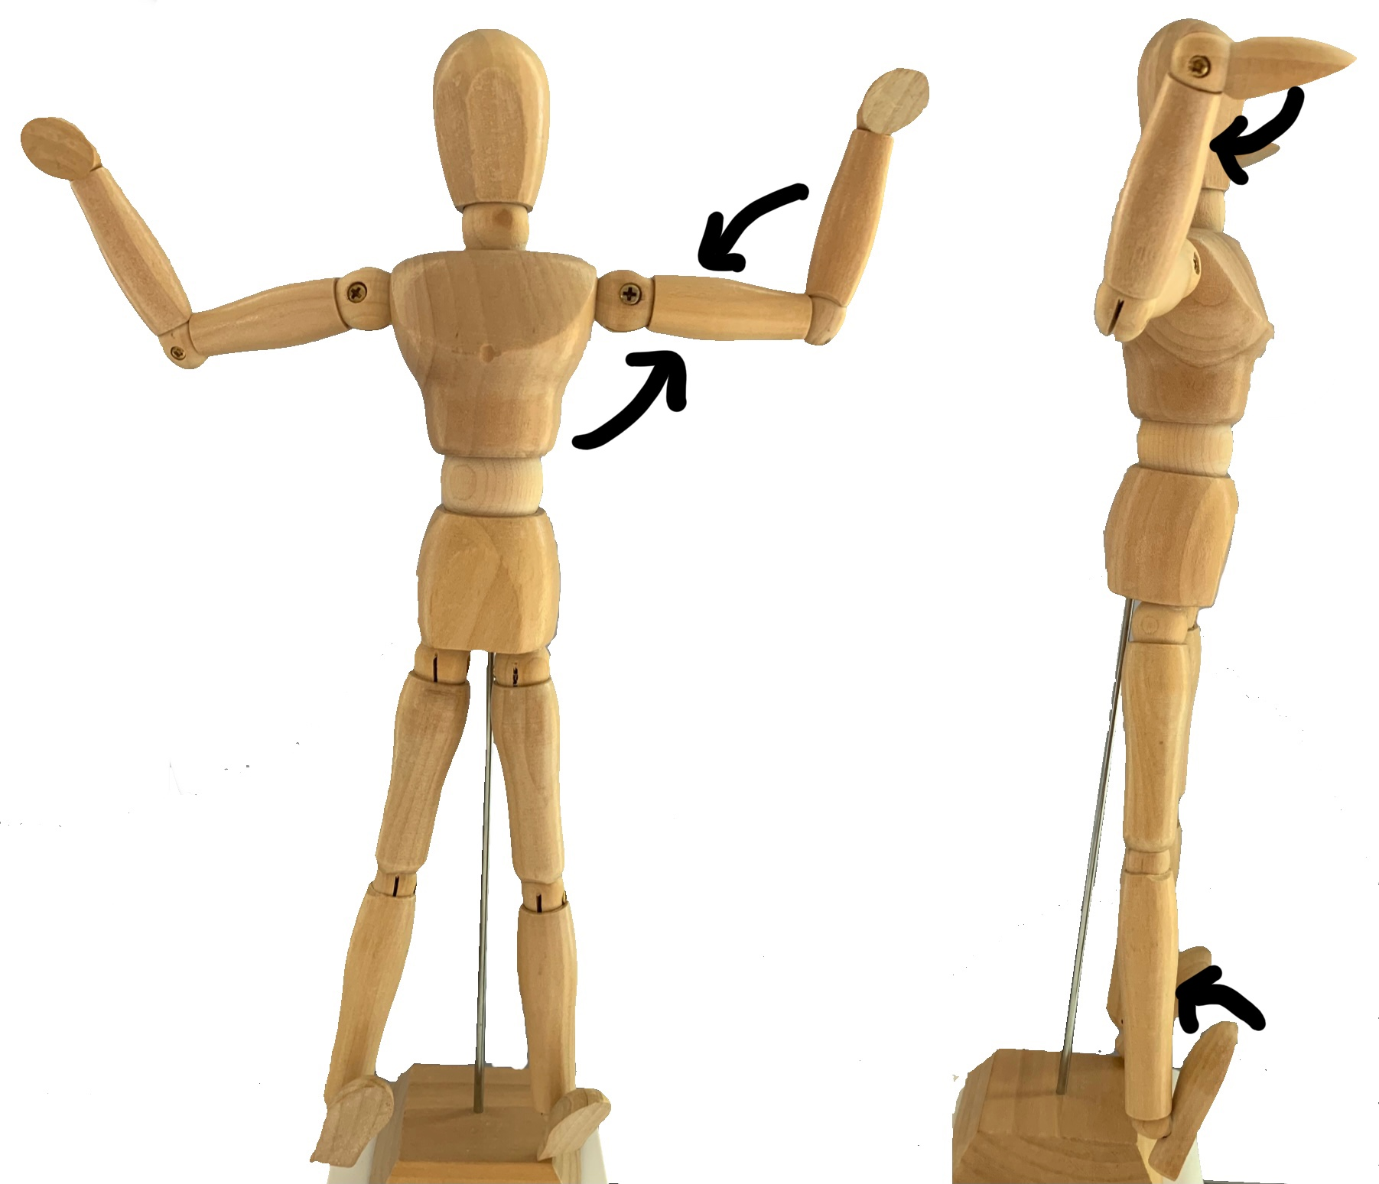
Muscle Actions
Activity 1
View the images in the lab book and identify the muscle movements being demonstrated.
Muscles
1
3
Arrow | Movement
1
2
3
4
2
4
Joint movements
Bio141 OER Lab Manual © 2022 by H. Wangerin, P. Rodgers, G. Backus is licensed under CC BY-NC-SA 4.0

Slide 6
Muscle Actions
Activity 1
Draw an arrow on the images to indicated the movement during muscle contraction (the first one is done for you).
Muscles
Adduction and lateral rotation
Movement:
Muscle action predictions
Bio141 OER Lab Manual © 2022 by H. Wangerin, P. Rodgers, G. Backus is licensed under CC BY-NC-SA 4.0

Slide 7
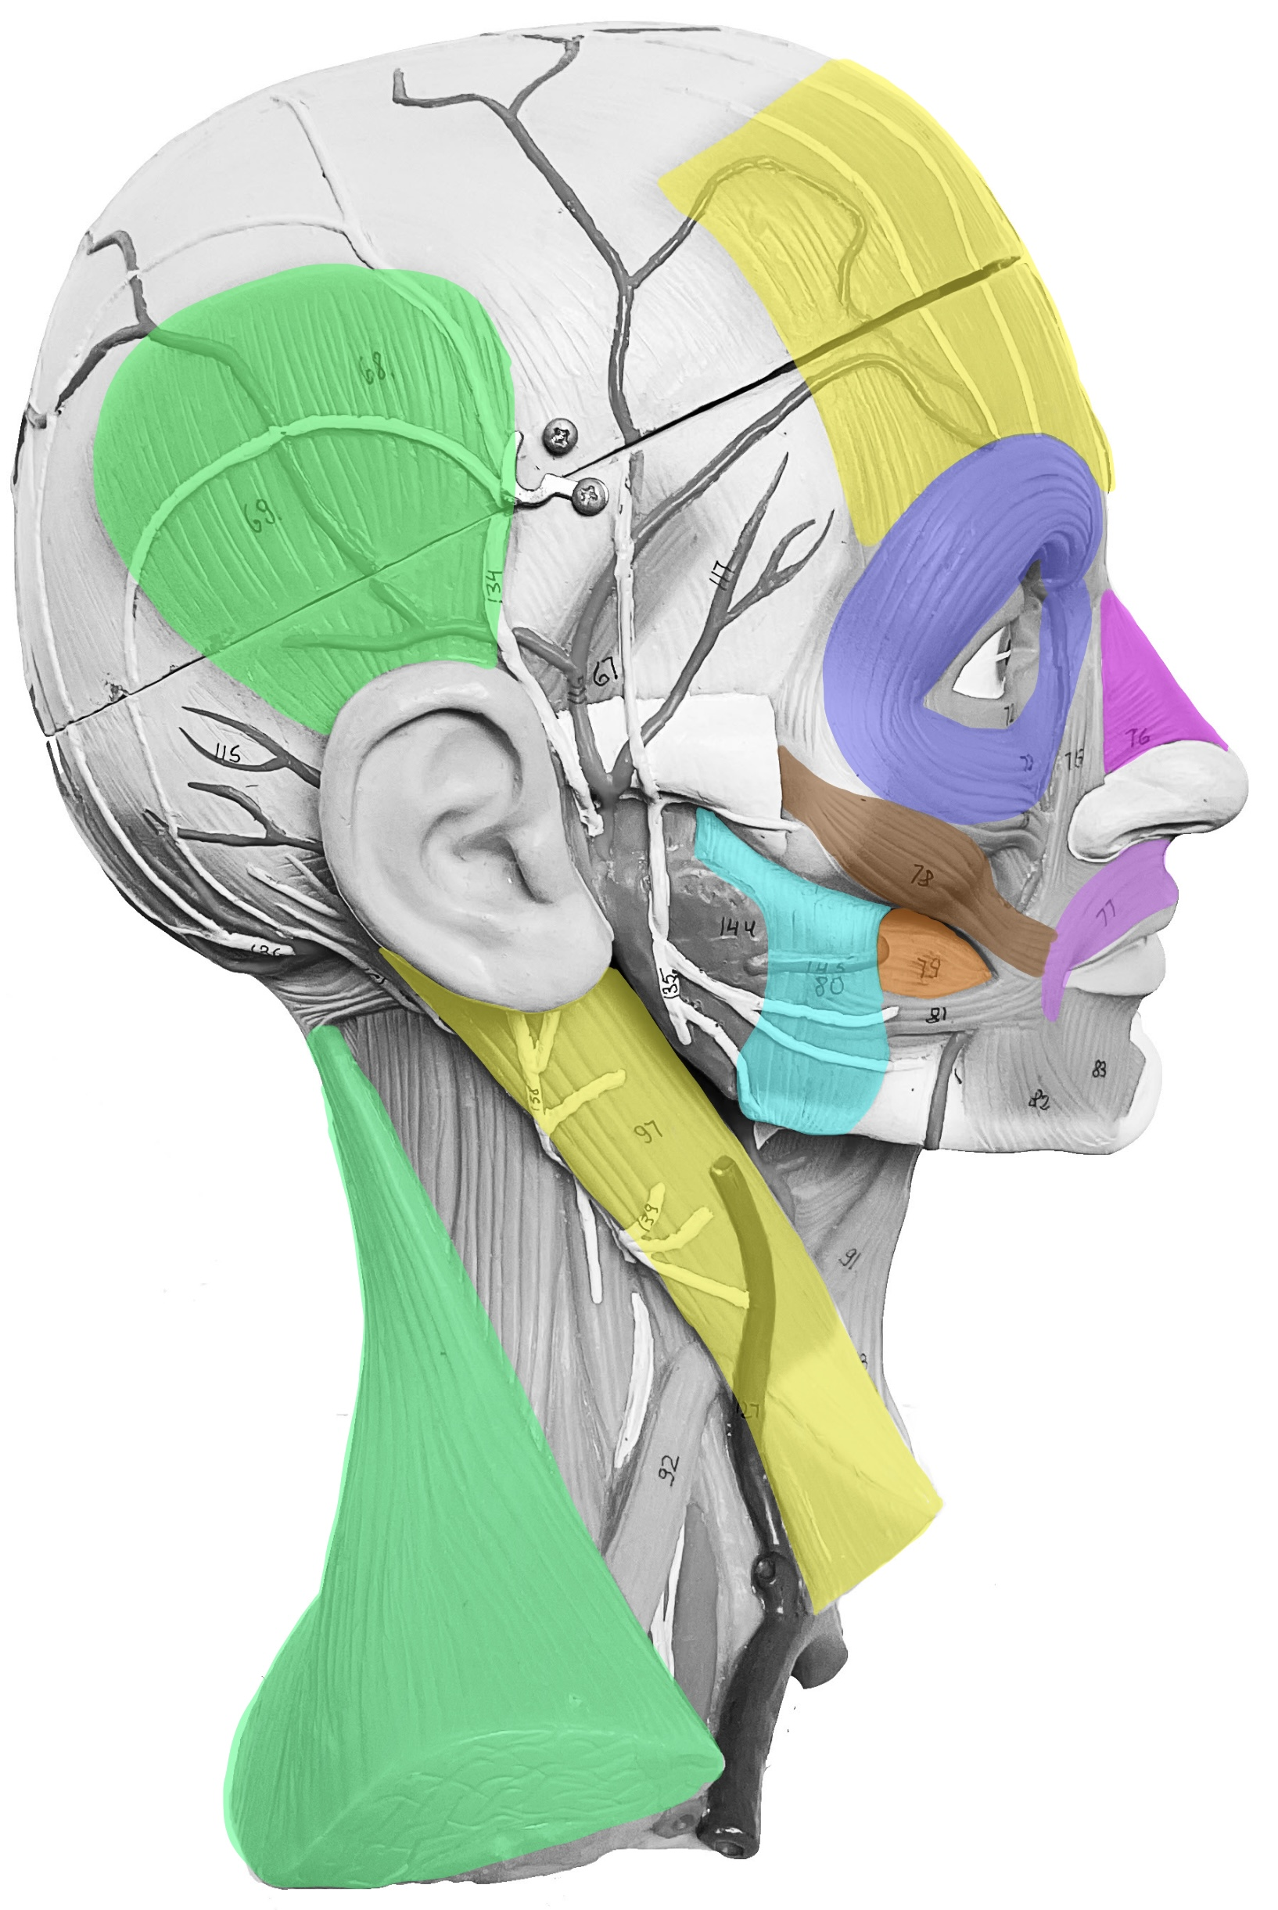
Muscles of the Axial Skeleton
Activity 2
Label the image of the muscle model (head and torso) by drawing lines between the term and the muscles, and then label the muscles on the model using the laminated labels.
Quiz one another!
Frontalis
Temporalis
Nasalis
Muscles
Orbicularis oculi
Zygomaticus
Masseter
Orbicularis oris
Buccinator
Sternocleidomastoid
Trapezius
Head muscles to label
Bio141 OER Lab Manual © 2022 by H. Wangerin, P. Rodgers, G. Backus is licensed under CC BY-NC-SA 4.0

Slide 8
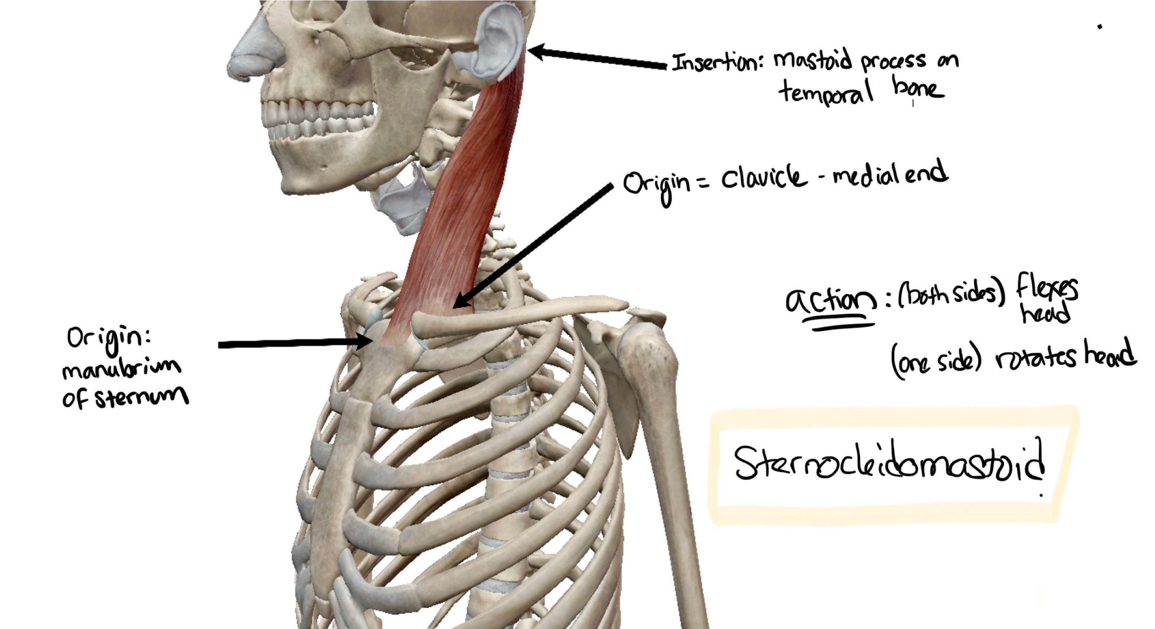
Muscles of the Axial Skeleton
Activity 2
Muscles
© Visible body

Slide 9
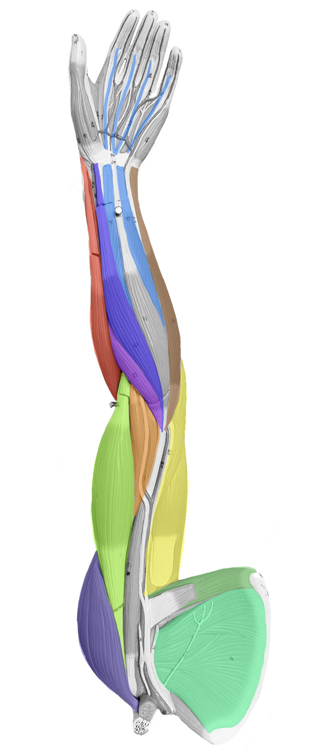
Muscles of the Appendicular Skeleton
Activity 3
Flexor digitorum superficialis
Label the image of the muscle model (arm and leg) by drawing lines between the term and the muscles, and then label the muscles on the model using the laminated labels.
Quiz one another!
Brachioradialis
Flexor carpi radialis
Flexor carpi ulnaris
Muscles
Pronator teres
Brachialis
Triceps brachii
Biceps brachii
Teres major
Deltoid
Subscapularis
Bio141 OER Lab Manual © 2022 by H. Wangerin, P. Rodgers, G. Backus is licensed under CC BY-NC-SA 4.0
Anterior arm muscles to label

Slide 10
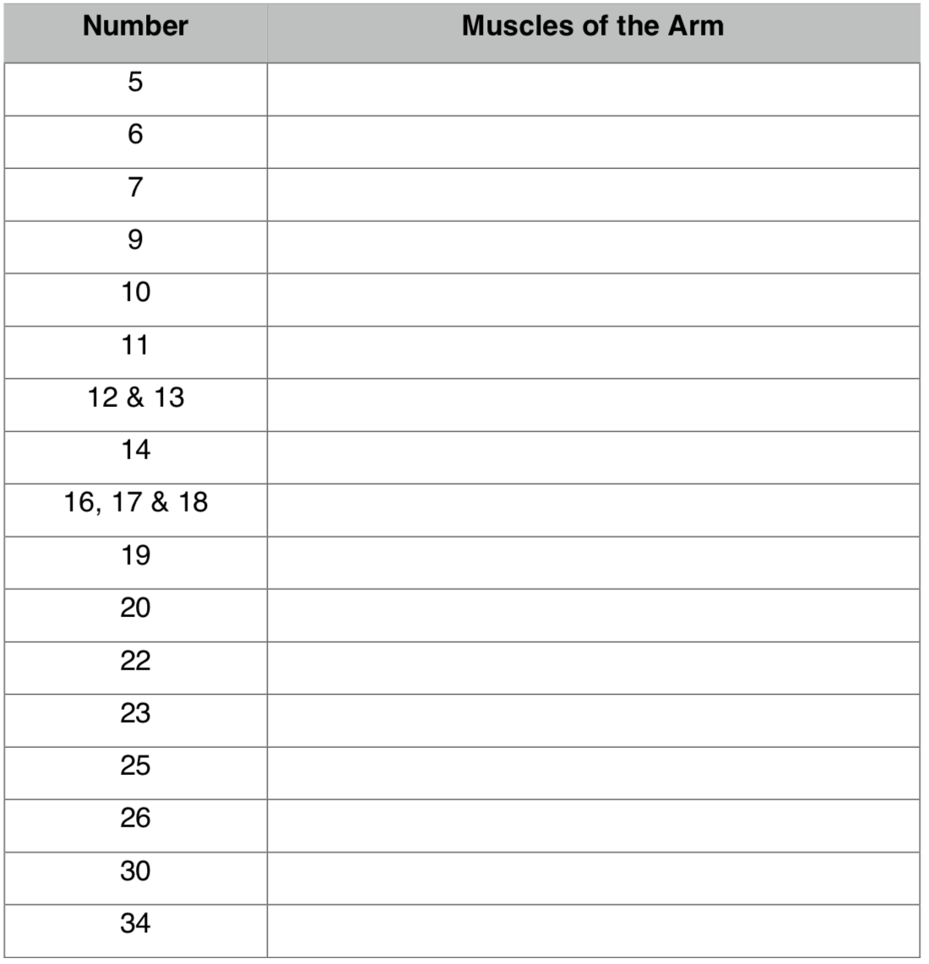
Muscles of the Appendicular Skeleton
Activity 3
Complete the chart using the numbers on the muscle model.
Quiz one another!
Repeat procedure for the leg.
Muscles

Slide 11
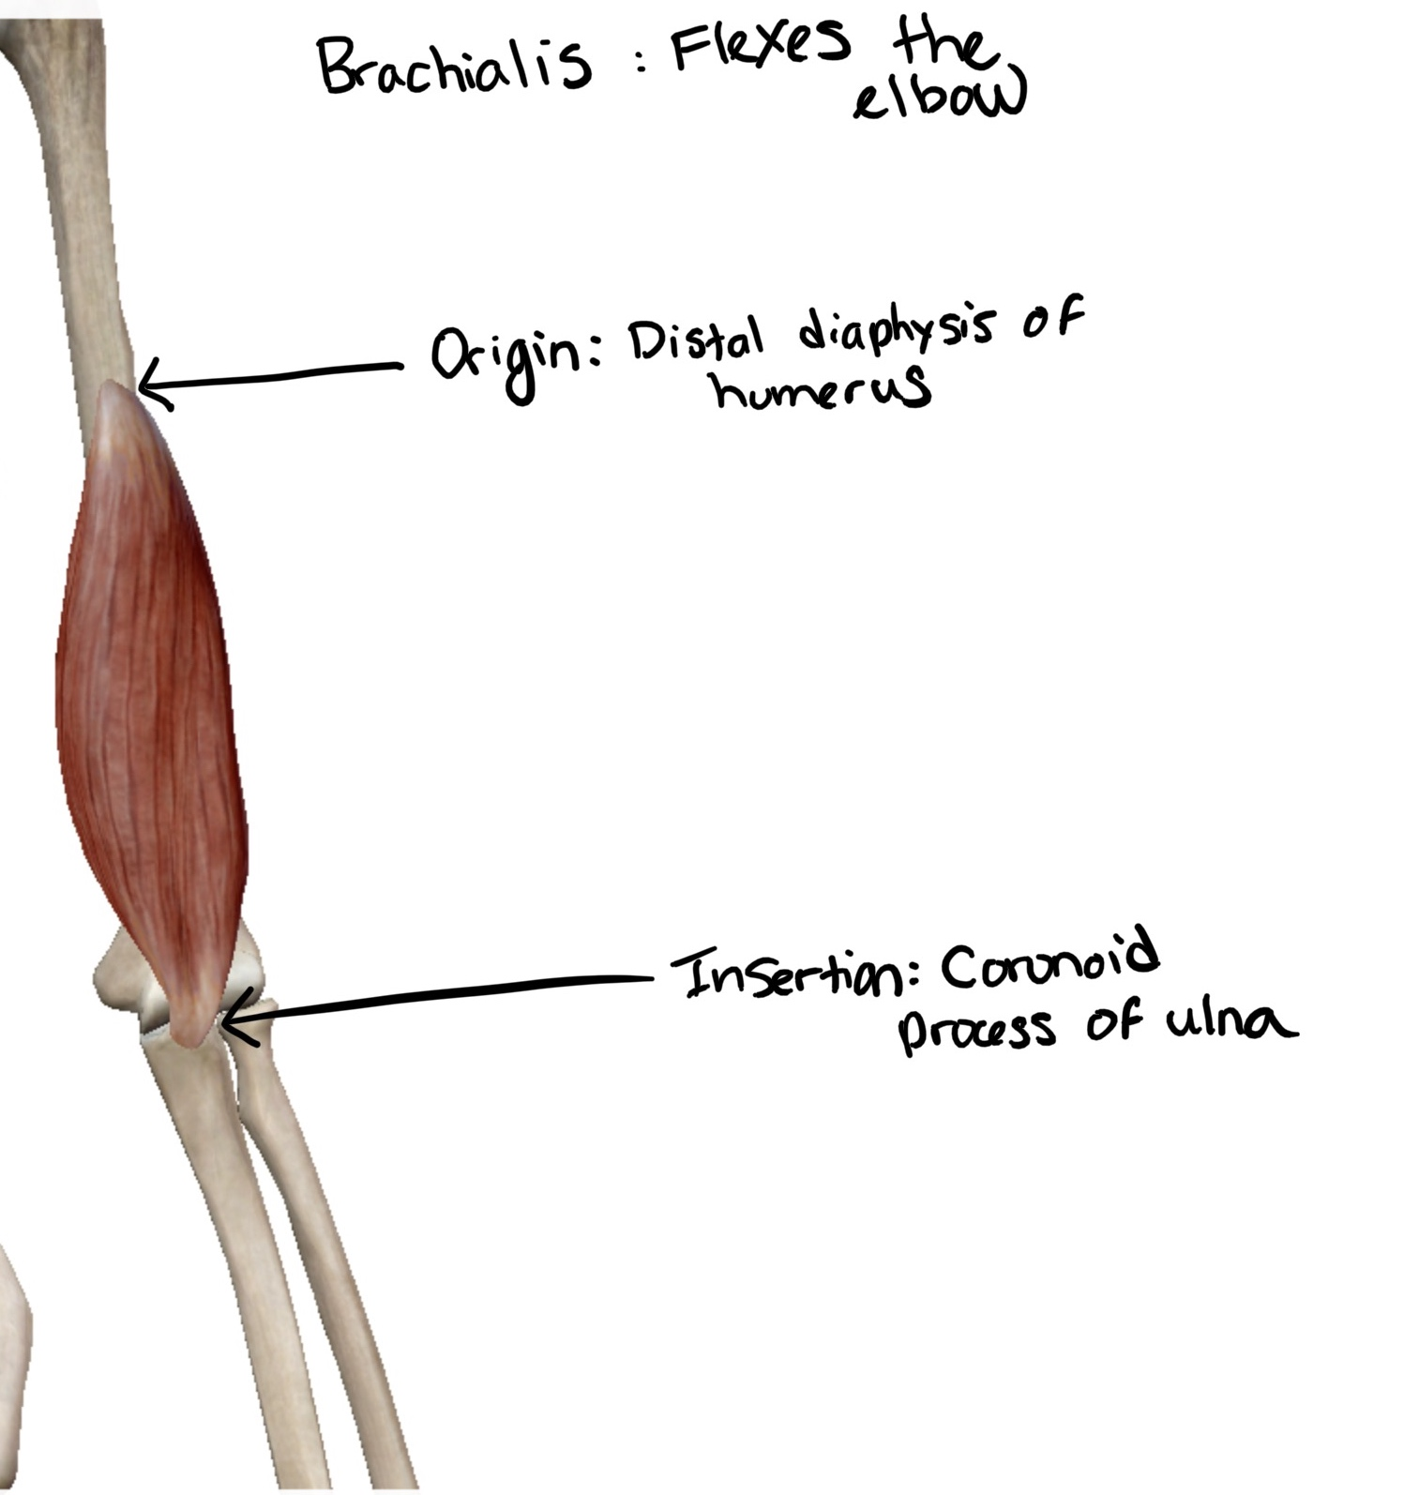
Muscles of the Appendicular Skeleton
Activity 3
Muscles
Bio141 OER Lab Manual © 2022 by H. Wangerin, P. Rodgers, G. Backus is licensed under CC BY-NC-SA 4.0
© Visible body

Slide 12
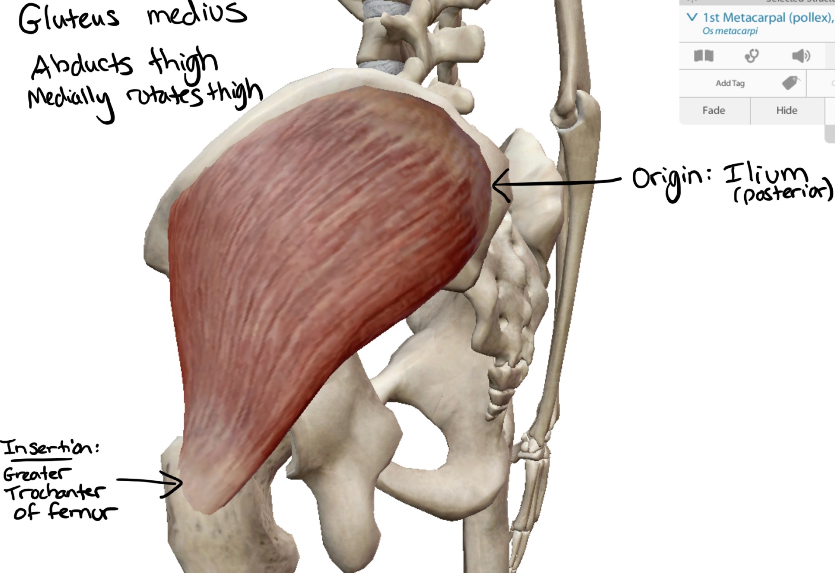
Muscles of the Appendicular Skeleton
Activity 3
Muscles
© Visible body
Bio141 OER Lab Manual © 2022 by H. Wangerin, P. Rodgers, G. Backus is licensed under CC BY-NC-SA 4.0

Slide 13
Lab Clean-Up: Before you leave be sure to…
Have your in-lab work checked
Remove and replace all of the terminology labels on the terminology sheets and return them to the binder
Place all of the material back in the lab tray neatly
Check the tray supply list with the supplies in the tray
Return the trays to the side table
Integument

