Slide 1
Forces
Objectives:
Definition of a Force
Newton’s Three Laws
Types of Forces

Slide 2
What is a Force?
Force
Interaction between TWO objects
Magnitude (Newton, Dyne, slug)
Direction

Slide 3
What is a Force?
Force
Interaction between TWO objects
Magnitude (Newton, Dyne, slug)
Direction
Review of Motion:
Speed: How fast an object is moving
Direction: In what direction is moving

Slide 4
Newton’s First Law
Motion: Speed
Direction
Law of Inertia:
You need a force to change the motion of an object.

Slide 5
Newton’s First Law
Motion: Speed
Direction
Law of Inertia:
You need a force to change the motion of an object.
Q1. You get in your car, turn the engine on and begin to move. Is there a force applied?
Motion: Speed
Direction

Slide 6
Newton’s First Law
Motion: Speed
Direction
Law of Inertia:
You need a force to change the motion of an object.
Q1. You get in your car, turn the engine on and begin to move. Is there a force applied?
Motion: Speed
Direction
✔
Ans. Yes

Slide 7
Newton’s First Law
Motion: Speed
Direction
Law of Inertia:
You need a force to change the motion of an object.
Q2. You are jogging at a constant pace of 5 mph along a circular track. Is there a force applied?
Motion: Speed
Direction

Slide 8
Newton’s First Law
Motion: Speed
Direction
Law of Inertia:
You need a force to change the motion of an object.
Q2. You are jogging at a constant speed of 5 mph along a circular track. Is there a force applied?
Motion: Speed
Direction
✔
Ans. Yes

Slide 9
Newton’s First Law
20
P1. You are driving at constant 55 mph along a straight line. Is there an overall force applied to your car?
(a) Yes
(b) No
(c) Do not know
P2. You are driving at 55 mph along the freeway and all of a sudden you press the brakes? Is there a force on your car?
(a) Yes
(b) No
(c) Do not know
P3. You are driving at 55 mph along the freeway and all of a sudden you press the brakes. As your car abruptly slows down, you notice a box on the passenger seat “flies off” to the front. Is there a force applied to the box?
(a) Yes
(b) No
(c) Do not know

Slide 10
Newton’s Second Law
Law of Acceleration:
Net Force = (Mass ) x (Acceleration)
Q3. Find the acceleration produced by a force of 2,500 slugs applied to a mass of 20.0 kg.
Net Force
Acceleration
=
Mass

Slide 11
Newton’s Second Law
Law of Acceleration:
Net Force = (Mass ) x (Acceleration)
Q3. If you apply the same force on a twice as heavy object, what would its acceleration be?
Net Force
Acceleration
=
Mass

Slide 12
Newton’s First Law
20
P1. An SUV is going 75.0 km/h and slows down to 25.0 km/h in 8.20 s. What is its acceleration?
Answer:
P2. If the SUV from the previous problem had a mass 2,000 kg, what was the net force applied on it while slowing down?
Answer:
P3. A force applied to an object with mass m produces a certain acceleration, a. What will be the acceleration of twice as heavy object that you push three times as hard?
Answer:

Slide 13
Gravity and Weight
Weight
The force Earth exerts on an object
W = mg
… N = (… kg ) x (9.8 m/s²)
… lb force = ( … slug ) x (32.2 ft/s²)
Q4. How much is the weight of a 5.0 kg rock?

Slide 14
Gravity and Weight
Weight
The force Earth exerts on an object
W = mg
… N = (… kg ) x (9.8 m/s²)
… lb force = ( … slug ) x (32.2 ft/s²)
Q4. How much is the weight of a 5.0 kg rock?
Weight = (5.0 ) x (9.8 m/s²) = 49.0 N
Q5. How much is the weight of a 5.0 kg rock in slugs?

Slide 15
Gravity Problems
20
P1. Find the weight of a 1350-kg automobile.
Answer:
P2. Find the weight of 10.0-slug object.
Answer:
P3. What is the mass of a 20,000-N automobile?
Answer:
P4. What is the mass in slugs of a 20,000-N automobile?
Answer:

Slide 16
The Normal Force
Weight = mg

Slide 17
The Normal Force
Normal Force
Normal Force
Pushes AWAY from the contact surface
Weight = mg

Slide 18
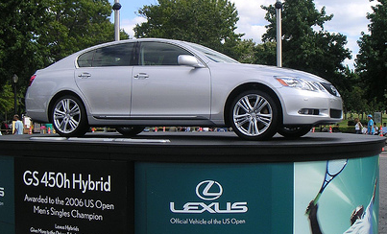
The Normal Force
Normal Force
Normal Force
Pushes AWAY from the contact surface
Weight = mg

Slide 19
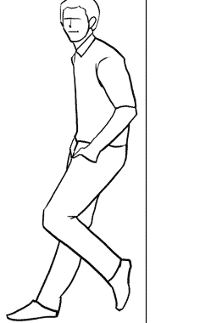
The Normal Force
Normal Force
Normal Force
Pushes AWAY from the contact surface
Weight = mg

Slide 20
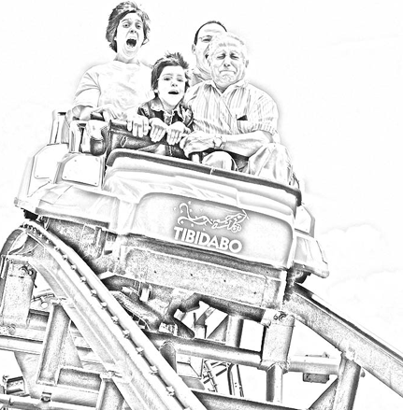
The Normal Force
Normal Force
Normal Force
Pushes AWAY from the contact surface
Weight = mg

Slide 21
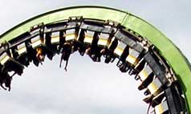
The Normal Force
Normal Force
Normal Force
Pushes AWAY from the contact surface
Weight = mg

Slide 22
The Normal Force
10
Normal Force
Normal Force
Pushes AWAY from the contact surface
Weight = mg

Slide 23
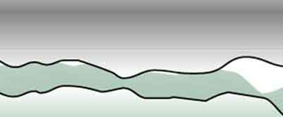
Friction
velocity
Friction
Friction
Opposing the SLIDING motion
Q6. Does the bottom surface experience friction?

Slide 24
Friction
velocity
Friction
Friction
Opposing the SLIDING motion
Q6. Does the bottom surface experience friction?
Yes! Only in the opposite direction.
Static Friction
Kinetic Friction
Friction when there IS NO sliding
Friction when there IS sliding

Slide 25
Normal Force and Friction
Normal Force
Kinetic Friction
Friction
Friction
=
μ (Normal Force)
Static Friction
Between 0 and μ (Normal Force)
The coefficient of friction:
Material | Static | Kinetic
Steel on steel | 0.58 | 0.20
Steel on steel (lubricated) | 0.13 | 0.13
Hardwood on hardwood | 0.40 | 0.25
Rubber on dry concrete | 2.0 | 1.0
Rubber on wet concrete | 1.5 | 0.97

Slide 26
Friction: Examples
Q7. While you are driving your car on a dry road, there is a friction between the tires and the road. Is it static or kinetic?
Q8. In which direction is that frictional force exerted by the road on your tires?

Slide 27
Friction & Normal Force Problems
20
P1. A box slides along the floor. If the normal force on it is 100 lb force, and μ is 0.1, what is the frictional force?
Answer:
P2. A box sits on the horizontal floor. If the normal force on it is 100 lb force, and μ is 0.2, what is the frictional force?
Answer:
P3. A 2.0 kg box slides along a rough surface. (a) Draw the forces that act on it? (b) How much is the Normal force?
Answer:

Slide 28
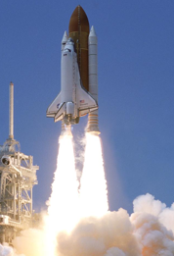
Newton’s Third Law
Action and Reaction
You cannot push without being pushed back

Slide 29
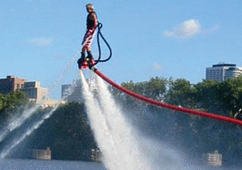
Newton’s Third Law
Action and Reaction
You cannot push without being pushed back

Slide 30
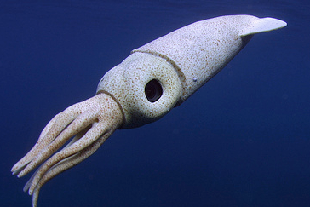
Newton’s Third Law
Action and Reaction
You cannot push without being pushed back

