Slide 1
Lec 03: Motion
Speed and Velocity
Motion with Constant Velocity
Acceleration
Free Fall
Relative Motion

Slide 2
Average Speed
You traveled 60 miles in 1 hour. What was your average speed?
Distance traveled
average speed
=
Time
Example: You jogged 200 m in 40 seconds. How much was your average speed

Slide 3
Speed, Velocity
Speed: How fast we move
Velocity: How fast we move and in what direction
Motion with Constant Velocity

Slide 4
Is It Constant Velocity?
You drive your car at 65 mph along the freeway in the north direction
(a) Yes
(b) No
(c) Don’t know
You drive your car at 65 mph along a circle
(a) Yes
(b) No
(c) Don’t know
You bring your car to a stop
(a) Yes
(b) No
(c) Don’t know

Slide 5
Change in Velocity: Acceleration
Present Velocity – Initial Velocity
Average acceleration
=
Time it took for the change
Question: Can we have a velocity but no acceleration?
Question: Can we have an acceleration but no velocity?

Slide 6
Puzzles
P1. You live 10 mi away from school. Assuming that you were moving at constant velocity all along and it takes you 30 minutes to come to school, how much was your speed?
P2. You turn the engine and start your car moving. In which direction is the acceleration, if any, of your car?
P3. Superman flying north smashes into a wall and is brought to a full stop. In which direction, if any, is his acceleration?

Slide 7
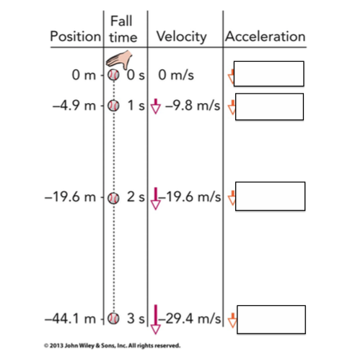
Free Fall
Can you see the Pattern?

Slide 8
Free Fall: Velocity and Distance
Apollo’s Feather and Hammer Experiment on the Moon
A 5-kg iron ball and a 10-kg iron ball are dropped from rest. For negligible air resistance, the acceleration of the heavier ball will be
less.
the same.
more.
undetermined.

Slide 9
Free Fall: Velocity and Distance
Velocity changes with time:
The distance covered by an accelerating object starting from rest is
Present velocity = initial velocity + acceleration x time
Distance = (0.5) x (acceleration) x (time) x (time)

Slide 10
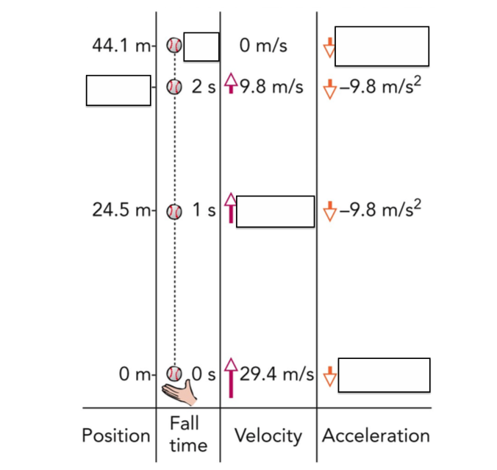
A puzzle: Fill in the blanks

Slide 11
Relative Motion
B
A
A
In what direction do you need to travel to reach B across?

Slide 12
Relative Motion
B
A
A
In what direction do you need to travel to reach B across?

Slide 13
Relative Motion
B
A
A
In what direction do you need to travel to reach B across?

Slide 14
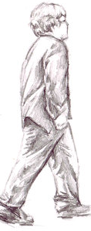
Relative Motion
3 mph
5 mph
A
How fast does the person walk relative to the ground?

Slide 15
Relative Motion
3 mph
5 mph
A
How fast does the person walk relative to the ground?
5 + 3 = 8 mph
What if the person walks in the opposite direction?

Slide 16
Relative Motion
3 mph
5 mph
A
How fast does the person walk relative to the ground?
5 + 3 = 8 mph
What if the person walks in the opposite direction?
5 - 3 = 2 mph

Slide 17
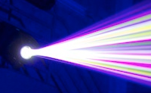
Speed of Light
300,000 km/s
30 km/s
A
A. More than 300,000 km/s
B. Less than 300,000 km/s
C. Same 300,000 km/s
D. I don’t know

Slide 18
Speed of Light
300,000 km/s
30 km/s
A
A. More than 300,000 km/s
B. Less than 300,000 km/s
C. Same 300,000 km/s
D. I don’t know

Slide 19
Puzzles
P1. A person walks along a moving walkway at the airport. The walkway moves at 4 mph. How fast is the person moving relative to the ground if he walks at 4 mph in the same direction?
P2. What if the person moves at 4 mph in the opposite direction?
P3. What if the person moves at 5 mph in the opposite direction?
P4. How fast does the light travel from the Earth to the Moon. Speed of light is 300,000 km/h. Distance is 380,000 km.
P5. The Earth travels about 30 km/s in space due to its rotation around the Sun. If you shine a beam of light along the same direction, how fast will the light travel with respect to the Sun?

