Slide 1
Temperature and Heat
Objectives:
Temperature
Boyle’s and Charles’ Law
Heat
Specific Heat
Thermal Expansion

Slide 2
Temperature
Related to how fast atoms/molecules are moving (Kinetic Energy)
Celsius (C)
Centigrade
Fahrenheit (F)
Kelvin (K)
Water boils
212 ºF
100 ºC
373 K
100 intervals (degrees)
http://www.wbuf.noaa.gov/tempfc.htm
32 ºF
0 ºC
273 K
Water freezes
Molecules and Atoms stop moving (no kinetic energy)
Absolute Zero
-273 ºC
0 K
-459 ºF

Slide 3
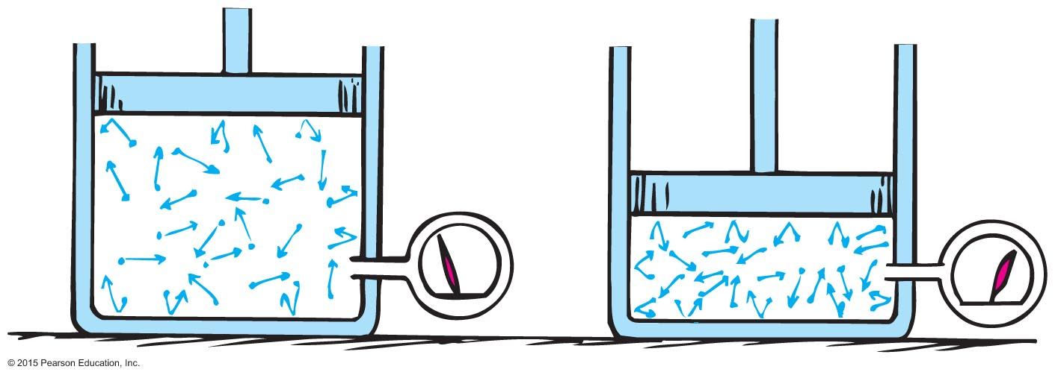
Boyle’s Law
Conditions:
Temperature does not vary
Amount of gas remains the same
The product of the Pressure and Volume remains constant!
PV = PV
LARGE Pressure
LARGE Volume
Small Volume
Small Pressure

Slide 4
Boyle’s Law
PV = PV
Question. How can we maintain constant temperature?
Ans. Something happens slow! It exchanges heat with the surrounding environment and maintains that temperature
Question. You measure the volume of a gas to be 12 mL 101 kPa. Then you let the gas expand slowly to 18 mL. What would be the pressure?

Slide 5
Boyle’s Law
PV = PV
Question: A piston in an airtight pump is withdrawn so that the volume of the air chamber is increased 3 times. What is the change in pressure?
The pressure is 3 times the original pressure.
The pressure is 1/3 the original pressure.
The pressure does not change.
There is not enough information to figure this out.

Slide 6
Charles’ Law
Charle’s Law
Volume remains constant!
Pressure
=
pressure
Temperature
temperature
Charle’s Law Requires Kelvin (No Celsius! No Fahrenheit!)
Question. How can we maintain constant volume?
Ans. Sealed container
Question. You take a sealed container of soup from the fridge and leave it outside at room temperature. After some time, you notice its cap is bulging out. Why?

Slide 7
Puzzles
P1. What is 70 F in Centigrade?
Ans.
P2. You seal a gas in a container. If you double the temperature of the gas, what happens to the pressure inside?
Ans.
P3. In the Boyle’s Law (keeping temperature constant), if you triple the pressure, what happens to the volume of the gas.
Ans.
P4. For a gas sealed in a container, you measure its temperature and pressure to be 300 K and 1 Atm. What happens to the pressure if you increase the temperature to 900 K?
Ans.

Slide 8
Heat
Amount of energy the flows from one object to another.
1 cal
Heat required to warm 1 g water by 1ºC
1 Cal
Heat required to warm 1000 g water by 1ºC
1 Joule
4,186 cal or 4.186 Cal
Note: The food-calories are the “big” calories (Cal), that is they are equivalent to the heat required to warm 1 kg water by 1 C
Question. You want to freeze a cup of water. Do you need to add or remove energy to it?
(a) Add (b) Remove (c) Neither

Slide 9
Heat
Energy ratings of food and fuel are determined from energy released when they are burned
Food-calorie is the “big” calorie (the heat to warm 1 kg water of by 1C):
1 food-calorie = 1 kcal = 1 Cal = 4 186 Joules
Question. “Sugar has 4000 food-calories per kilogram. One food-calorie is 4,184 Joules. How many Joules will be released by combustion 1 kg of sugar?” (The Martian)

Slide 10
Specific Heat
Question. How many calories are necessary to heat 50 g of water by 1ºC
(Heat)
=
(50 g) (1 cal)
Question. How many calories are necessary to heat 50 g of water by 10ºC?
(Heat)
=
(50 g) (1 cal)
(10ºC)
Question. How many calories are necessary to heat 50 g of iron by 10ºC?
(Heat)
=
(50 g) (??? cal)
(10ºC)
Specific heat
0.108 cal/g
(Heat)
=
(mass) (specific heat)
(temperature change)

Slide 11
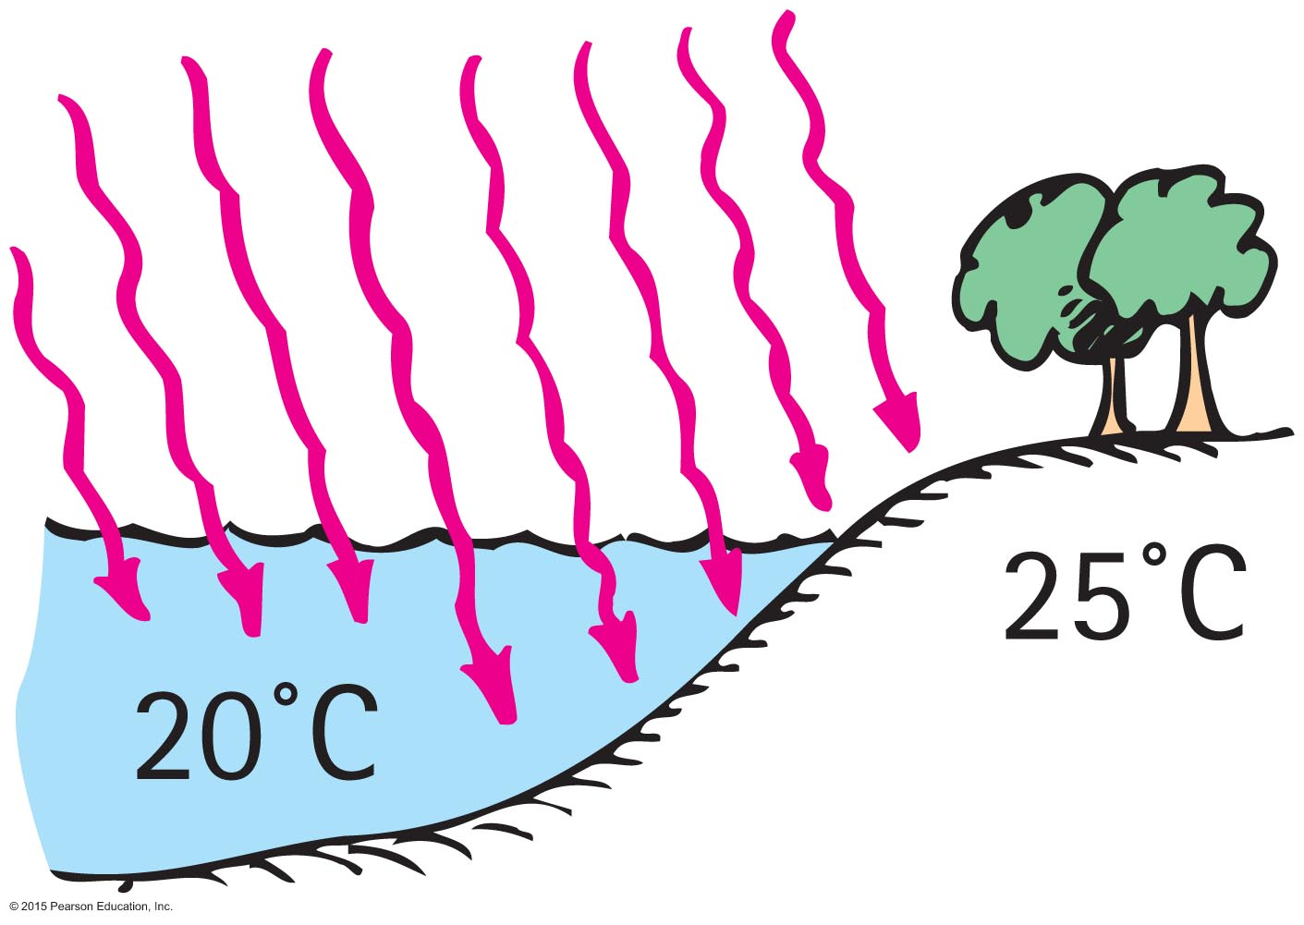
Specific Heat
Question. Which has the higher specific heat capacity, water or land?
Water
Land
Both of the above are the same.
None of the above.

Slide 12
Puzzles
P1. On a hot day, your body sweats in order to remove excess energy. When is this cooling more efficient – in dry climates or humid climate?
P2. In cold wet weather it is better to wear socks made of wool. Wool has the ability to wick away and absorb water, and thus keeps your feet warmer. How is it that dry feet feel warmer than wet feet?
P3. You add 2.5 kcal of heat to 50 g of water. By how many degree does its temperature rise?
P4. You place an ice cube on the stove top and wait until it melts.
(a) Ice absorbed heat and turned into water
(b) Ice released heat and turned into water
(c) Ice changed into water without any heat transfer.

