Slide 1
Vibrations
Objectives:
Periodic Motion: Period and Frequency
Pendulum: Grandfather’s Clock
Measuring Time
Resonance

Slide 2
Periodic Motion
“Repetitive Motion”
Period
T [seconds]
The time it takes for one cycle/vibration/repetition
Frequency
F [Hertz, Hz]
How many cycles/vibrations/repetitions in one second.
Example: Pendulum swings 5 times in 10 seconds.
What is its period, T?
What is its frequency, f?
10 s
5
1
T =
f =
T =
5
10 s
f

Slide 3
Example
A block on a spring bounces 4 times every 2 seconds. What is its period?
(a) 4 seconds
(c) 2 seconds
(b) 0.5 seconds
(d) 8 seconds
Question. What is its frequency?
4
f =
Hz
2

Slide 4
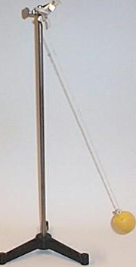
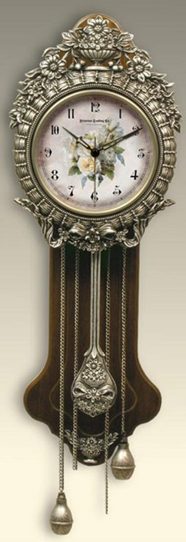
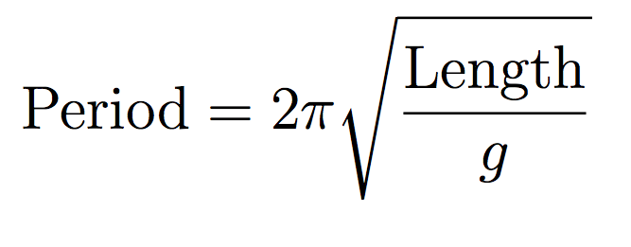
Pendulum
Simple Pendulum
Question: How much is the period of a 1-m long pendulum?
Question: The acceleration due to gravity near Mar’s surface is about 3.8 m/s² . Will the clock be behind or ahead?

Slide 5
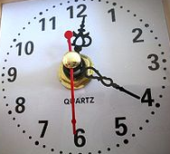
How do we measure time?
Grandfather’s Clock
Quartz Clocks
Vibrating Crystal
Atomic Clocks
Vibrating Caesium-133 atom
1 second: 9,192,631,770 cycles of the light emitted by Cs133

Slide 6
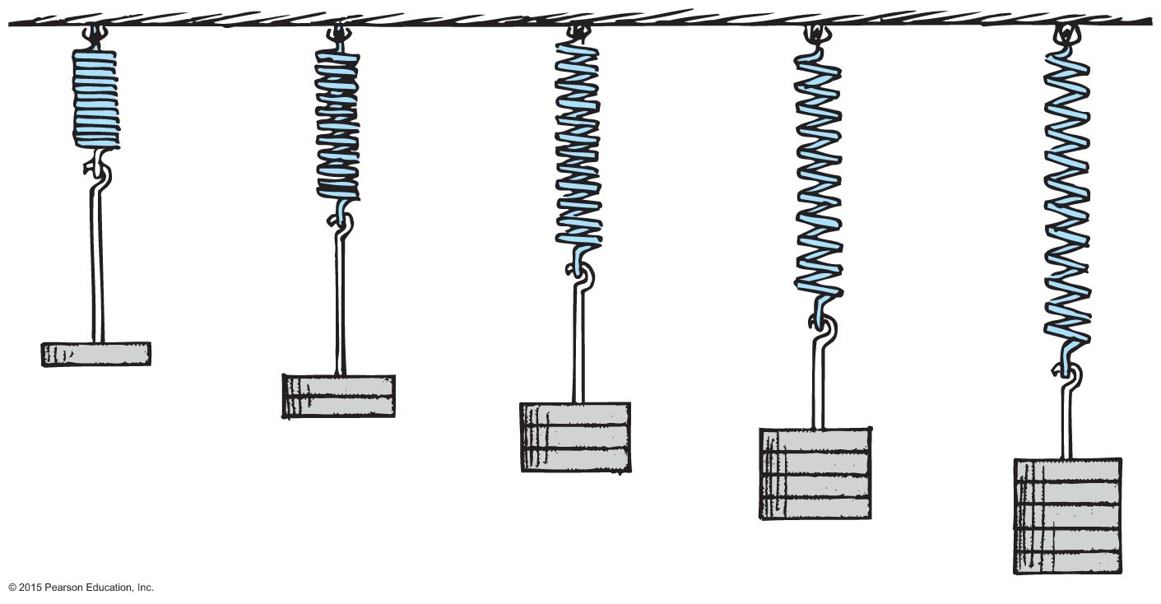
Springs: Hooke’s Law
Question: If you wish to triple the stretching of a spring, how much more force do you need to apply?

Slide 7
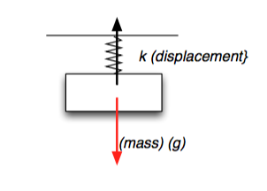
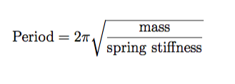
Springs
An Object Attached to A Spring
Question: Which vibrations happen faster ( smaller period and large frequency)
(a) Large mass
(b) Small mass
(c) It doesn’t matter

Slide 8
Natural Frequencies and Resonance
Natural Frequencies
Question: What will happen if you begin to push the block rhythmically with the same frequency as it “likes” to oscillate?
Resonance: Things “like” to be pushed to vibrate with their natural frequency. They move farther and farther from equilibrium!!!

Slide 9
Natural Frequencies and Resonance
Tacoma Narrows Bridge Collapse
https://www.youtube.com/watch?v=3mclp9QmCGs
Question: You sit on a swing at the playground and you begin to pump your legs. Can you swing by yourself? How do you stop?

Slide 10
Puzzles
P1. A planet revolves around its axis 50 times in 1 hour. What is its period? Frequency?
P2. One pendulum swings with a period of 1 s, and another swings with a period of 2 s. Which one moves faster?
P3. You need to use a pendulum to measure time, but its period is too large for your needs. What do you need to do?
Increase its length
Decrease its length
Change the gravitational acceleration
P4. A block can be attached to two springs. When will the vibrations have higher frequency (more cycles per second): when the spring is stiff or when it is soft?
P5. You need to use a pendulum to measure time, but its period is larger than you need. What do you need to do?

