Slide 1
Sound
Objectives:
Characteristics of Sound
Doppler Effect
Producing Sound
Beats: Tuning musical instruments

Slide 2
Sound
Longitudinal Pressure (Air Density) Waves
Speed of Sound
(speed) = 331 + 0.6 T (C)
Question: How far did the lightning fall?
My grandma taught me to count between the time I saw a lightning and heard the following thunder. She said I was safe if I could count up to three. How far is that?

Slide 3
Sound Example
You hear thunder 2 seconds after you see a lightning flash. How far away is the lightning?
340 m/s
660 m/s
More than 660 m/s
There's no way to tell.

Slide 4
Speed of Sound
Depends on density and the elastic properties of the medium
Sound travels 4x faster in water than in air.
Sound travels 15x faster in steel than air.

Slide 5
Sound
Frequency (Hz)
Pitch
Infra sound
audible
Ultra sound
20 Hz
20 kHz

Slide 6
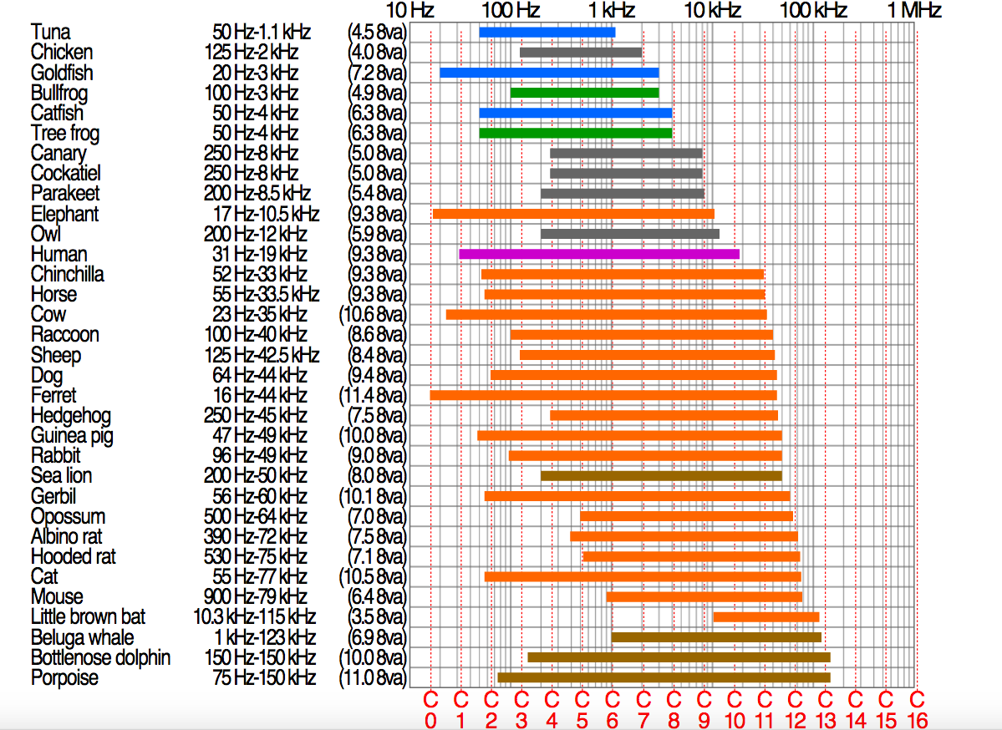

Slide 7
Sound
Loudness
Energy
Type | Sound (dB)
Threshold of hearing | 0
Rustling of leaves | 10
Quiet whisper | 20
Normal conversation (1 m) | 40 – 60
Average home | 50
Traffic on a busy street (10 m) | 80 – 90
Jet airplane at 100 m | 110 - 140
Loud Rock Concert | 120
Threshold of Pain | 120

Slide 8
Sound
Our ear “hears” sound in non-linear manner.
10 – 20 dB increase in Loudness requires 10 TIMES more energy to be delivered by the sound wave.
10 – 30 dB increase in Loudness requires 100 TIMES more energy to be delivered by the sound wave.
10 – 40 dB increase in Loudness requires 1000 TIMES more energy to be delivered by the sound wave.

Slide 9
Sound Example
How much more energy is required for a 40 – 90 dB increase in loudness?
Increase: 90 – 40 – 50 dB
Increase in Energy delivered by sound:
10 x 10 x 10 x 10 x 10 = 100, 000 times more

Slide 10
Doppler Effect
Frequency changes as the source or the detector of the sound moves
Sound is heard at higher frequency if the distance between the source and the “ear” decreases (they move towards each other)
Sound is heard at lower frequency if the distance between the source and the “ear” increases (they move away each other)

Slide 11
Doppler Effect Example
A police siren emits sound at 450 Hz. If the police car is behind you and approaching you, what will be the frequency that you hear?
450 Hz
478 Hz
425 Hz
343 Hz

Slide 12
Doppler Effect Example
A police siren emits sound at 450 Hz. If the police car is behind you and then it passes you what will be the frequency that you hear now as the car is going away from you?
450 Hz
478 Hz
425 Hz
343 Hz

Slide 13
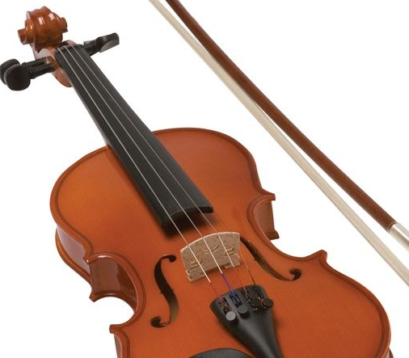
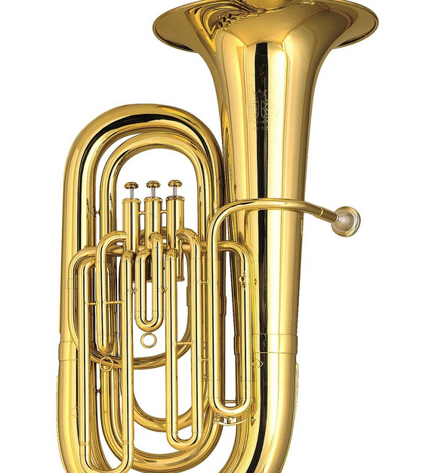
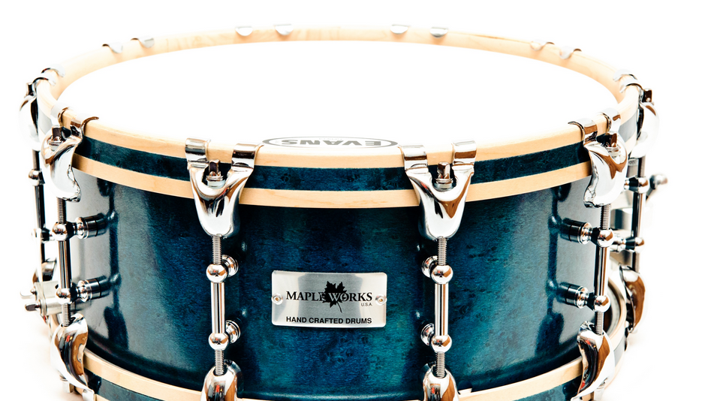
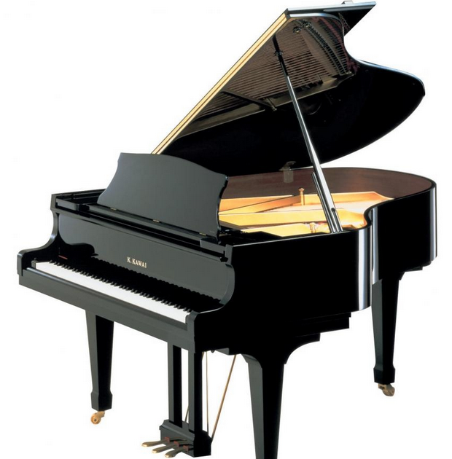
Producing Sound
How can you produce sound?
Question. Is the piano a string or percussion instrument?
Standing Wave Patterns created along a string, inside an air tube, or membrane, produce sound wave

Slide 14
Puzzles
P1. How longs does sound travel 100 m at 20C?
P2. It is said that you put your ear to the ground you could hear horses sooner than if you just listen in air. Is it correct?
P3. If you want to increase the volume of a sound from 20 dB to 30 dB, by how much do you need to increase the amount of energy delivered by the sound?
P4. A bat emits 40 kHz sound wave toward a wall. As the bat approaches the ball it hears the sound reflected by the wall. What is the frequency that it “hears”?
(a) 40 kHz (b) more than 40 Khz (c) less than 40 kHz

