Slide 1
DHRM 1.61 Teleworking
VCCS and NOVA Implementation

Slide 2
DHRM 1.61
Covers Executive Branch Employees
Supersedes individual agency-employee telework agreements as of July 5
Underscores the importance of in-person work to service excellence, teamwork, peer-to-peer learning, and meeting performance objectives
Returns teleworking to an exception offered in limited situations
Elevates the approval authority for all but one day of telework to the Executive Cabinet

Slide 3
DHRM 1.61
Does NOT apply to
Employees with ADA accommodations that include telework
Teaching Faculty
Applies to
Classified Staff
Wage Employees (P14)
To ensure fairness and consistency, is being adopted by NOVA for
Administrative Faculty
Professional Faculty
NOVA’s updated Telework Policy for all employees as of July 5 will align with DHRM 1.61, following our past practice of adopting the state policy.

Slide 4
NOVA Telework Framework
Takes into consideration the following new guidance and requirements included in DHRM Policy 1.61:
in-office work builds the strongest peer-to peer learning, consistent mentorship and overall teamwork;
a high-level of in-office operations and in-person service hours for the public are required for Virginia state agencies;
both individual and team objectives and performance expectations must guide new telework agreements; and
teleworking is a benefit for state employees rather than an obligation of the Commonwealth.

Slide 5
Impact of Enrollment Shifts
Summer enrollment
On-Campus: +1000 FTE / +728% YOY
Zoom: -1900 FTE / -34% YOY
Fall enrollment
On-Campus: +700 FTE / +60% YOY
Zoom: -300 FTE / -18% YOY
NOL enrollment strong

Slide 6
What will be key going forward
EWP on file with Human Resources
Supervisor

Slide 7
Telework Process Overview: One Day
One Day a Week: Due May 20 by 5 pm
Standard Telework Agreement Completed by Employee
NOVA Electronic Form Completed by Supervisor
Both routed to President with copy to Administrative Council member
Authority delegated by Chancellor to President to act within terms of DHRM 1.61 and the Standard Telework Agreement

Slide 8
Telework Process Overview: Two or More Days
Two or More Days a Week: Due May 19 by 12 pm
Standard Telework Agreement Completed by Employee
NOVA Fillable PDF with Required Supporting Documentation Completed by Supervisor
Emailed by Supervisor to PresidentsOffice@nvcc.edu
Initial review by President for alignment with VCCS criteria and terms of DHRM 1.61 and the Standard Telework Agreement
If approved, sent to the Dept of Education on May 20 by President with copy to VCCS HR
Approved or denied by Education Secretary (2) or Chief of Staff (3 or more)

Slide 9
Telework Exclusions
P14s whose positions have not been designated and approved as remote are not eligible to apply for telework.
Employees who are still in their probationary period are not eligible to apply for telework.

Slide 10
NOVA Criteria: One Day
NOVA will consider applications for one day a week telework from Classified Staff, Professional Faculty, and Administrative Faculty who hold positions that, based on their current EWPs on file within Human Resources:
have supervisory responsibilities for a division, office, project, or initiative that consists exclusively of remote operations, offers exclusively online/remote services to students and/or employees, and includes no employees with on-site responsibilities; OR
have no supervisory responsibilities and provide in-person direct services to students and/or other employees for less than 30% of their job responsibilities; OR
have no supervisory responsibilities and rely on regular interaction with other NOVA employees to complete less than 30% of their job responsibilities.

Slide 11
VCCS Criteria: Two or More Days
A necessary condition for a position to be considered for telework for two or more days a week:
According to the current EWP on file in Human Resources, it is designated as a position that requires no in-person, on-site responsibilities and no in-person interactions with students, employees, or the public when teleworking. Required documentation: position EWP
If this condition is not met, an employee in this position cannot apply.

Slide 12
VCCS Criteria: Two or More Days
In addition, to be considered for two or more days of telework, a position must meet at least one of the following four criteria and the Supervisor must provide full and clear supporting documentation:
The search for this position did not identify any applicants within the DMV region who met the position’s qualifications and/or who would accept the position’s salary. Example of documentation: documented search outcomes
The physical space dedicated to this position before the pandemic has been permanently reallocated to another college function with higher priority or is no longer leased by the college. Example of documentation: revised lease agreement; NOVA Facilities memo that verifies elimination of office

Slide 13
VCCS Criteria: Two or More Days
In addition, to be considered for two or more days of telework, a position must meet at least one of the following four criteria and the Supervisor must provide full and clear supporting documentation (continued):
Providing more than one day of telework provides a measurable and significant financial benefit to the college. Example of documentation: recurring salary cost savings validated by the NOVA Budget Office
Providing less than two days of telework poses an immediate risk to retention of an employee based on another offer or a significant number of postings for the same position within the region list telework as a condition of employment. Example of documentation: offer letter from another employer explicitly identifying telework as part of offer; regional job postings for the same position that explicitly list and define telework at two days or more per week

Slide 14
Standard Telework Agreement
NOVA’s adoption of the standards of DHRM Policy 1.61 Teleworking and the Standard Telework Agreement for all non-teaching employees extends to the “Terms of Telework Agreement” included on the application form.
Employees and supervisors should read and understand the “Terms of Telework Agreement” provided on the DHRM Standard Telework Agreement before moving forward with any request.

Slide 15
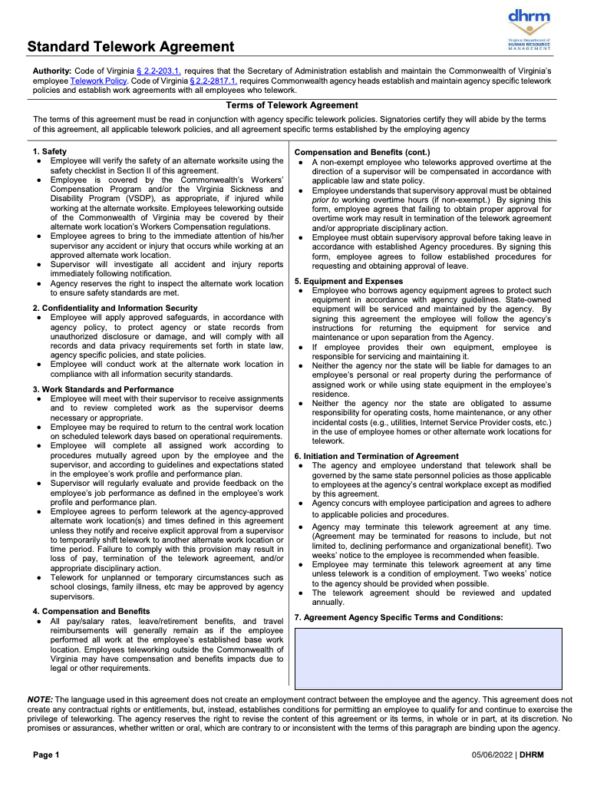
Terms of Telework Agreement
Review carefully.
Failure by employees and/or supervisors to follow the “Terms of Telework Agreement” will result in immediate suspension of employee telework and may result in disciplinary action.

Slide 16
NOVA Telework Supervisor Review
Required for an employee’s agreement to be considered
Aligns with the responsibilities of supervisors identified in DHRM 1.61, including but not limited to
Determining positions where telework is appropriate for managing the affairs and operations of their agency
Assessing individual and team objectives and overall performance expectations of the team when awarding new telework agreements.
Ensuring that individual telework agreements reflect specific days of on-site work that are consistent with effective delivery of services and team collaboration
Walks through each element of DHRM 1.61 and the Telework Terms of Agreement.
Requires attestation and signature.

Slide 17
Once More—the Process
One Day a Week: May 20 at 5 pm
Electronic Form
Standard Telework Agreement
Supervisor Review/Attestation
Decision by President
Two or More Days a Week: May 19 at 12 pm
Email
Standard Telework Agreement
Supervisor Review/Attestation and Required Documentation
First Review by President
Decision by Executive Cabinet Member

