Slide 1
NOVA Academic Master Plan 2024-2027

Slide 2
Today’s Agenda
Academic Master Plan – Purpose and Contents
Academic Affairs Structure
Campus Emphasis and Future Direction
Your Ideas

Slide 3
Academic Master Plan

Slide 4
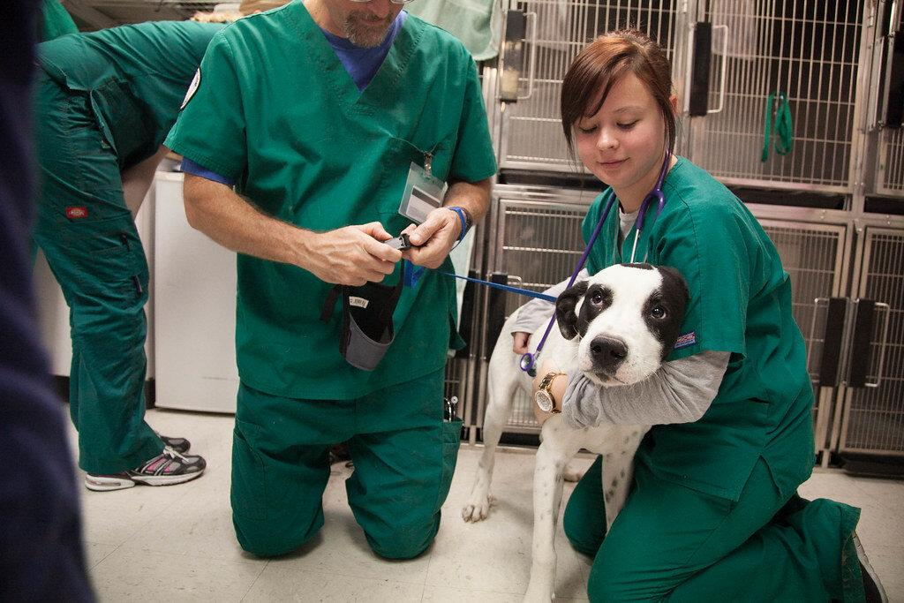
ACADEMIC AFFAIRS Eun-woo chang Vice President of Academic Affairs/Chief Academic Officer
Academic Affairs
Jen Daniels (interim)
Dual Enrollment,
Outreach & Retention
Susan Nieves-Campos (interim)
E-Learning
(NOVA Online/NOL)
Cynthia Pascal
Libraries
Matt Todd
Faculty Professional
Development
William (Preston) Davis
International Education
Leeza Fernand
Credit for Prior Learning
Curriculum & Innovative Education
Honors/PTK
University Partnerships
(including ADVANCE and Transfer)
Direct Enrollment
E-Summer Program
Early Online College
JumpStart2NOVA
School District Partnerships
Student Application, Enrollment Prep
Online Course Development and Delivery
Online Student Services, including the Virtual Student Union (VSU)
Open Educational Resources (OER)
Shared Service Distance Learning (SSDL)
Course Reserves
Equipment and Technology
Digital Media
Interlibrary Loans
Library Instruction
Resource Center
Center for the Advancement of Teaching Excellence (CATE)
New Faculty Orientation
Power Up Your Pedagogies(PUP) Conference
Spring Faculty Convening
Community College Initiative
Fulbright Program
Study Abroad

Slide 5
Academic Master Plan Contents
Introduction/background
Current Status/Data
Academic Master Plan Goals and Objectives
Academic Affairs - Division Goals and Priorities
Academic Affairs – Campus Goals and Priorities
Academic Program/Discipline Review
2024-2027 Academic Initiatives
Evaluation Plan
Summary/Conclusion

Slide 6
Current “Hot” Topics
Academic Integrity Labs
Dual Enrollment Transfer Programs
Gateway Courses Success Rate Tutoring
Retention Rates Graduation Rates
Competency Based Education eLearning – NOVA Online
Technologies (Artificial Intelligence, ChatGPT, etc.) Libraries
Faculty Professional Development International Programs
Workforce Development – Connection with Credit Programs

Slide 7
questions
What specific programs or courses do you believe NOVA should invest in over the next three years to enhance access and quality in higher education and workforce development?
Which facilities or campus enhancements do you believe are necessary to improve the overall learning environment at NOVA and support the mission of equitable access to education?
Are there any specific technologies or resources that should be integrated into NOVA's educational infrastructure to enhance the student learning experience?

Slide 8
Questions (Continued)
4) How can NOVA improve student learning outcomes? For example….
How could we better support faculty in implementing teaching strategies and practices that lead to improved student learning outcomes?
What improvements or changes do you recommend for NOVA's online synchronous (remote, hybrid, Hy-flex) and asynchronous course offerings and/or faculty trainings to enhance the learning experience?
What changes to the curriculum development or program assessment processes might be needed?
5) Do you have any additional suggestions or insights regarding NOVA’s Academic Master Plan that you would like to share?

Slide 9
What are YOUR ideas?
Please raise your (virtual hand), and we will call on you to unmute and share your ideas.
You can also complete the Google survey (https://forms.gle/RbFzk8PYyEsx586q9),
OR, you can email us at academics@nvcc.edu.
Thank you!

