Slide 1
Work and Energy
Objectives:
Work done by Forces
Power
Energy: Kinetic, Potential, and others

Slide 2
Work done by Forces
The amount of energy moved by a force
Work = (Force ) x (Distance)
Positive
Negative
Zero

Slide 3
Work done by Forces
The amount of energy moved by a force
Work = (Force ) x (Distance)
Units:
1 Joule (J) : 1 N x 1 meter
Foot pound (ft.lb): 1 lb x 1 ft
Calorie: Heat 1 kg water by 1C
BTU : Heat 1 lb water by 1F
eV: Energy of 1 electron through 1V

Slide 4
Work Examples
20
Q1. A worker pushes a 350-lb cart a distance of 30 ft by exerting a constant force of 40 lb. How much work does the person do?
Work in (ft.lb) = 40 lb x 30 ft = 1,200 ft.lb
Q2. You throw a 5.0-kg rock upward. How much is the work done by gravity during a 10-m ascent?
Work in (J) = - (5.0 x 9.8 ) N x 10 m = - 490 J
Q3. How much will be the work of gravity during a 10-m descent for the same 5.0-kg rock?
.
Work in (J) = (5.0 x 9.8 ) N x 10 m = + 490 J

Slide 5
Work
20
P1. Convert 500 ft.lb into Joules
Ans.
P2. Calculate the work in Joules done by a 20.0 N force applied on a box while it moves 10.0 m if
(a) The force is parallel to the displacement.
Ans.
(b) The force is directly opposite to the displacement.
Ans.
(c) The force is perpendicular to the displacement.
Ans.
P3. A 2.5-kg rock is dropped from 10.0 m height. What is the work done by the gravity for the entire 10.0-m distance?
Ans.
P4. You throw a 2.5-kg rock upward and it goes 5.0 m above the ground. Calculate the work done by gravity.
Ans.

Slide 6
Power
The amount of work done per unit time
Work done by Force
Power
=
time it took
Units:
Watt (W) : 1 Joule every second
Kilowatt (kW) : 1,000 W
Megawatt (MW) : 1,000,000 W
Horsepower (hp): 550 ft.lb every second

Slide 7
Energy vs. Power
Q4. Our household electricity consumption is measured in gigawatts-hour (GWh). Is that energy or power?
Ans.
Q5. And what is 1GWh in the SI system?
Ans.
Q6. A 1,500 lb cating is raised 22.0 ft in 2.50 min. Find the required horsepower
Work in (ft.lb) 1,500 lb x 22.0 ft = 33,000 ft.lb
Power in (hp) = 33,000 ft.lb / 2.50 (60 s) = 220 hp

Slide 8
Power
20
P1. What is 500 MW.h measured in Joules?
Ans.
P2. What is 100 Joules in hp?
Ans.
P3. If you run a 75W light bulb for 20 min, how much energy in Joules did you consume?
Ans.
P4. A wattmeter shows that a motor is drawing 2,200 W. What horsepower is being delivered?
Ans.
P5. How much energy in Joules does the motor deliver in 1 hr?
Ans.
P6. You consume 2000 food calories a day while maintaining const. weight. What is the average power you produce a day?
Ans.

Slide 9
Conservation of Energy
Conservation of Energy Principle
Energy cannot be created or destroyed. Energy can only change its state.
Kinetic Energy
1
2
Kinetic Energy
=
mv
2
Gravitational Potential Energy
Potential Energy
=
m g h

Slide 10
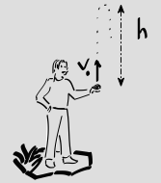
Example: Free Falling Rock
Q6. You throw a 2.0-kg rock with speed of 8.8544 m/s upward and it reaches 4.0 m before it stops. What what speed did you throw it? How much is the energy at the top?
Potential Energy
=
m g h
= (2.0 kg) (9.8 m/s²) (4.0 m) = 78.4 J
1
2
Kinetic Energy
=
mv
= 0
2
Potential Energy
=
m g h
= 0
1
2
Kinetic Energy
=
mv
= 0.5 (2.0 ) (8.8544)² =
2
= 78.4 J

Slide 11
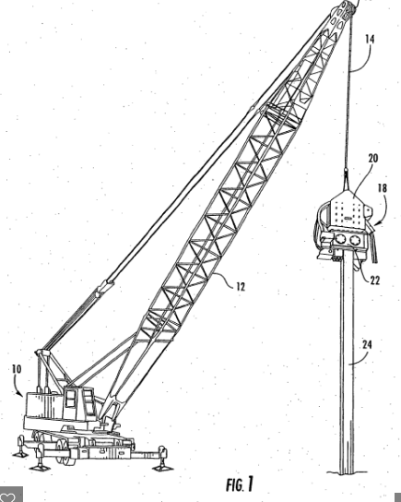
A Pile Driver
Q10. A pile driver falls freely from a height of 3.50 m above a pile. What is its velocity as it hits the pile?
PE = (m) (g) (h)
KE = 1/2 (m) (v)²
(m) (g) (h) = 1/2 (m) (v)²
(g) (h) = 1/2 (v)²
(9.8) (3.50) = 1/2 (v)²
v = 8.28 m/s = 18.6 mph

Slide 12
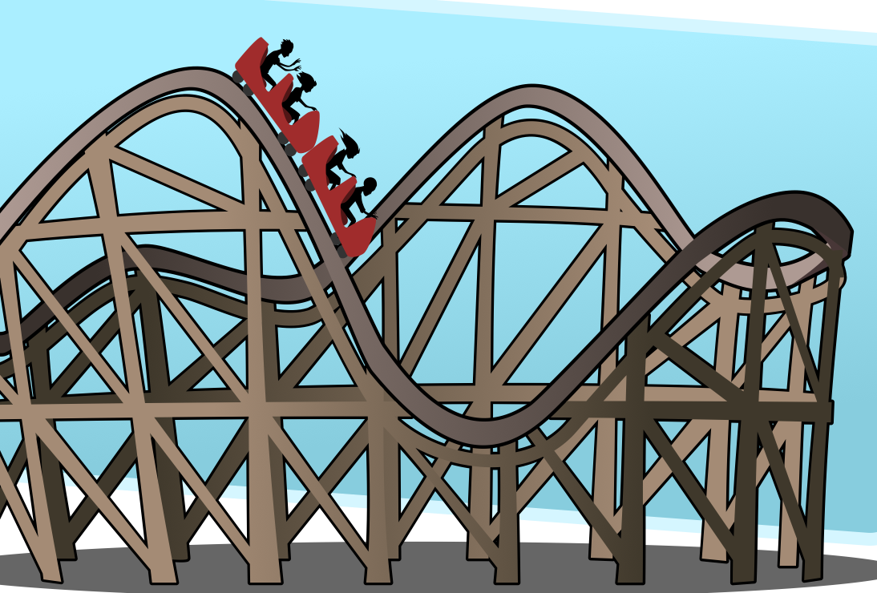
Example: Roller Coaster
Q7. What is the Potential Energy and the Kinetic Energy at the top?
v_{top} = 2.0 m/s
H = 50 m
v = ?
Q8. What is the kinetic Energy at the bottom?
Q9. What is the speed at the bottom?

