Slide 1
Electricity
Objectives:
Electric Force and Charges
Batteries, Electromotive Force
Electric Current and Ohm’s Law
Electric Power
Electric Circuits

Slide 2
Electric Force and Charge
Electric Charge
Positive
-
+
Negative
Electric Force
+
+
Repulsion
-
-
Repulsion
+
-
Attraction
Electron
-
- 1 e
Proton
+
+ 1 e
1 e: Smallest amount of charge on a separate object

Slide 3
Atoms and Ions
Neutral
Atoms
Number of electrons are equal to that of protons. Positive and Negative Balance!
Positive Ions
Missing Electrons, Positive is more than Negative
Negative Ions
Missing Electrons, Positive is more than Negative
Electronegativity:
How strongly atoms hold to their electrons
High
It takes more energy to separate an electron. More difficult to convert into positive ion
Low
It takes less energy to separate an electron. Easier to convert into positive ion
Q. Of Cu (copper, 1.90) and Zn (zinc, 1.65), which will require less energy to convert: Cu -> Cu²⁺ or Zn -> Zn²⁺

Slide 4
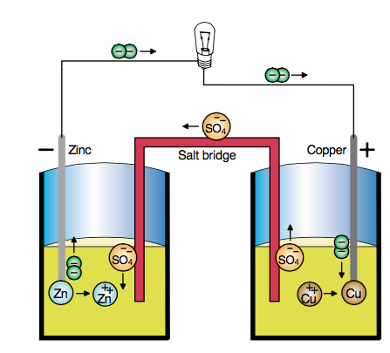
Daniell’s Cell
Voltage: 1.1 V
Zn on left electrode and Zn²⁺ ions in solution are in balance.
Cu on right electrode and Cu²⁺ ions in solution are in balance.
!!! It costs less energy to create Zn²⁺ ions than Cu²⁺ ions !!!
Negative Zn side: Too many Zn²⁺. Their corresponding electrons will remain on Zn plate
Positive Cu side: Too few Cu²⁺. That side will be happy to attract electrons to convert its neutral Cu into Cu²⁺

Slide 5
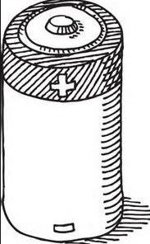
Electromotive Force
Electromotive Force/Pressure
E
[Volts]
Work to move one charge
Q. How can you create 3.0 V with 1.5-V battery?
1.5 V
1.5 V
1.5 V
Q. How much is the E when you connect in parallel?
Q. How much is the E ?
1.5 V
1.5 V
1.5 V
Ans. 1.5 V
Ans. 0 V
1.5 V

Slide 6
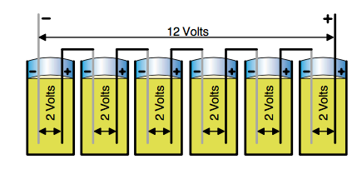
Lead-Acid Battery
Q. How many volts does a car battery produces?
Q. How many Daniell’s cells do we need for that?
Lead – Acid Battery: Electrochemical reaction between the Lead and Lead Dioxide electrodes, and sulfuric acid
Voltage: 2.0 V

Slide 7
Dry Cell Batteries
Liquid-filled batteries are not practical sometimes. We need a “dry” cell.
Carbon – Zinc: 1.5 V
Alkaline: 1.35 V (mercury-based) or 1.5 V (silver oxide type)
Question: How are the 9.0 V batteries produced?
Ans. 6 tiny carbon-zinc or alkaline batteries in series.

Slide 8
Rechargeable Batteries
Nickel - Cadmium
Can be recharged many times
Natural Voltage of 1.2 V (Less than the 1.5 V of the previous batteries
They have “memory”: they loose their efficiency when discharged past the point they are usually discharged
Cadmium is toxic!
Lithium
Can be recharged many times
Natural Voltage: 2.50 V !
Very light (Li is light) – great for watches, cameras, etc.

Slide 9
Electric Current
Electric Current
Amount of positive charges flowing every second
[Ampere] or [A]
Note: Physically, it is the negative charges that move!
+
+
I
1.5 V
-
Q. Safe or unsafe?
 | (a) Safe | (b)Unsafe | (c) Uhhh
1.0 A
1.0 mA
1.0 µA

Slide 10
Ohm’s Law
Electric Current through is directly proportional to the Electromotive Force (Pressure)
E
I
=
R
Resistance
R
E
Ohm [Ω]
+
+
1.5 V
I
-
Q. How much is the current generated by 1.5 V through a 6.0-kΩ resistor (load)?
E
1.5
I
=
=
= 0.25 mA
R
6000

Slide 11
Power
Watts: How many Joules every second
P
=
E
I
E
P
=
I
2
R
+
+
2
P
=
E
1.5 V
I
R
-
Q. How much power is dissipated in the load if E=2.0 V
and I = 0.5 A?
P
=
E
I
P
=
(2.0 V)
(0.5 A)
Ans. 1.0 W
Q. How much power is dissipated in 2.0-kΩ load if E=2.0?
Ans. 2.0 mW

Slide 12
Ohm’s Law; Power
20
P1. If you double the voltage, what happens to the current through the load?
Ans.
P2. 1.2-mA current goes through a 50-kΩ load. What is E?
Ans.
P3. The resistance of a human is approximately 1.0 MΩ. How much will be the current if you hold the terminals of a 9.0-V battery.
Ans.
P4. A 200-W light bulb is connected to the electrical outlet. How much is the current through it?
Ans.
P5. A 20-kΩ load is connect to a 20.0-V battery. How much is the power?
Ans.
P6*. A 20-kΩ load is connect to a 20.0-V battery. How much energy does it consume in 1 min?

Slide 13
Electric Circuits in Series
R₁
R₂
Total Resistance
=
R₁
+
R₂
+
R₃
+
…

Slide 14
Electric Circuits in Series
3.0 Ω
+
5.0 Ω
=
8.0 Ω
Total Resistance
=
R₁
+
R₂
+
R₃
+
…
Q. How much is the resistance in the circuit?
Q. How much is the current in the circuit?
Ans. 1.125 Amp

Slide 15
Electric Circuits in Parallel
R₁
R₂
1
1
1
1
=
+
+
+
…
Total Resistance
R₁
R₂
R₃

Slide 16
Electric Circuits in Parallel
1
1
1
+
=
4.0
10.0
R_{total}
1
0.25
+
0.1
=
R_{total}
1
0.35
=
1
1
1
1
R_{total}
=
+
+
+
…
Total Resistance
R₁
R₂
R₃
R_{total}
=
2.86 Ω
Q. How much is the resistance in the circuit?
Q. How much is the current in the circuit?
Ans. 3.15 Amp

Slide 17
Circuits in Series and Parallel
20
P1. Find the series elements
P3. Find the parallel elements
P2. Find the resistance of the series elements
P4. Find the resistance of the parallel elements

