Slide 1
Thermodynamically favorable membrane conformation
“Head” regions of phospholipids are hydrophilic, so love water. “Tail” regions are hydrophobic, so fear water and “hide” from it. In other words, cells membranes form in water because they HAVE to!

Slide 2
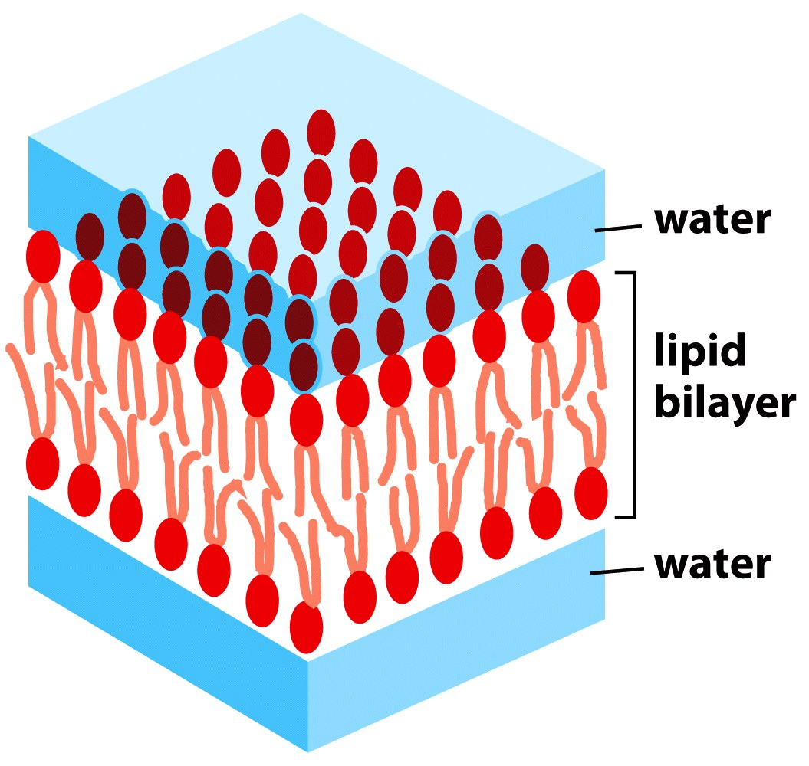
Figure 11-11a Essential Cell Biology (© Garland Science 2010)

Slide 3
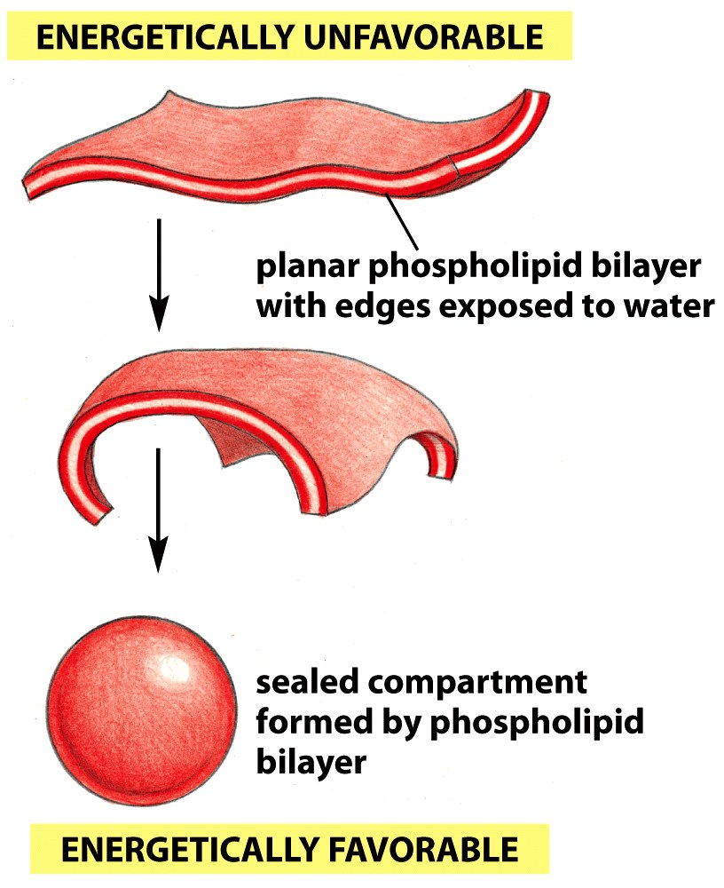
Figure 11-12 Essential Cell Biology (© Garland Science 2010)

Slide 4
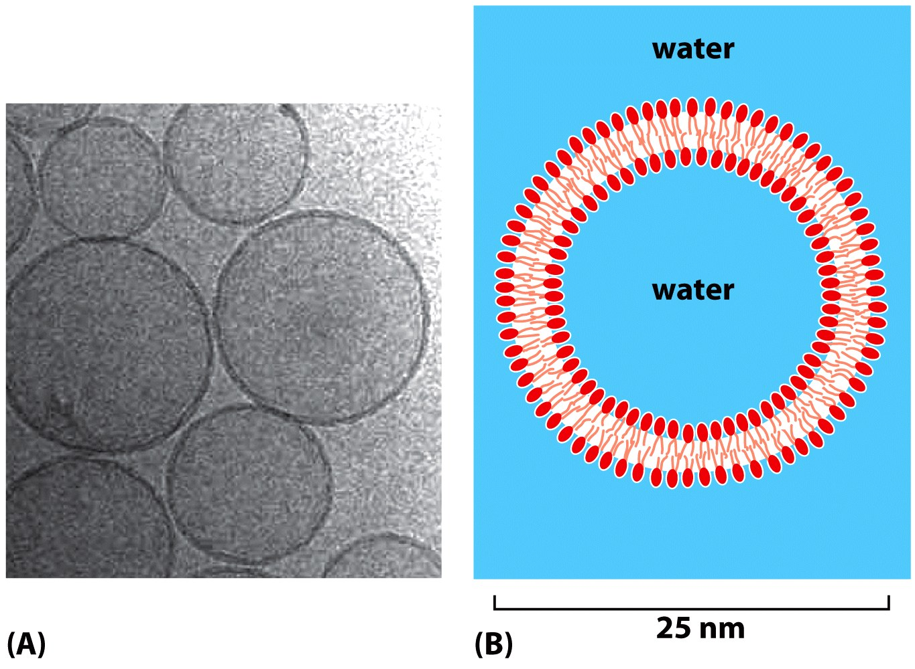
Figure 11-13 Essential Cell Biology (© Garland Science 2010)

Slide 5
Cell membranes as capacitors:
A voltage develops across a cell membrane due to the sodium/potassium pump. Three Na+ ions are pumped out of the cell for every two K+ ions pumped in, thus creating a net of +1 charge out of the cell with each cycle of the pump. Nerve cells make use of this to send a signal called an action potential, which is how these cells signal to each other or to other cells like muscle cells and glands.

Slide 6
The Resting Membrane Potential
Potential difference across membrane of resting cell
Approximately –70 mV in neurons (cytoplasmic side of membrane negatively charged relative to outside)
Actual voltage difference varies from -40 mV to -90 mV
Membrane termed polarized
Generated by:
Differences in ionic makeup of ICF and ECF
Differential permeability of the plasma membrane

Slide 7
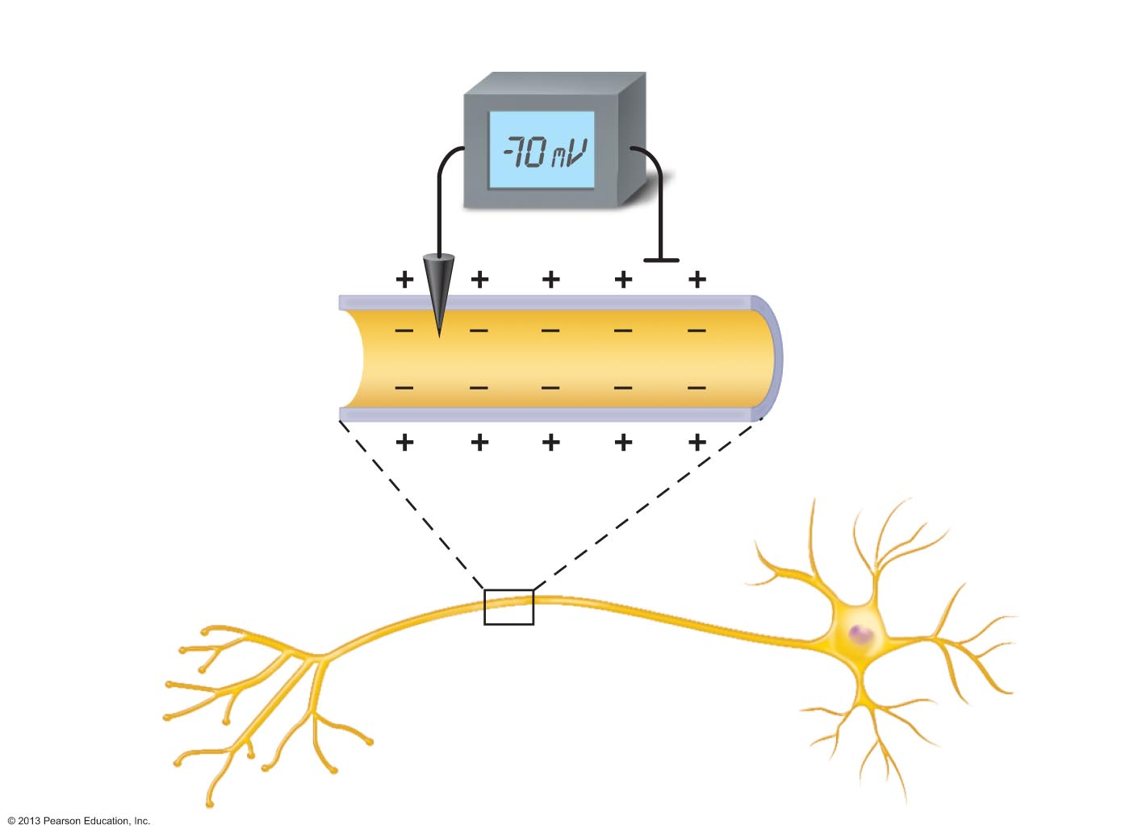
Figure 11.7 Measuring membrane potential in neurons.
Voltmeter
Plasma
membrane
Ground electrode
outside cell
Microelectrode
inside cell
Axon
Neuron

Slide 8
Resting Membrane Potential: Differences in Ionic Composition
ECF has higher concentration of Na⁺ than ICF
Balanced chiefly by chloride ions (Cl⁻)
ICF has higher concentration of K⁺ than ECF
Balanced by negatively charged proteins
K⁺ plays most important role in membrane potential
PLAY
A&P Flix™: Resting Membrane Potential

Slide 9
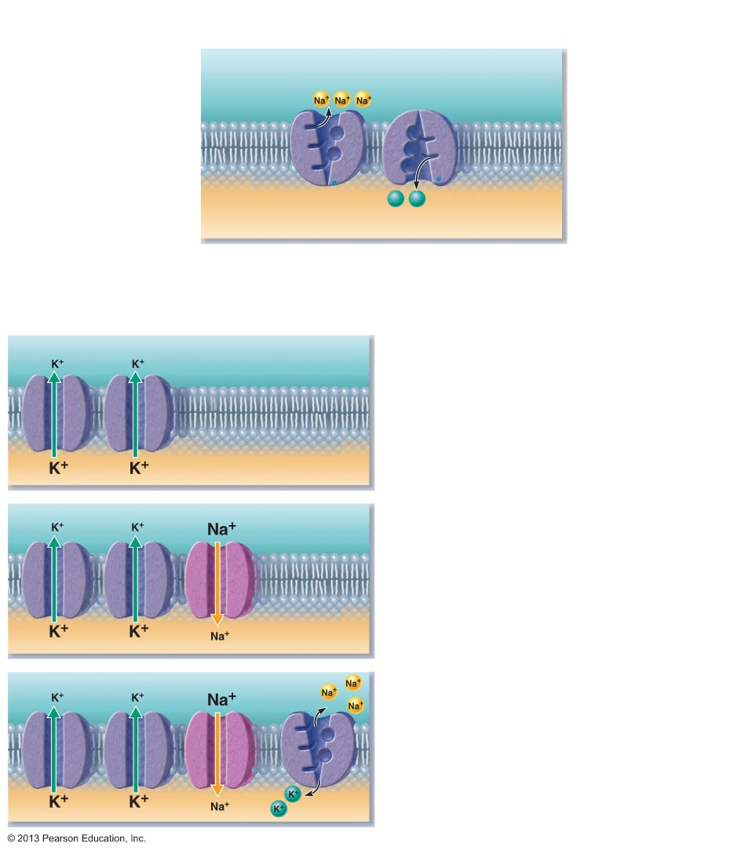
Figure 11.8 Generating a resting membrane potential depends on (1) differences in K⁺ and Na⁺ concentrations inside and outside cells, and (2) differences in permeability of the plasma membrane to these ions.
The concentrations of Na⁺ and K⁺ on each side of the membrane are different.
The Na⁺ concentration
is higher outside the
cell.
Outside cell
K⁺
(5 mM)
Na⁺
(140 mM)
The K⁺ concentration is
higher inside the cell.
K⁺
(140 mM)
Na⁺
(15 mM)
K⁺
K⁺
Na+-K+ pumps maintain
the concentration
gradients of Na+ and K+
across the membrane.
Inside cell
The permeabilities of Na⁺ and K⁺ across the
membrane are different.
K⁺ leakage channels
Suppose a cell has only K⁺ channels...
K⁺ loss through abundant leakage
channels establishes a negative
membrane potential.
Cell interior
–90 mV
Now, let’s add some Na⁺ channels to our cell...
Na⁺ entry through leakage channels reduces
the negative membrane potential slightly.
Cell interior
–70 mV
Na⁺-K⁺ pump
Finally, let’s add a pump to compensate
for leaking ions.
Na⁺-K⁺ ATPases (Pumps) maintain the
concentration gradients, resulting in the
resting membrane potential.
Cell interior
–70 mV

Slide 10
Membrane Potential Changes Used as Communication Signals
Membrane potential changes when
Concentrations of ions across membrane change
Membrane permeability to ions changes
Changes produce two types signals
Graded potentials
Incoming signals operating over short distances
Action potentials
Long-distance signals of axons
Changes in membrane potential used as signals to receive, integrate, and send information

Slide 11
Changes in Membrane Potential
Terms describing membrane potential changes relative to resting membrane potential
Depolarization
Decrease in membrane potential (toward zero and above)
Inside of membrane becomes less negative than resting membrane potential
Increases probability of producing a nerve impulse

Slide 12
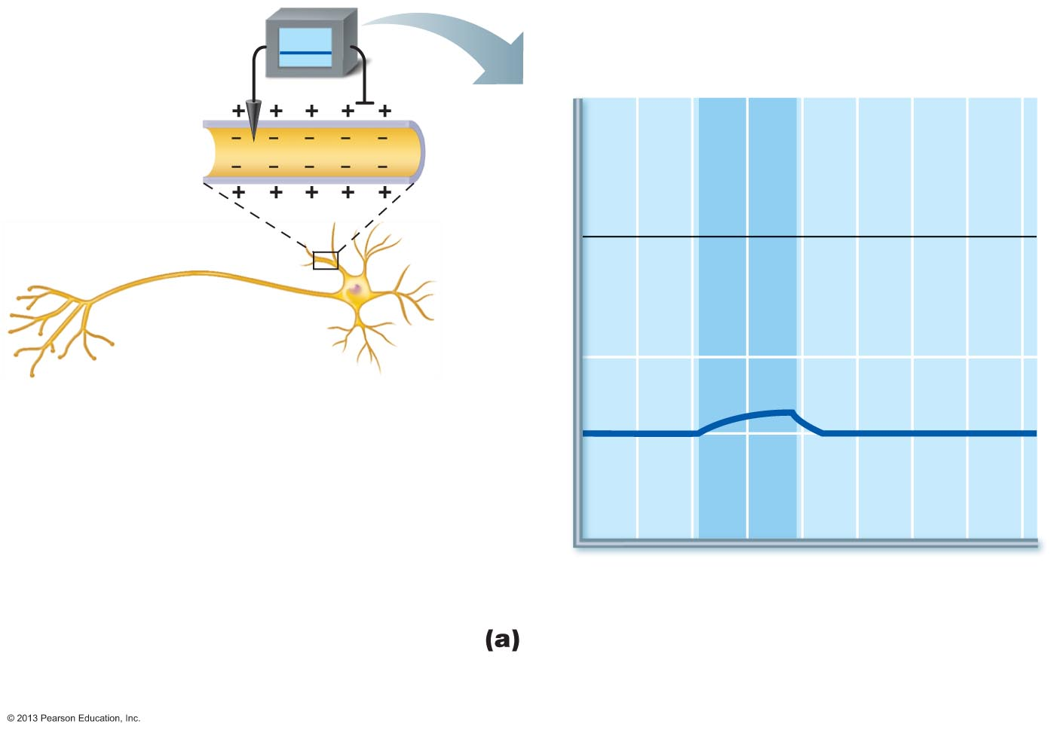
Figure 11.9a Depolarization and hyperpolarization of the membrane.
Depolarizing stimulus
+50
Inside
positive
0
Inside
negative
Membrane potential (voltage, mV)
–50
Depolarization
–70
Resting
potential
–100
0
1
2
3
4
5
6
7
Time (ms)
Depolarization: The membrane potential
moves toward 0 mV, the inside becoming less
negative (more positive).

Slide 13
Changes in Membrane Potential
Terms describing membrane potential changes relative to resting membrane potential
Hyperpolarization
An increase in membrane potential (away from zero)
Inside of cell more negative than resting membrane potential)
Reduces probability of producing a nerve impulse

Slide 14
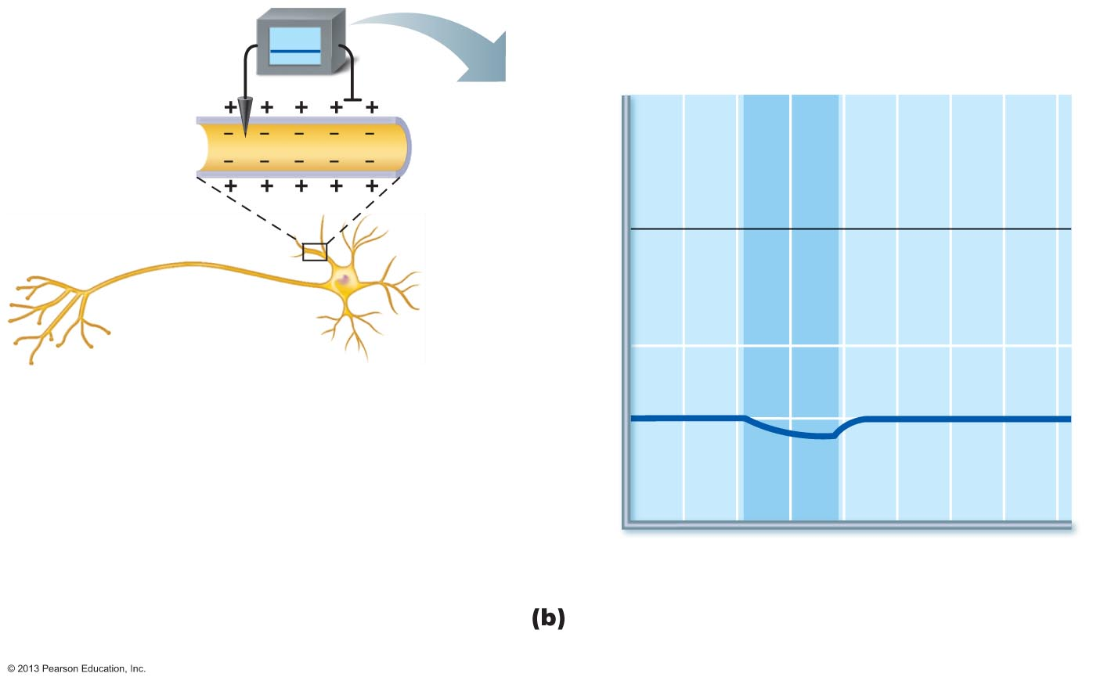
Figure 11.9b Depolarization and hyperpolarization of the membrane.
Hyperpolarizing stimulus
+50
0
Membrane potential (voltage, mV)
–50
Resting
potential
–70
Hyper-
polarization
–100
0
1
2
3
4
5
6
7
Time (ms)
Hyperpolarization: The membrane potential
increases, the inside becoming more negative.

Slide 15
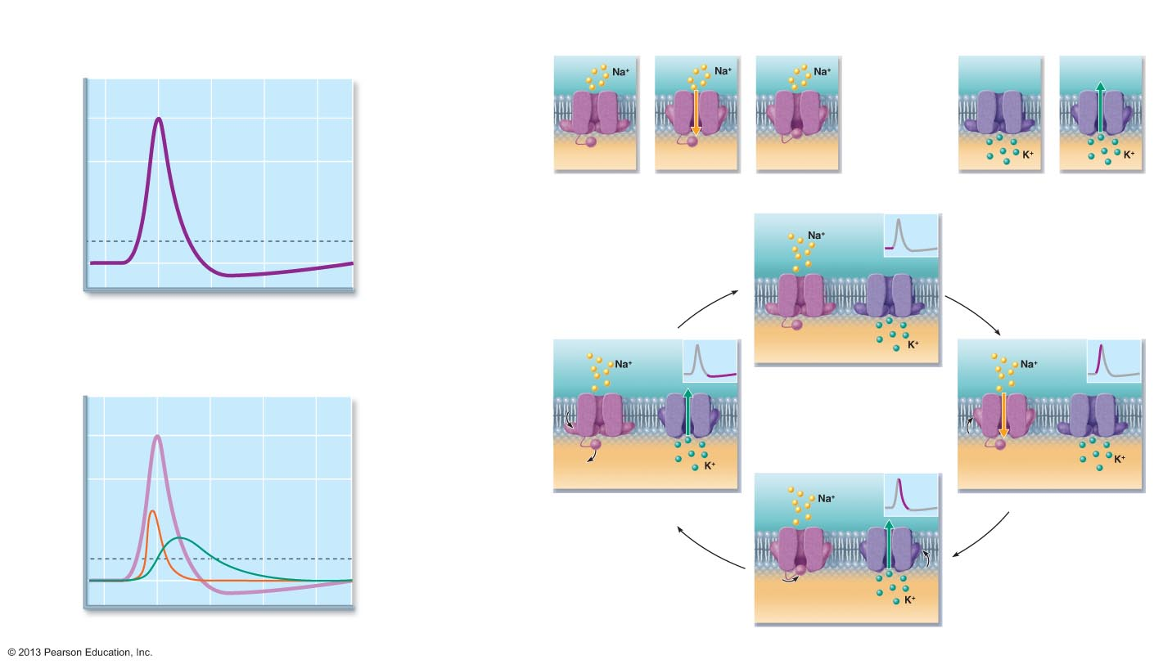
Figure 11.11 The action potential (AP) is a brief change in membrane potential in a “patch” of membrane that is depolarized by local currents.
The big picture
The key players
Resting state
Depolarization
Voltage-gated Na⁺ channels
Voltage-gated K⁺ channels
1
2
Outside
cell
Outside
cell
+30
3
Repolarization
0
3
Inside
cell
Activation
gate
Inactivation
gate
Inside
cell
Membrane potential (mV)
Action
potential
Closed
Opened
Inactivated
Closed
Opened
2
Hyperpolarization
4
The events
–55
Threshold
Potassium
channel
–70
1
1
Sodium
channel
4
0 1 2 3 4
Time (ms)
Activation
gates
The AP is caused by permeability changes in the
plasma membrane:
Inactivation
gate
Resting state
1
+30
3
Action
potential
0
Membrane potential (mV)
Na⁺
permeability
Relative membrane
permeability
Hyperpolarization
Depolarization
2
4
2
K⁺ permeability
–55
–70
1
1
4
0 1 2 3 4
Time (ms)
Repolarization
3

Slide 16
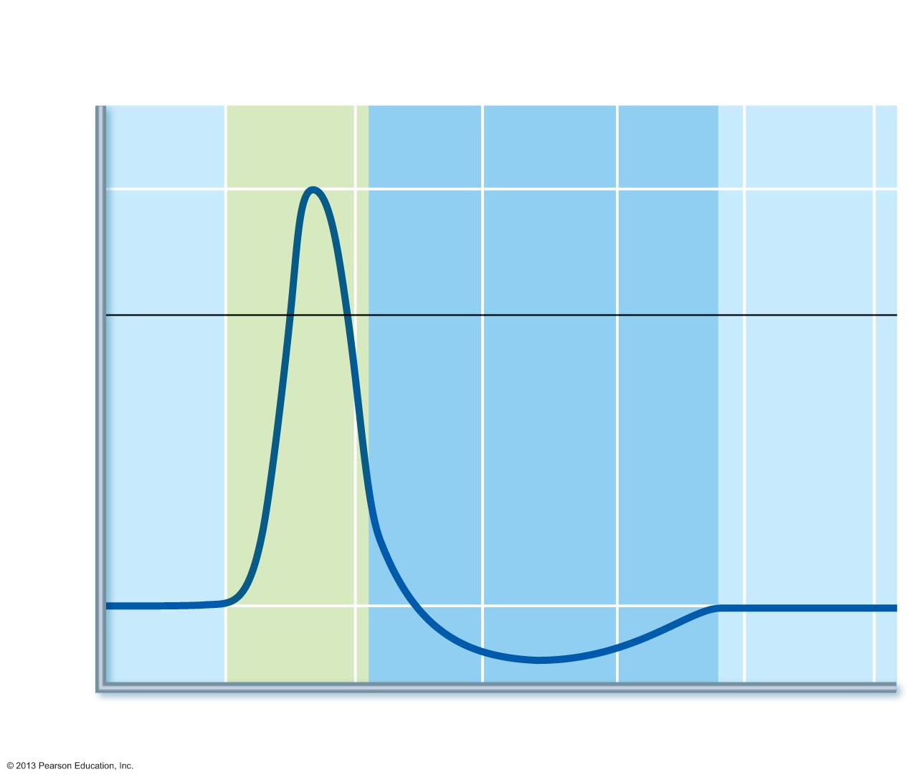
Figure 11.14 Absolute and relative refractory periods in an AP.
Absolute refractory
period
Relative refractory
period
Depolarization
(Na⁺ enters)
+30
0
Membrane potential (mV)
Repolarization
(K⁺ leaves)
Hyperpolarization
–70
Stimulus
0
1
2
3
4
5
Time (ms)

Slide 17
Molecular Motors
Hydrolysis of ATP is often the energy source. Some proteins act as tiny machines, including as motors for movement of cargo. Shown is such a motor “walking” along the cytoskeleton inside a cell, pulling with it a vescicle (small membrane-bound transporter) full of cargo such as other proteins. The consistency of the cytoplasm inside the cell is more like mud than water, so this takes considerable force!

Slide 18
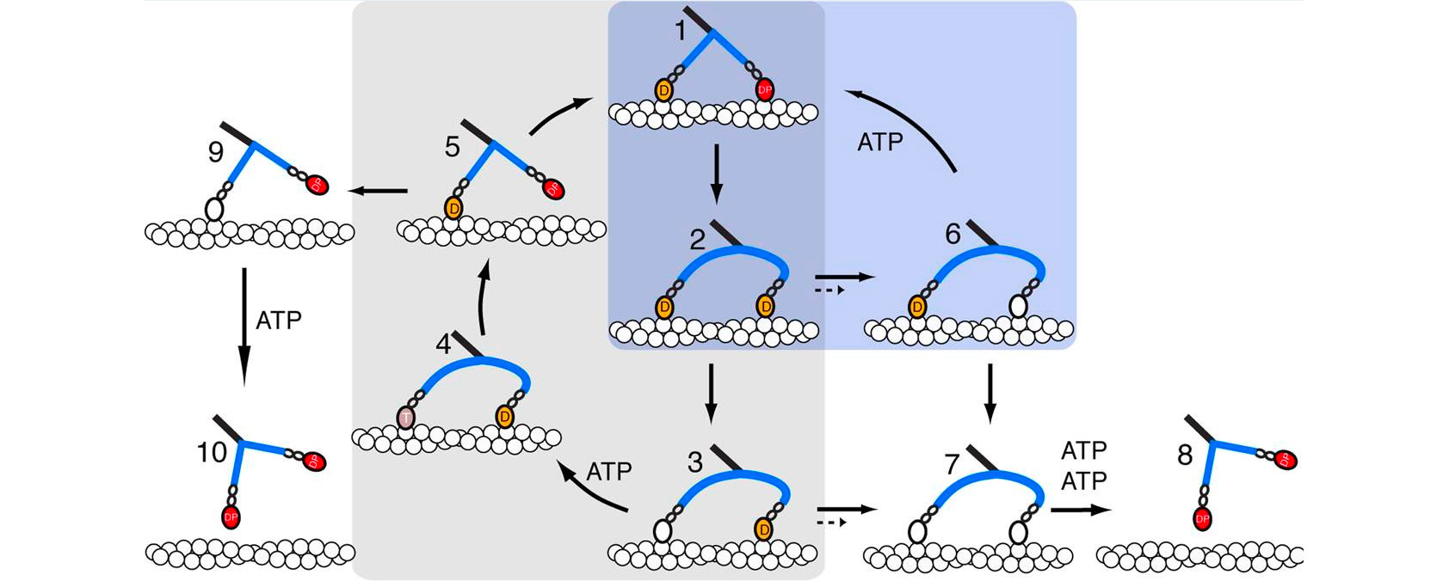
http://www.astbury.leeds.ac.uk/people/staff/staffpage.php?StaffID=MPec

Slide 19
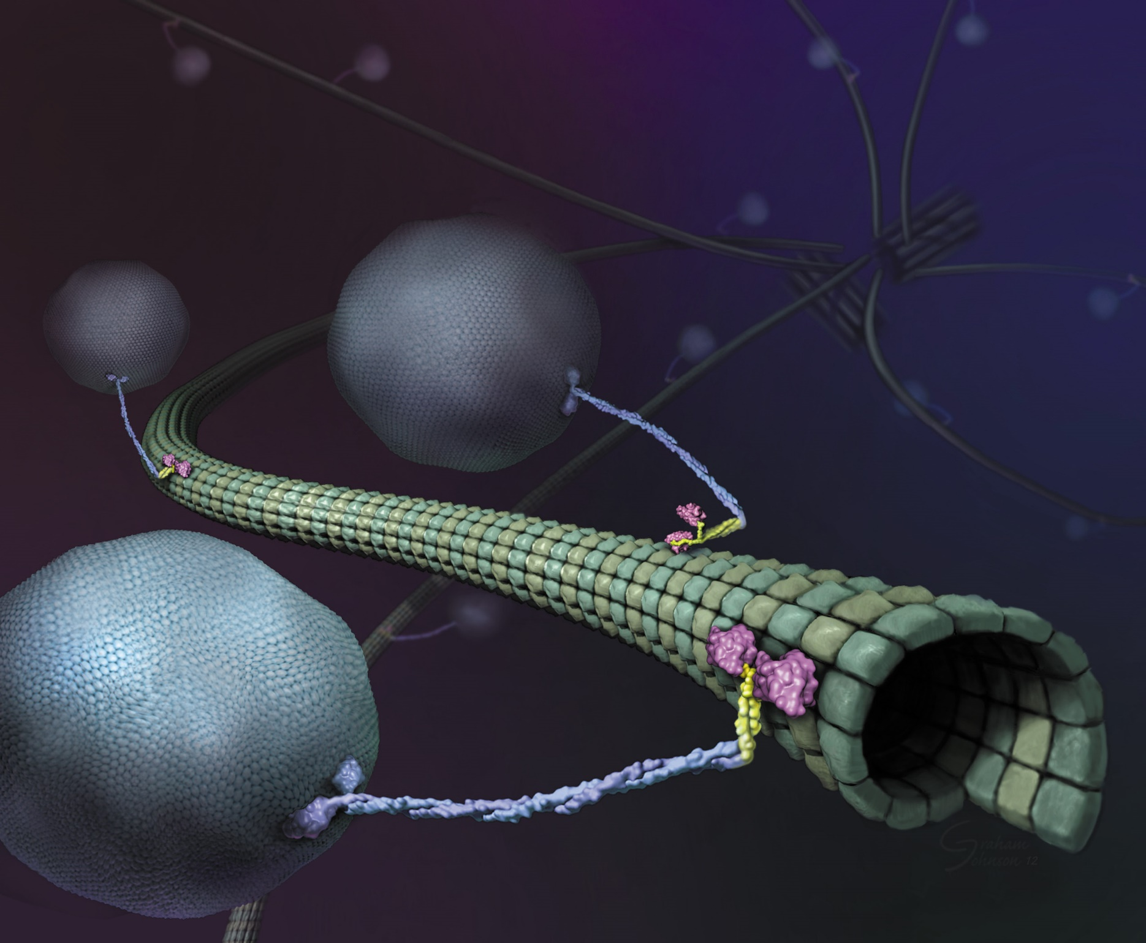
https://valelab.ucsf.edu/wp-content/uploads/2016/03/KinesinCargoArt.jpg

